Slide 1
Finite mixture model with EM algorithm
Prof. Dr. Loc Nguyen, PostDoc
Loc Nguyen’s Academic Network, Vietnam
Email: ng_phloc@yahoo.com
Homepage: www.locnguyen.net

Slide 2
Abstract
Expectation maximization (EM) algorithm is a popular and powerful mathematical method for parameter estimation in case that there exist both observed data and hidden data. Therefore, EM is appropriate to applications which aim to exploit latent aspects under heterogeneous data. This report focuses on probabilistic finite mixture model which is a popular and successful application of EM, which is fully explained in my book (Nguyen, Tutorial on EM algorithm, 2020, pp. 78-88). I also proposed a special regression model associated with mixture model in which missing values are acceptable.

Slide 3
Table of contents
Introduction to EM algorithm
Finite mixture model
Mixture model with dyadic data
Mixture regression model

Slide 4
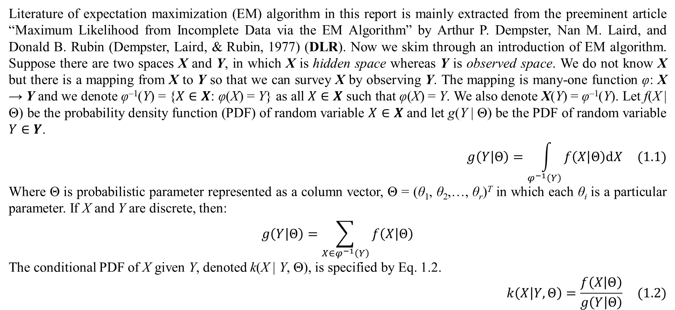
1. Introduction to EM algorithm
Literature of expectation maximization (EM) algorithm in this report is mainly extracted from the preeminent article “Maximum Likelihood from Incomplete Data via the EM Algorithm” by Arthur P. Dempster, Nan M. Laird, and Donald B. Rubin (Dempster, Laird, & Rubin, 1977) (DLR). Now we skim through an introduction of EM algorithm. Suppose there are two spaces X and Y, in which X is hidden space whereas Y is observed space. We do not know X but there is a mapping from X to Y so that we can survey X by observing Y. The mapping is many-one function φ: X → Y and we denote φ^{–1}(Y) = {$X∈X$: φ(X) = Y} as all $X∈X$ such that φ(X) = Y. We also denote X(Y) = φ^{–1}(Y). Let f(X | Θ) be the probability density function (PDF) of random variable $X∈X$ and let g(Y | Θ) be the PDF of random variable $Y∈Y$.
$$g\left(Y | Θ\right)=\int_{φ^{−1}\left(Y\right)}{f\left(X | Θ\right)dX} (1.1)$$
Where Θ is probabilistic parameter represented as a column vector, Θ = (θ₁, θ₂,…, θ_{r})^{T} in which each θ_{i} is a particular parameter. If X and Y are discrete, then:
$$g\left(Y | Θ\right)=\sum_{X∈φ^{−1}\left(Y\right)}{f\left(X | Θ\right)}$$
The conditional PDF of X given Y, denoted k(X | Y, Θ), is specified by Eq. 1.2.
$$k\left(X | Y,Θ\right)=\frac{f\left(X | Θ\right)}{g\left(Y | Θ\right)} (1.2)$$

Slide 5
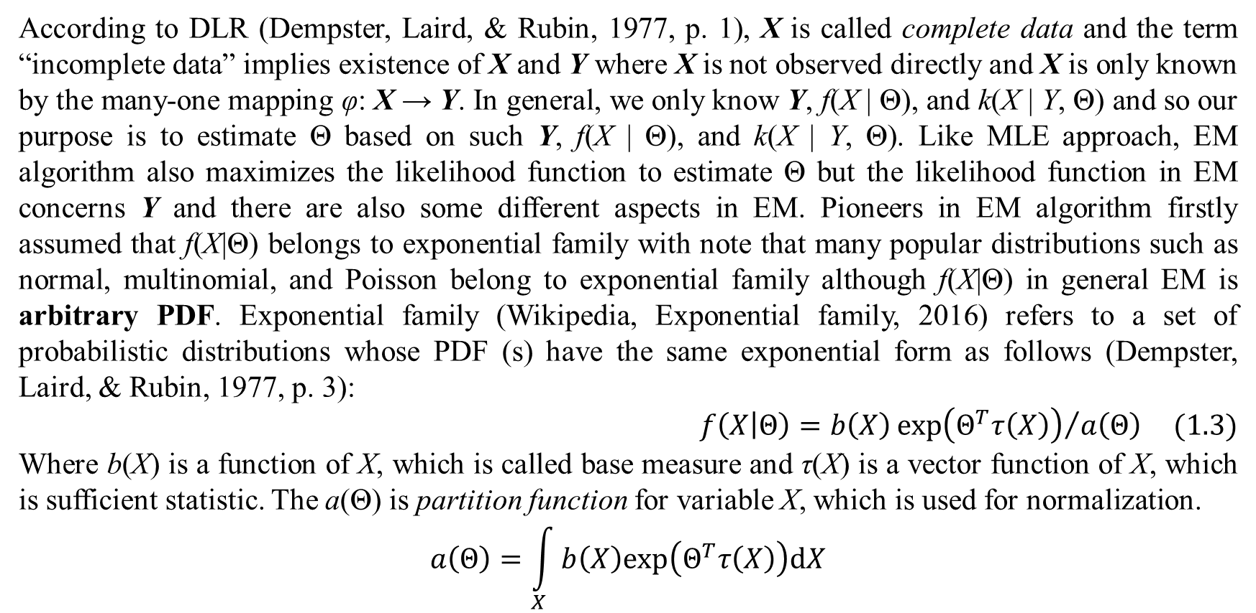
1. Introduction to EM algorithm
According to DLR (Dempster, Laird, & Rubin, 1977, p. 1), X is called complete data and the term “incomplete data” implies existence of X and Y where X is not observed directly and X is only known by the many-one mapping φ: X → Y. In general, we only know Y, f(X | Θ), and k(X | Y, Θ) and so our purpose is to estimate Θ based on such Y, f(X | Θ), and k(X | Y, Θ). Like MLE approach, EM algorithm also maximizes the likelihood function to estimate Θ but the likelihood function in EM concerns Y and there are also some different aspects in EM. Pioneers in EM algorithm firstly assumed that f(X|Θ) belongs to exponential family with note that many popular distributions such as normal, multinomial, and Poisson belong to exponential family although f(X|Θ) in general EM is arbitrary PDF. Exponential family (Wikipedia, Exponential family, 2016) refers to a set of probabilistic distributions whose PDF (s) have the same exponential form as follows (Dempster, Laird, & Rubin, 1977, p. 3):
$$f\left(X | Θ\right)=b\left(X\right){exp\left(Θ^{T}τ\left(X\right)\right)}/{a\left(Θ\right)} (1.3)$$
Where b(X) is a function of X, which is called base measure and τ(X) is a vector function of X, which is sufficient statistic. The a(Θ) is partition function for variable X, which is used for normalization.
$$a\left(Θ\right)=\int_{X}{b\left(X\right)exp\left(Θ^{T}τ\left(X\right)\right)dX}$$

Slide 6
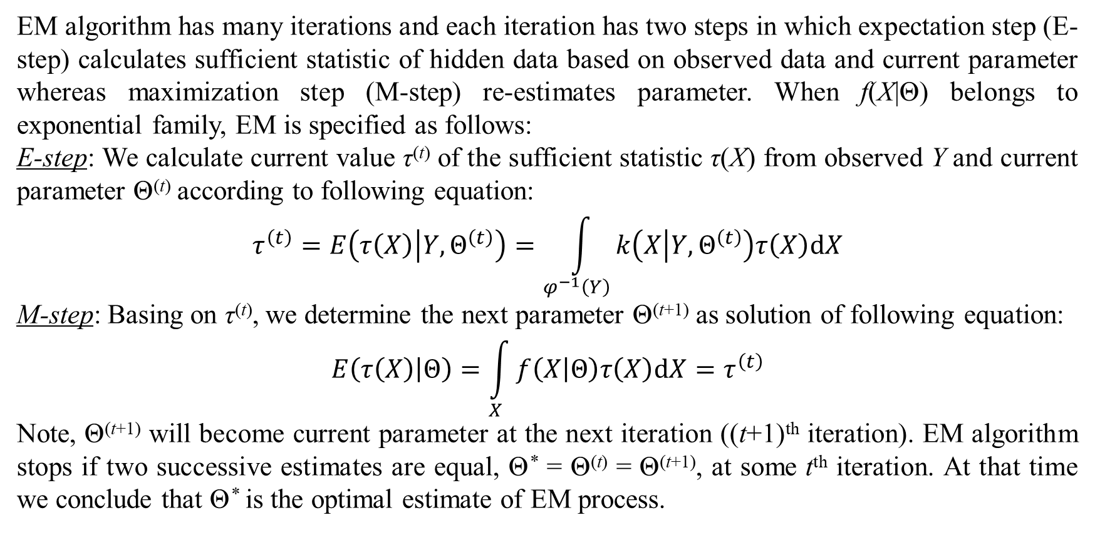
1. Introduction to EM algorithm
EM algorithm has many iterations and each iteration has two steps in which expectation step (E-step) calculates sufficient statistic of hidden data based on observed data and current parameter whereas maximization step (M-step) re-estimates parameter. When f(X|Θ) belongs to exponential family, EM is specified as follows:
E-step: We calculate current value τ^{(t)} of the sufficient statistic τ(X) from observed Y and current parameter Θ^{(t)} according to following equation:
$$τ^{\left(t\right)}=E\left(τ\left(X\right) | Y,Θ^{\left(t\right)}\right)=\int_{φ^{−1}\left(Y\right)}{k\left(X | Y,Θ^{\left(t\right)}\right)τ\left(X\right)dX}$$
M-step: Basing on τ^{(t)}, we determine the next parameter Θ^{(t+1)} as solution of following equation:
$$E\left(τ\left(X\right) | Θ\right)=\int_{X}{f\left(X | Θ\right)τ\left(X\right)dX}=τ^{\left(t\right)}$$
Note, Θ^{(t+1)} will become current parameter at the next iteration ((t+1)^{th} iteration). EM algorithm stops if two successive estimates are equal, Θ* = Θ^{(t)} = Θ^{(t+1)}, at some t^{th} iteration. At that time we conclude that Θ* is the optimal estimate of EM process.

Slide 7
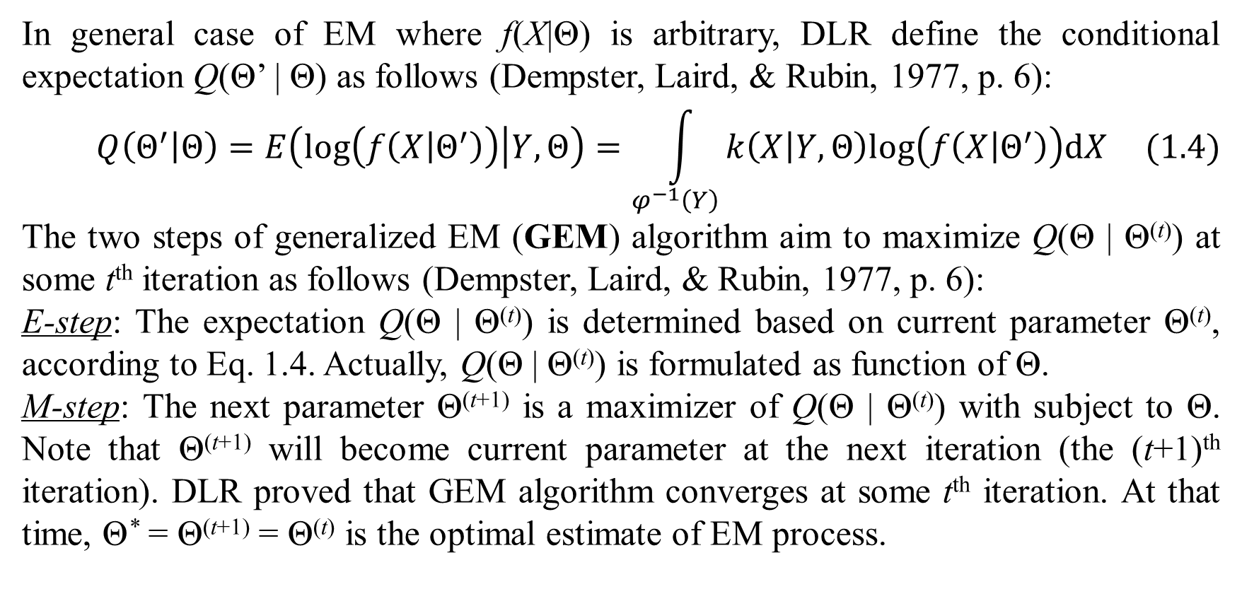
1. Introduction to EM algorithm
In general case of EM where f(X|Θ) is arbitrary, DLR define the conditional expectation Q(Θ’ | Θ) as follows (Dempster, Laird, & Rubin, 1977, p. 6):
$$Q\left(Θ^{′} | Θ\right)=E\left(log\left(f\left(X | Θ^{′}\right)\right) | Y,Θ\right)=\int_{φ^{−1}\left(Y\right)}{k\left(X | Y,Θ\right)log\left(f\left(X | Θ^{′}\right)\right)dX} (1.4)$$
The two steps of generalized EM (GEM) algorithm aim to maximize Q(Θ | Θ^{(t)}) at some t^{th} iteration as follows (Dempster, Laird, & Rubin, 1977, p. 6):
E-step: The expectation Q(Θ | Θ^{(t)}) is determined based on current parameter Θ^{(t)}, according to Eq. 1.4. Actually, Q(Θ | Θ^{(t)}) is formulated as function of Θ.
M-step: The next parameter Θ^{(t+1)} is a maximizer of Q(Θ | Θ^{(t)}) with subject to Θ. Note that Θ^{(t+1)} will become current parameter at the next iteration (the (t+1)^{th} iteration). DLR proved that GEM algorithm converges at some t^{th} iteration. At that time, Θ* = Θ^{(t+1)} = Θ^{(t)} is the optimal estimate of EM process.

Slide 8
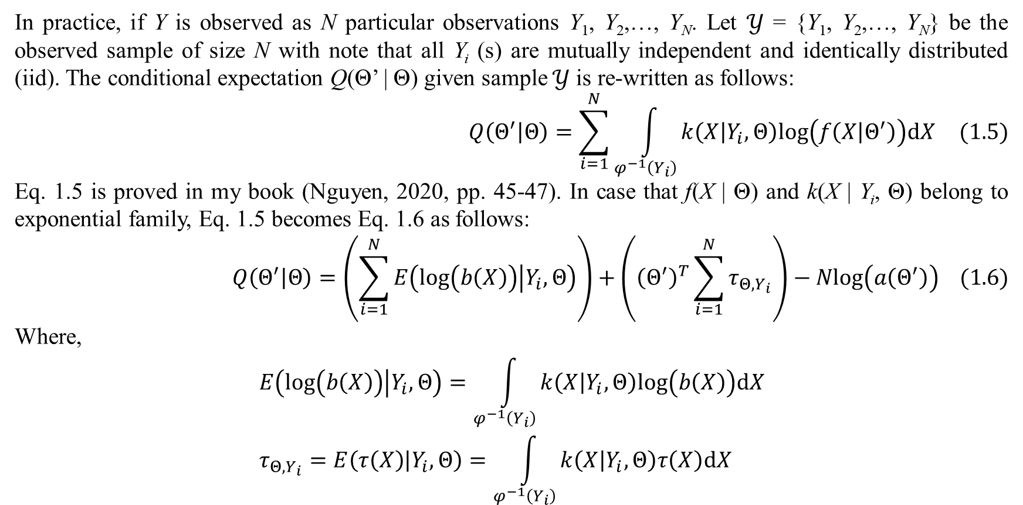
1. Introduction to EM algorithm
In practice, if Y is observed as N particular observations Y₁, Y₂,…, Y_{N}. Let $𝒴$ = {Y₁, Y₂,…, Y_{N}} be the observed sample of size N with note that all Y_{i} (s) are mutually independent and identically distributed (iid). The conditional expectation Q(Θ’ | Θ) given sample $𝒴$ is re-written as follows:
$$Q\left(Θ^{′} | Θ\right)=\sum_{i=1}^{N}{\int_{φ^{−1}\left(Y_{i}\right)}{k\left(X | Y_{i},Θ\right)log\left(f\left(X | Θ^{′}\right)\right)dX}} (1.5)$$
Eq. 1.5 is proved in my book (Nguyen, 2020, pp. 45-47). In case that f(X | Θ) and k(X | Y_{i}, Θ) belong to exponential family, Eq. 1.5 becomes Eq. 1.6 as follows:
$$Q\left(Θ^{′} | Θ\right)=\left(\sum_{i=1}^{N}{E\left(log\left(b\left(X\right)\right) | Y_{i},Θ\right)}\right)+\left({\left(Θ^{′}\right)}^{T}\sum_{i=1}^{N}{τ_{Θ,Y_{i}}}\right)−Nlog\left(a\left(Θ^{′}\right)\right) (1.6)$$
Where,
$$E\left(log\left(b\left(X\right)\right) | Y_{i},Θ\right)=\int_{φ^{−1}\left(Y_{i}\right)}{k\left(X | Y_{i},Θ\right)log\left(b\left(X\right)\right)dX} \\ τ_{Θ,Y_{i}}=E\left(τ\left(X\right) | Y_{i},Θ\right)=\int_{φ^{−1}\left(Y_{i}\right)}{k\left(X | Y_{i},Θ\right)τ\left(X\right)dX}$$

Slide 9
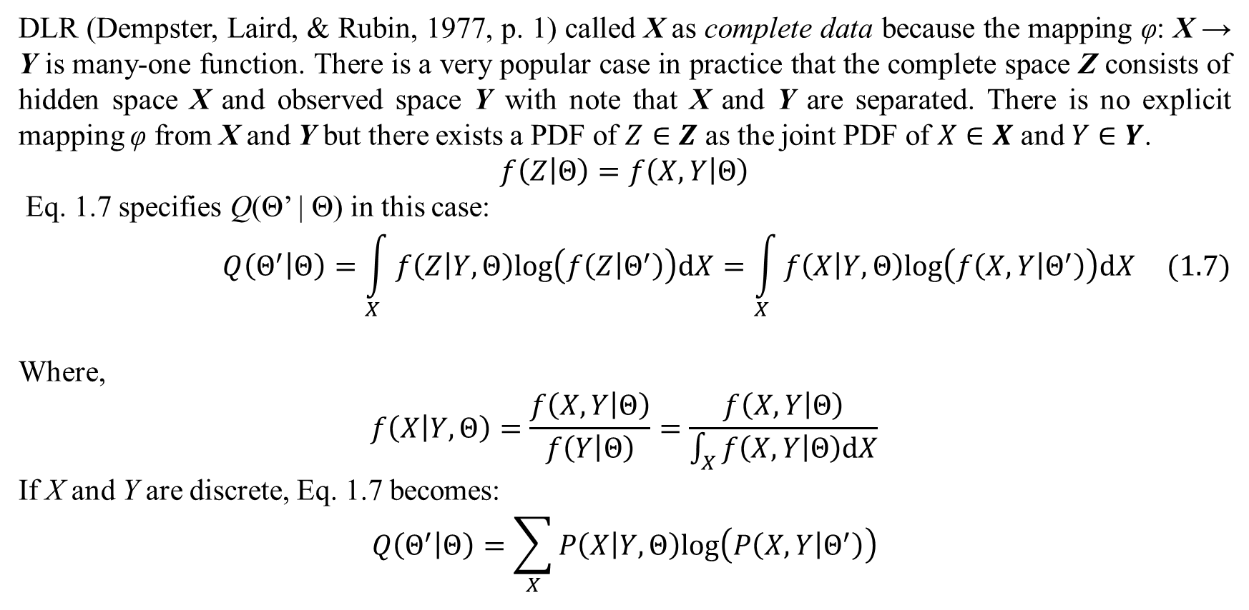
1. Introduction to EM algorithm
DLR (Dempster, Laird, & Rubin, 1977, p. 1) called X as complete data because the mapping φ: X → Y is many-one function. There is a very popular case in practice that the complete space Z consists of hidden space X and observed space Y with note that X and Y are separated. There is no explicit mapping φ from X and Y but there exists a PDF of $Z∈Z$ as the joint PDF of $X∈X$ and $Y∈Y$.
$$f\left(Z | Θ\right)=f\left(X,Y | Θ\right)$$
Eq. 1.7 specifies Q(Θ’ | Θ) in this case:
$$Q\left(Θ^{′} | Θ\right)=\int_{X}{f\left(Z | Y,Θ\right)log\left(f\left(Z | Θ^{′}\right)\right)dX}=\int_{X}{f\left(X | Y,Θ\right)log\left(f\left(X,Y | Θ^{′}\right)\right)dX} (1.7)$$
Where,
$$f\left(X | Y,Θ\right)=\frac{f\left(X,Y | Θ\right)}{f\left(Y | Θ\right)}=\frac{f\left(X,Y | Θ\right)}{\int_{X}{f\left(X,Y | Θ\right)dX}}$$
If X and Y are discrete, Eq. 1.7 becomes:
$$Q\left(Θ^{′} | Θ\right)=\sum_{X}{P\left(X | Y,Θ\right)log\left(P\left(X,Y | Θ^{′}\right)\right)}$$

Slide 10
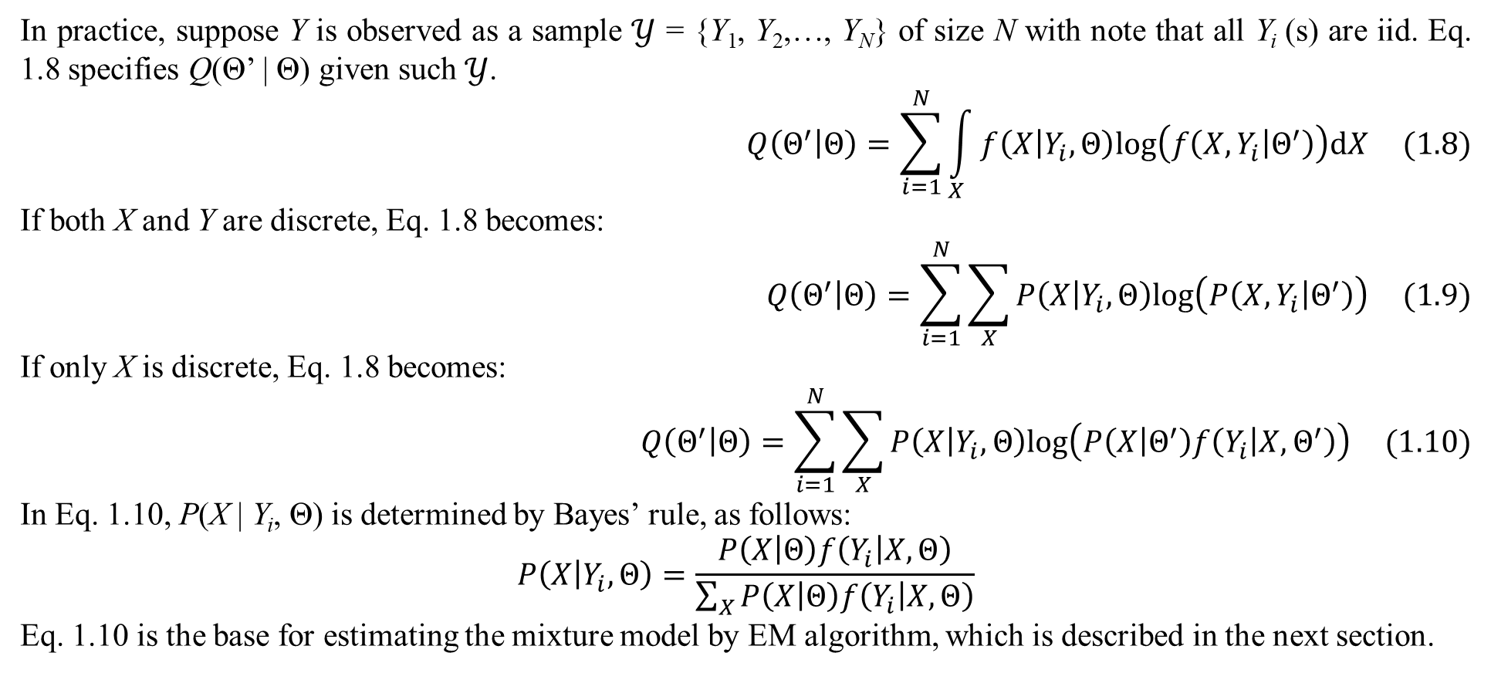
1. Introduction to EM algorithm
In practice, suppose Y is observed as a sample $𝒴$ = {Y₁, Y₂,…, Y_{N}} of size N with note that all Y_{i} (s) are iid. Eq. 1.8 specifies Q(Θ’ | Θ) given such $𝒴$.
$$Q\left(Θ^{′} | Θ\right)=\sum_{i=1}^{N}{\int_{X}{f\left(X | Y_{i},Θ\right)log\left(f\left(X,Y_{i} | Θ^{′}\right)\right)dX}} (1.8)$$
If both X and Y are discrete, Eq. 1.8 becomes:
$$Q\left(Θ^{′} | Θ\right)=\sum_{i=1}^{N}{\sum_{X}{P\left(X | Y_{i},Θ\right)log\left(P\left(X,Y_{i} | Θ^{′}\right)\right)}} (1.9)$$
If only X is discrete, Eq. 1.8 becomes:
$$Q\left(Θ^{′} | Θ\right)=\sum_{i=1}^{N}{\sum_{X}{P\left(X | Y_{i},Θ\right)log\left(P\left(X | Θ^{′}\right)f\left(Y_{i} | X,Θ^{′}\right)\right)}} (1.10)$$
In Eq. 1.10, P(X | Y_{i}, Θ) is determined by Bayes’ rule, as follows:
$$P\left(X | Y_{i},Θ\right)=\frac{P\left(X | Θ\right)f\left(Y_{i} | X,Θ\right)}{\sum_{X}{P\left(X | Θ\right)f\left(Y_{i} | X,Θ\right)}}$$
Eq. 1.10 is the base for estimating the mixture model by EM algorithm, which is described in the next section.

Slide 11
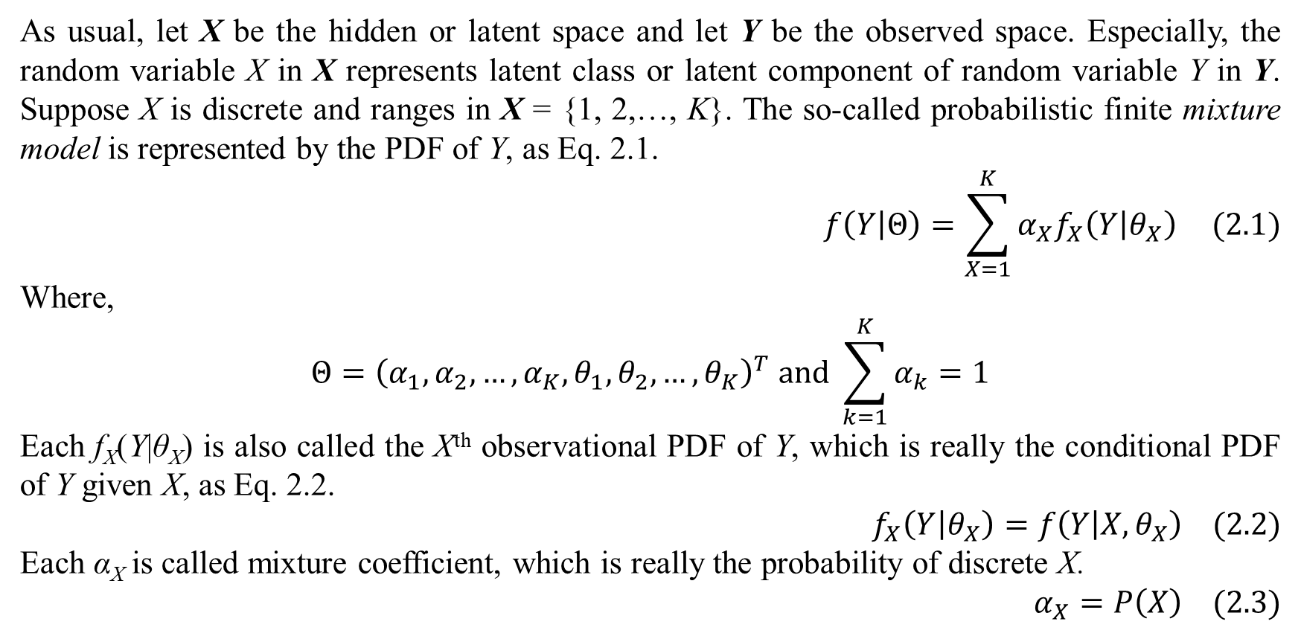
2. Finite mixture model
As usual, let X be the hidden or latent space and let Y be the observed space. Especially, the random variable X in X represents latent class or latent component of random variable Y in Y. Suppose X is discrete and ranges in X = {1, 2,…, K}. The so-called probabilistic finite mixture model is represented by the PDF of Y, as Eq. 2.1.
$$f\left(Y | Θ\right)=\sum_{X=1}^{K}{α_{X}f_{X}\left(Y | θ_{X}\right)} (2.1)$$
Where,
$$Θ={\left(α_{1},α_{2},…,α_{K},θ_{1},θ_{2},…,θ_{K}\right)}^{T} and \sum_{k=1}^{K}{α_{k}}=1$$
Each f_{X}(Y|θ_{X}) is also called the Xth observational PDF of Y, which is really the conditional PDF of Y given X, as Eq. 2.2.
$$f_{X}\left(Y | θ_{X}\right)=f\left(Y | X,θ_{X}\right) (2.2)$$
Each α_{X} is called mixture coefficient, which is really the probability of discrete X.
$$α_{X}=P\left(X\right) (2.3)$$

Slide 12
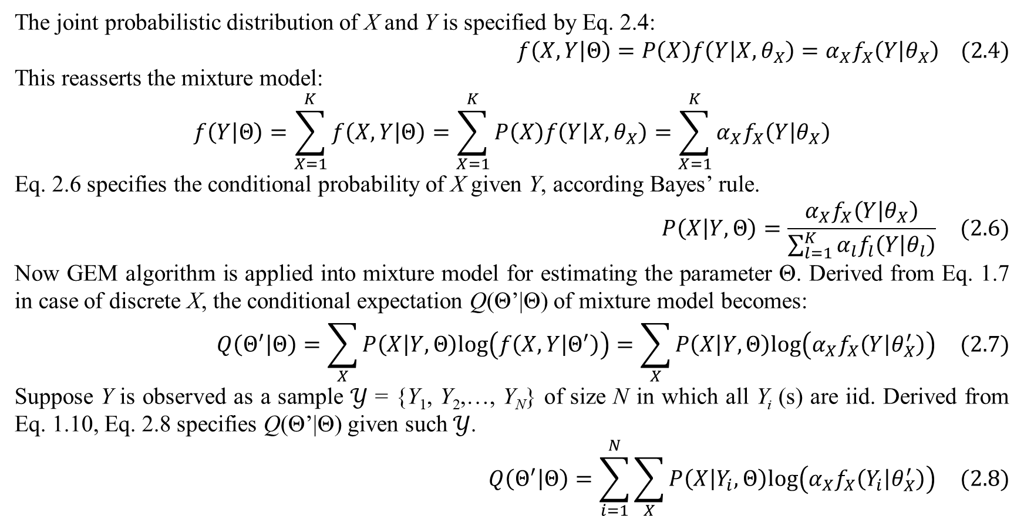
2. Finite mixture model
The joint probabilistic distribution of X and Y is specified by Eq. 2.4:
$$f\left(X,Y | Θ\right)=P\left(X\right)f\left(Y | X,θ_{X}\right)=α_{X}f_{X}\left(Y | θ_{X}\right) (2.4)$$
This reasserts the mixture model:
$$f\left(Y | Θ\right)=\sum_{X=1}^{K}{f\left(X,Y | Θ\right)}=\sum_{X=1}^{K}{P\left(X\right)f\left(Y | X,θ_{X}\right)}=\sum_{X=1}^{K}{α_{X}f_{X}\left(Y | θ_{X}\right)}$$
Eq. 2.6 specifies the conditional probability of X given Y, according Bayes’ rule.
$$P\left(X | Y,Θ\right)=\frac{α_{X}f_{X}\left(Y | θ_{X}\right)}{\sum_{l=1}^{K}{α_{l}f_{l}\left(Y | θ_{l}\right)}} (2.6)$$
Now GEM algorithm is applied into mixture model for estimating the parameter Θ. Derived from Eq. 1.7 in case of discrete X, the conditional expectation Q(Θ’|Θ) of mixture model becomes:
$$Q\left(Θ^{′} | Θ\right)=\sum_{X}{P\left(X | Y,Θ\right)log\left(f\left(X,Y | Θ^{′}\right)\right)}=\sum_{X}{P\left(X | Y,Θ\right)log\left(α_{X}f_{X}\left(Y | θ_{X}^{′}\right)\right)} (2.7)$$
Suppose Y is observed as a sample $𝒴$ = {Y₁, Y₂,…, Y_{N}} of size N in which all Y_{i} (s) are iid. Derived from Eq. 1.10, Eq. 2.8 specifies Q(Θ’|Θ) given such $𝒴$.
$$Q\left(Θ^{′} | Θ\right)=\sum_{i=1}^{N}{\sum_{X}{P\left(X | Y_{i},Θ\right)log\left(α_{X}f_{X}\left(Y_{i} | θ_{X}^{′}\right)\right)}} (2.8)$$

Slide 13
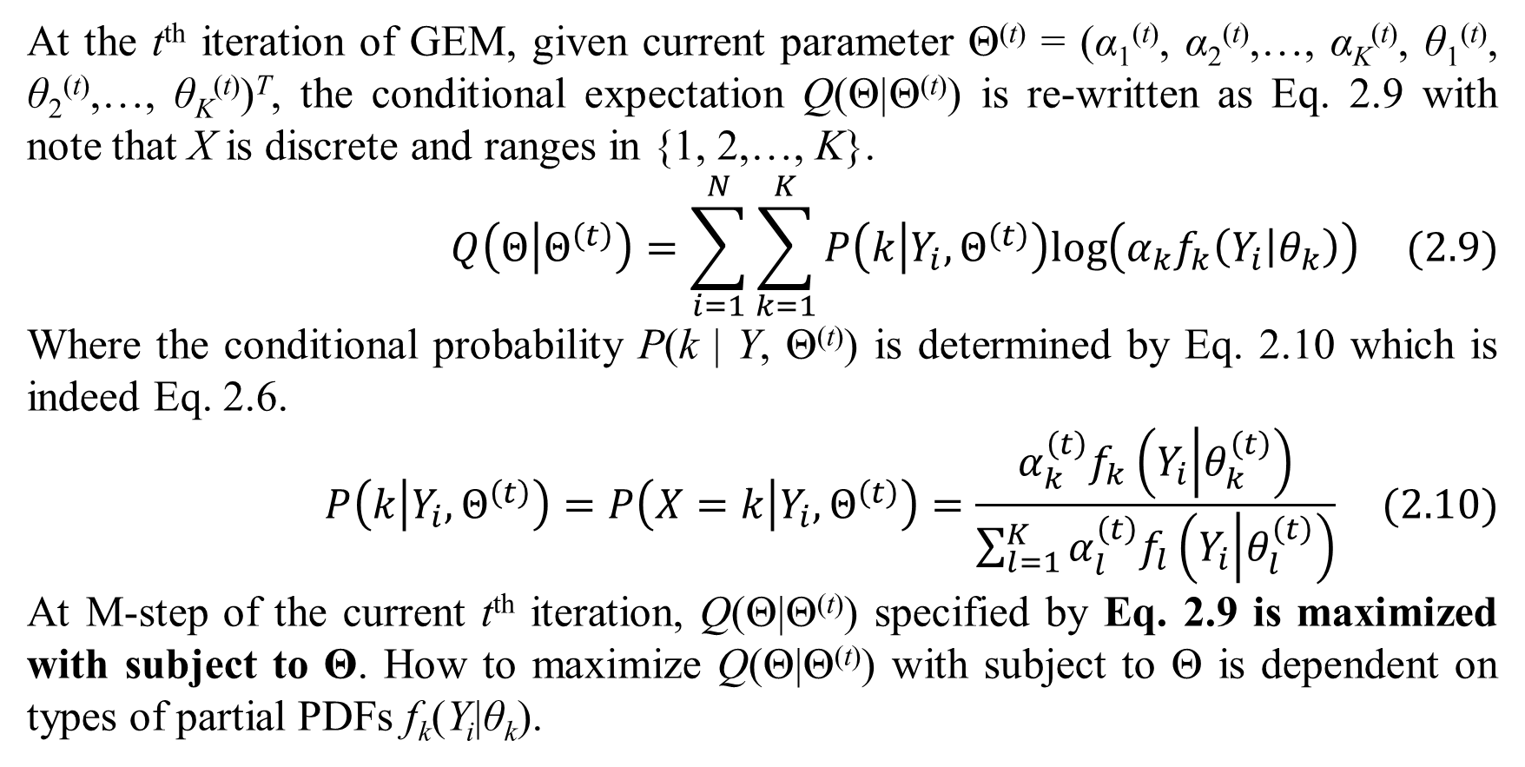
2. Finite mixture model
At the t^{th} iteration of GEM, given current parameter Θ^{(t)} = (α₁^{(t)}, α₂^{(t)},…, α_{K}^{(t)}, θ₁^{(t)}, θ₂^{(t)},…, θ_{K}^{(t)})^{T}, the conditional expectation Q(Θ|Θ^{(t)}) is re-written as Eq. 2.9 with note that X is discrete and ranges in {1, 2,…, K}.
$$Q\left(Θ | Θ^{\left(t\right)}\right)=\sum_{i=1}^{N}{\sum_{k=1}^{K}{P\left(k | Y_{i},Θ^{\left(t\right)}\right)log\left(α_{k}f_{k}\left(Y_{i} | θ_{k}\right)\right)}} (2.9)$$
Where the conditional probability P(k | Y, Θ^{(t)}) is determined by Eq. 2.10 which is indeed Eq. 2.6.
$$P\left(k | Y_{i},Θ^{\left(t\right)}\right)=P\left(X=k | Y_{i},Θ^{\left(t\right)}\right)=\frac{α_{k}^{\left(t\right)}f_{k}\left(Y_{i} | θ_{k}^{\left(t\right)}\right)}{\sum_{l=1}^{K}{α_{l}^{\left(t\right)}f_{l}\left(Y_{i} | θ_{l}^{\left(t\right)}\right)}} (2.10)$$
At M-step of the current t^{th} iteration, Q(Θ|Θ^{(t)}) specified by Eq. 2.9 is maximized with subject to Θ. How to maximize Q(Θ|Θ^{(t)}) with subject to Θ is dependent on types of partial PDFs f_{k}(Y_{i}|θ_{k}).

Slide 14
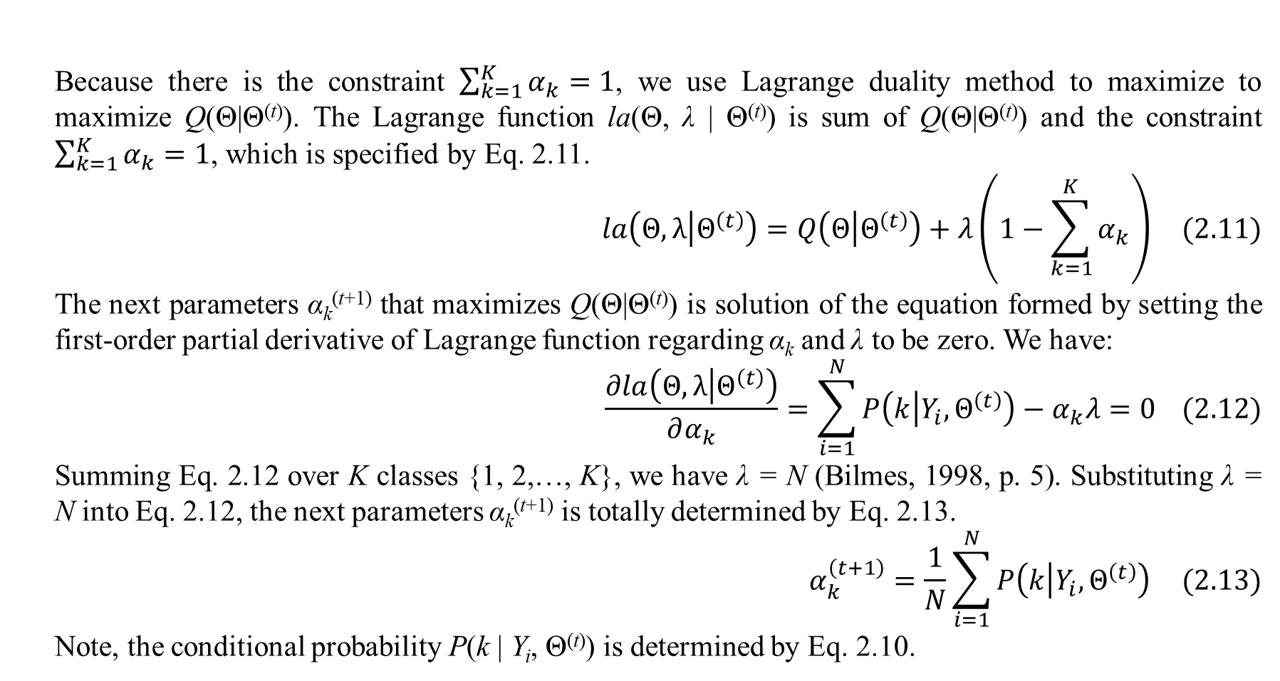
2. Finite mixture model
Because there is the constraint $\sum_{k=1}^{K}{α_{k}}=1$, we use Lagrange duality method to maximize to maximize Q(Θ|Θ^{(t)}). The Lagrange function la(Θ, λ | Θ^{(t)}) is sum of Q(Θ|Θ^{(t)}) and the constraint $\sum_{k=1}^{K}{α_{k}}=1$, which is specified by Eq. 2.11.
$$la\left(Θ,λ | Θ^{\left(t\right)}\right)=Q\left(Θ | Θ^{\left(t\right)}\right)+λ\left(1−\sum_{k=1}^{K}{α_{k}}\right) (2.11)$$
The next parameters α_{k}^{(t+1)} that maximizes Q(Θ|Θ^{(t)}) is solution of the equation formed by setting the first-order partial derivative of Lagrange function regarding α_{k} and λ to be zero. We have:
$$\frac{∂la\left(Θ,λ | Θ^{\left(t\right)}\right)}{∂α_{k}}=\sum_{i=1}^{N}{P\left(k | Y_{i},Θ^{\left(t\right)}\right)}−α_{k}λ=0 (2.12)$$
Summing Eq. 2.12 over K classes {1, 2,…, K}, we have λ = N (Bilmes, 1998, p. 5). Substituting λ = N into Eq. 2.12, the next parameters α_{k}^{(t+1)} is totally determined by Eq. 2.13.
$$α_{k}^{\left(t+1\right)}=\frac{1}{N}\sum_{i=1}^{N}{P\left(k | Y_{i},Θ^{\left(t\right)}\right)} (2.13)$$
Note, the conditional probability P(k | Y_{i}, Θ^{(t)}) is determined by Eq. 2.10.

Slide 15
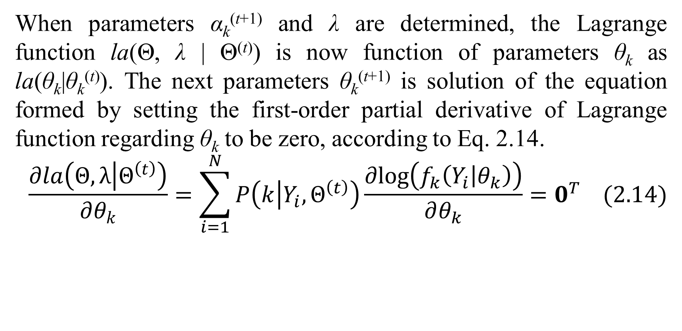
2. Finite mixture model
When parameters α_{k}^{(t+1)} and λ are determined, the Lagrange function la(Θ, λ | Θ^{(t)}) is now function of parameters θ_{k} as la(θ_{k}|θ_{k}^{(t)}). The next parameters θ_{k}^{(t+1)} is solution of the equation formed by setting the first-order partial derivative of Lagrange function regarding θ_{k} to be zero, according to Eq. 2.14.
$$\frac{∂la\left(Θ,λ | Θ^{\left(t\right)}\right)}{∂θ_{k}}=\sum_{i=1}^{N}{P\left(k | Y_{i},Θ^{\left(t\right)}\right)\frac{∂log\left(f_{k}\left(Y_{i} | θ_{k}\right)\right)}{∂θ_{k}}}=0^{T} (2.14)$$

Slide 16
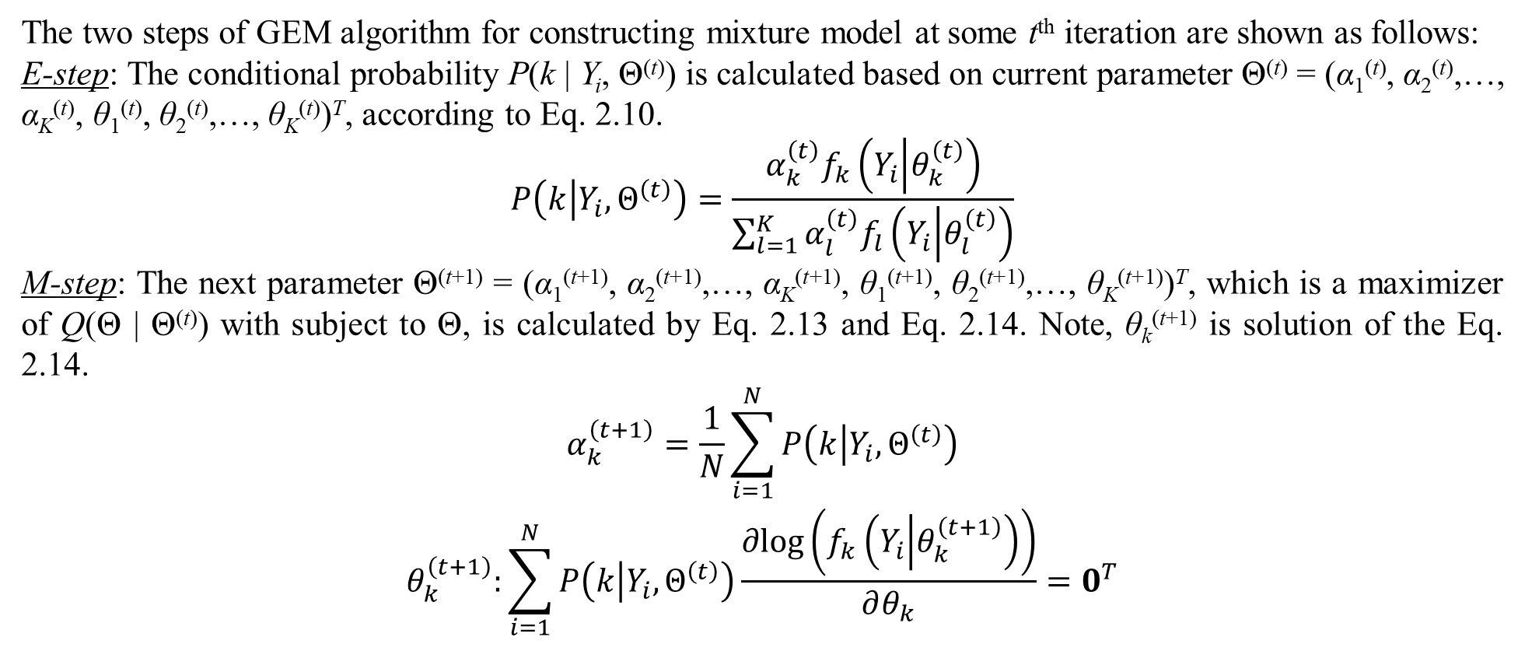
2. Finite mixture model
The two steps of GEM algorithm for constructing mixture model at some t^{th} iteration are shown as follows:
E-step: The conditional probability P(k | Y_{i}, Θ^{(t)}) is calculated based on current parameter Θ^{(t)} = (α₁^{(t)}, α₂^{(t)},…, α_{K}^{(t)}, θ₁^{(t)}, θ₂^{(t)},…, θ_{K}^{(t)})^{T}, according to Eq. 2.10.
$$P\left(k | Y_{i},Θ^{\left(t\right)}\right)=\frac{α_{k}^{\left(t\right)}f_{k}\left(Y_{i} | θ_{k}^{\left(t\right)}\right)}{\sum_{l=1}^{K}{α_{l}^{\left(t\right)}f_{l}\left(Y_{i} | θ_{l}^{\left(t\right)}\right)}}$$
M-step: The next parameter Θ^{(t+1)} = (α₁^{(t+1)}, α₂^{(t+1)},…, α_{K}^{(t+1)}, θ₁^{(t+1)}, θ₂^{(t+1)},…, θ_{K}^{(t+1)})^{T}, which is a maximizer of Q(Θ | Θ^{(t)}) with subject to Θ, is calculated by Eq. 2.13 and Eq. 2.14. Note, θ_{k}^{(t+1)} is solution of the Eq. 2.14.
$$\begin{matrix}α_{k}^{\left(t+1\right)}=\frac{1}{N}\sum_{i=1}^{N}{P\left(k | Y_{i},Θ^{\left(t\right)}\right)} \\ θ_{k}^{\left(t+1\right)}:\sum_{i=1}^{N}{P\left(k | Y_{i},Θ^{\left(t\right)}\right)\frac{∂log\left(f_{k}\left(Y_{i} | θ_{k}^{\left(t+1\right)}\right)\right)}{∂θ_{k}}}=0^{T}\end{matrix}$$

Slide 17
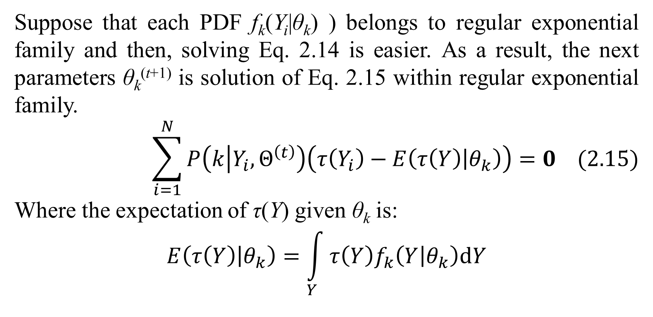
2. Finite mixture model
Suppose that each PDF f_{k}(Y_{i}|θ_{k}) ) belongs to regular exponential family and then, solving Eq. 2.14 is easier. As a result, the next parameters θ_{k}^{(t+1)} is solution of Eq. 2.15 within regular exponential family.
$$\sum_{i=1}^{N}{P\left(k | Y_{i},Θ^{\left(t\right)}\right)\left(τ\left(Y_{i}\right)−E\left(τ\left(Y\right) | θ_{k}\right)\right)}=0 (2.15)$$
Where the expectation of τ(Y) given θ_{k} is:
$$E\left(τ\left(Y\right) | θ_{k}\right)=\int_{Y}{τ\left(Y\right)f_{k}\left(Y | θ_{k}\right)dY}$$

Slide 18
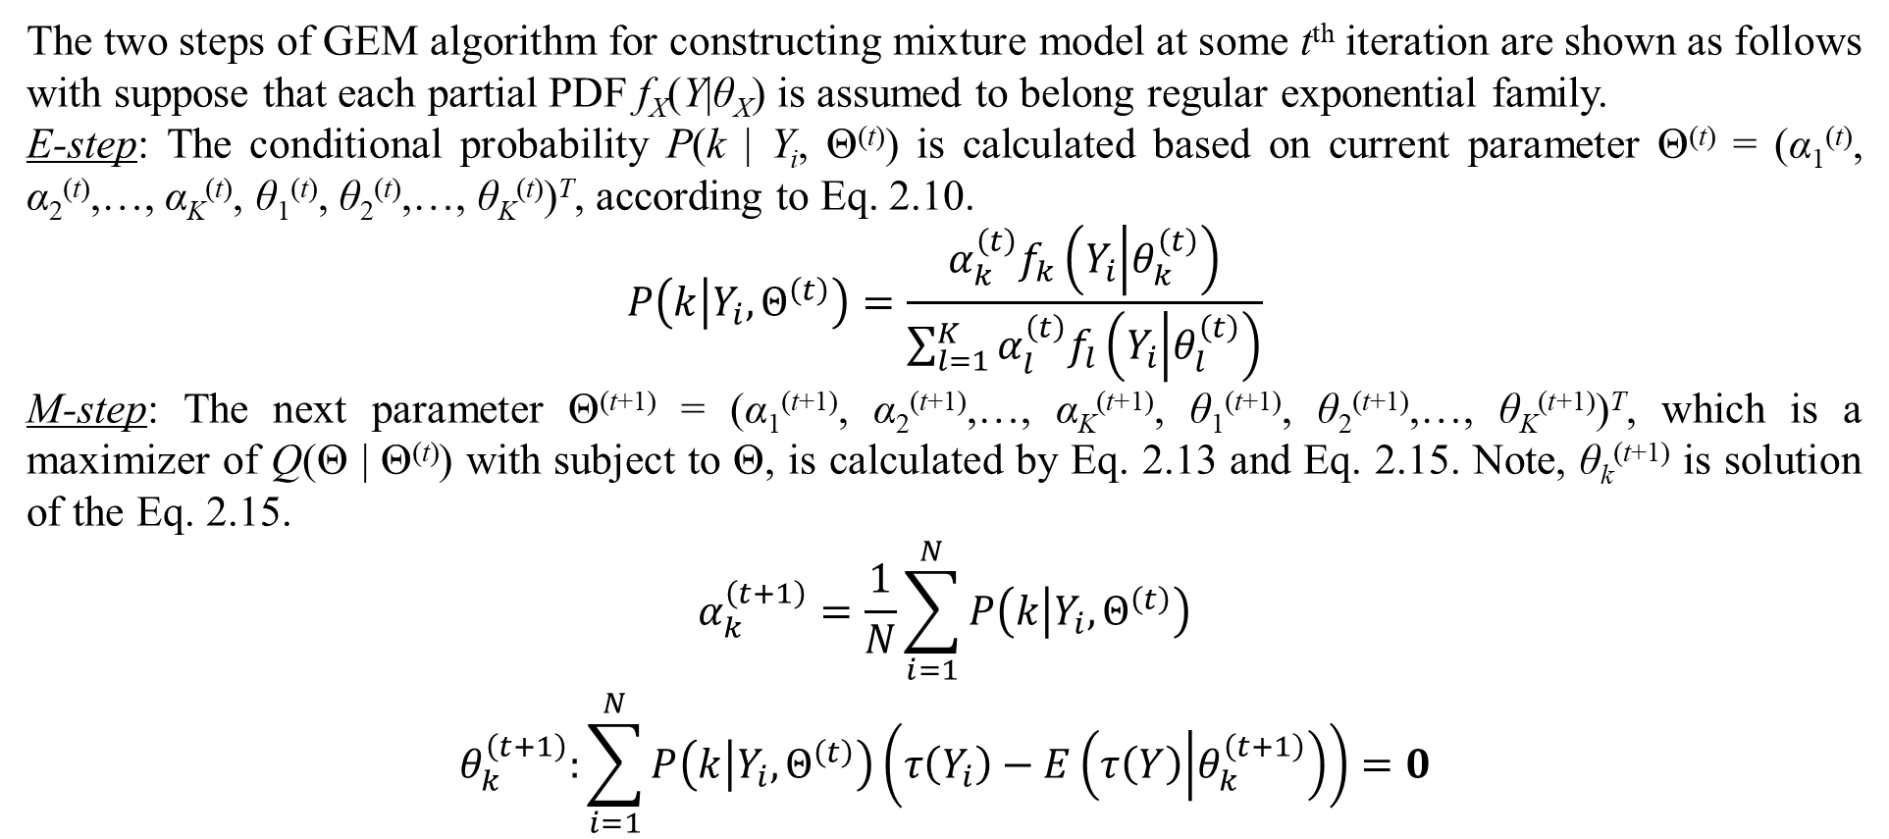
2. Finite mixture model
The two steps of GEM algorithm for constructing mixture model at some t^{th} iteration are shown as follows with suppose that each partial PDF f_{X}(Y|θ_{X}) is assumed to belong regular exponential family.
E-step: The conditional probability P(k | Y_{i}, Θ^{(t)}) is calculated based on current parameter Θ^{(t)} = (α₁^{(t)}, α₂^{(t)},…, α_{K}^{(t)}, θ₁^{(t)}, θ₂^{(t)},…, θ_{K}^{(t)})^{T}, according to Eq. 2.10.
$$P\left(k | Y_{i},Θ^{\left(t\right)}\right)=\frac{α_{k}^{\left(t\right)}f_{k}\left(Y_{i} | θ_{k}^{\left(t\right)}\right)}{\sum_{l=1}^{K}{α_{l}^{\left(t\right)}f_{l}\left(Y_{i} | θ_{l}^{\left(t\right)}\right)}}$$
M-step: The next parameter Θ^{(t+1)} = (α₁^{(t+1)}, α₂^{(t+1)},…, α_{K}^{(t+1)}, θ₁^{(t+1)}, θ₂^{(t+1)},…, θ_{K}^{(t+1)})^{T}, which is a maximizer of Q(Θ | Θ^{(t)}) with subject to Θ, is calculated by Eq. 2.13 and Eq. 2.15. Note, θ_{k}^{(t+1)} is solution of the Eq. 2.15.
$$\begin{matrix}α_{k}^{\left(t+1\right)}=\frac{1}{N}\sum_{i=1}^{N}{P\left(k | Y_{i},Θ^{\left(t\right)}\right)} \\ θ_{k}^{\left(t+1\right)}:\sum_{i=1}^{N}{P\left(k | Y_{i},Θ^{\left(t\right)}\right)\left(τ\left(Y_{i}\right)−E\left(τ\left(Y\right) | θ_{k}^{\left(t+1\right)}\right)\right)}=0\end{matrix}$$

Slide 19
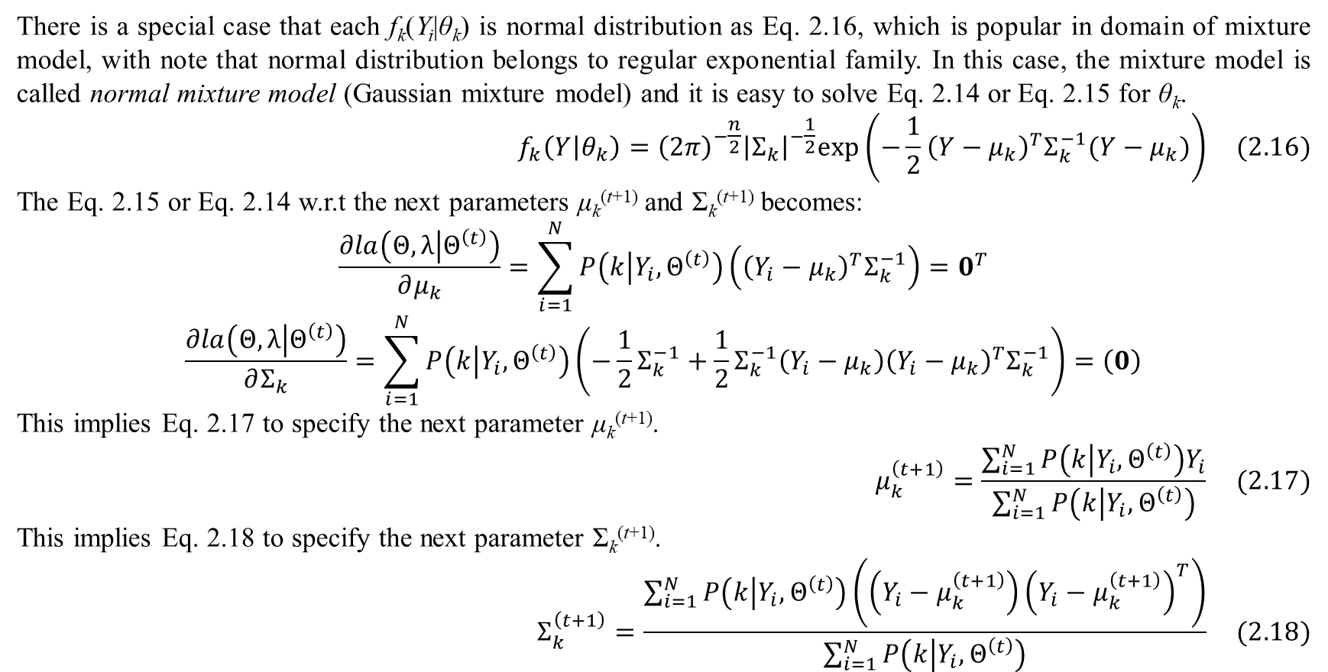
2. Finite mixture model
There is a special case that each f_{k}(Y_{i}|θ_{k}) is normal distribution as Eq. 2.16, which is popular in domain of mixture model, with note that normal distribution belongs to regular exponential family. In this case, the mixture model is called normal mixture model (Gaussian mixture model) and it is easy to solve Eq. 2.14 or Eq. 2.15 for θ_{k}.
$$f_{k}\left(Y | θ_{k}\right)={\left(2π\right)}^{−\frac{n}{2}}{\left|Σ_{k}\right|}^{−\frac{1}{2}}exp\left(−\frac{1}{2}{\left(Y−μ_{k}\right)}^{T}Σ_{k}^{−1}(Y−μ_{k})\right) (2.16)$$
The Eq. 2.15 or Eq. 2.14 w.r.t the next parameters μ_{k}^{(t+1)} and Σ_{k}^{(t+1)} becomes:
$$\frac{∂la\left(Θ,λ | Θ^{\left(t\right)}\right)}{∂μ_{k}}=\sum_{i=1}^{N}{P\left(k | Y_{i},Θ^{\left(t\right)}\right)\left({\left(Y_{i}−μ_{k}\right)}^{T}Σ_{k}^{−1}\right)}=0^{T}$$
$$\frac{∂la\left(Θ,λ | Θ^{\left(t\right)}\right)}{∂Σ_{k}}=\sum_{i=1}^{N}{P\left(k | Y_{i},Θ^{\left(t\right)}\right)\left(−\frac{1}{2}Σ_{k}^{−1}+\frac{1}{2}Σ_{k}^{−1}\left(Y_{i}−μ_{k}\right){\left(Y_{i}−μ_{k}\right)}^{T}Σ_{k}^{−1}\right)}=\left(0\right)$$
This implies Eq. 2.17 to specify the next parameter μ_{k}^{(t+1)}.
$$μ_{k}^{\left(t+1\right)}=\frac{\sum_{i=1}^{N}{P\left(k | Y_{i},Θ^{\left(t\right)}\right)Y_{i}}}{\sum_{i=1}^{N}{P\left(k | Y_{i},Θ^{\left(t\right)}\right)}} (2.17)$$
This implies Eq. 2.18 to specify the next parameter Σ_{k}^{(t+1)}.
$$Σ_{k}^{\left(t+1\right)}=\frac{\sum_{i=1}^{N}{P\left(k | Y_{i},Θ^{\left(t\right)}\right)\left(\left(Y_{i}−μ_{k}^{\left(t+1\right)}\right){\left(Y_{i}−μ_{k}^{\left(t+1\right)}\right)}^{T}\right)}}{\sum_{i=1}^{N}{P\left(k | Y_{i},Θ^{\left(t\right)}\right)}} (2.18)$$

Slide 20
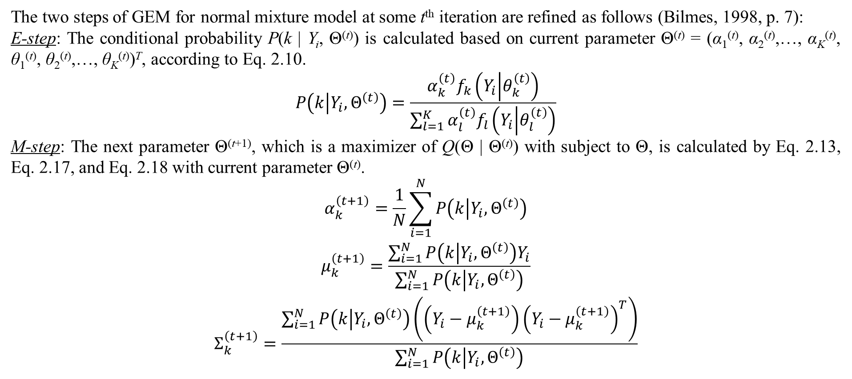
2. Finite mixture model
The two steps of GEM for normal mixture model at some t^{th} iteration are refined as follows (Bilmes, 1998, p. 7):
E-step: The conditional probability P(k | Y_{i}, Θ^{(t)}) is calculated based on current parameter Θ^{(t)} = (α₁^{(t)}, α₂^{(t)},…, α_{K}^{(t)}, θ₁^{(t)}, θ₂^{(t)},…, θ_{K}^{(t)})^{T}, according to Eq. 2.10.
$$P\left(k | Y_{i},Θ^{\left(t\right)}\right)=\frac{α_{k}^{\left(t\right)}f_{k}\left(Y_{i} | θ_{k}^{\left(t\right)}\right)}{\sum_{l=1}^{K}{α_{l}^{\left(t\right)}f_{l}\left(Y_{i} | θ_{l}^{\left(t\right)}\right)}}$$
M-step: The next parameter Θ^{(t+1)}, which is a maximizer of Q(Θ | Θ^{(t)}) with subject to Θ, is calculated by Eq. 2.13, Eq. 2.17, and Eq. 2.18 with current parameter Θ^{(t)}.
$$\begin{matrix}α_{k}^{\left(t+1\right)}=\frac{1}{N}\sum_{i=1}^{N}{P\left(k | Y_{i},Θ^{\left(t\right)}\right)} \\ μ_{k}^{\left(t+1\right)}=\frac{\sum_{i=1}^{N}{P\left(k | Y_{i},Θ^{\left(t\right)}\right)Y_{i}}}{\sum_{i=1}^{N}{P\left(k | Y_{i},Θ^{\left(t\right)}\right)}} \\ Σ_{k}^{\left(t+1\right)}=\frac{\sum_{i=1}^{N}{P\left(k | Y_{i},Θ^{\left(t\right)}\right)\left(\left(Y_{i}−μ_{k}^{\left(t+1\right)}\right){\left(Y_{i}−μ_{k}^{\left(t+1\right)}\right)}^{T}\right)}}{\sum_{i=1}^{N}{P\left(k | Y_{i},Θ^{\left(t\right)}\right)}}\end{matrix}$$

Slide 21
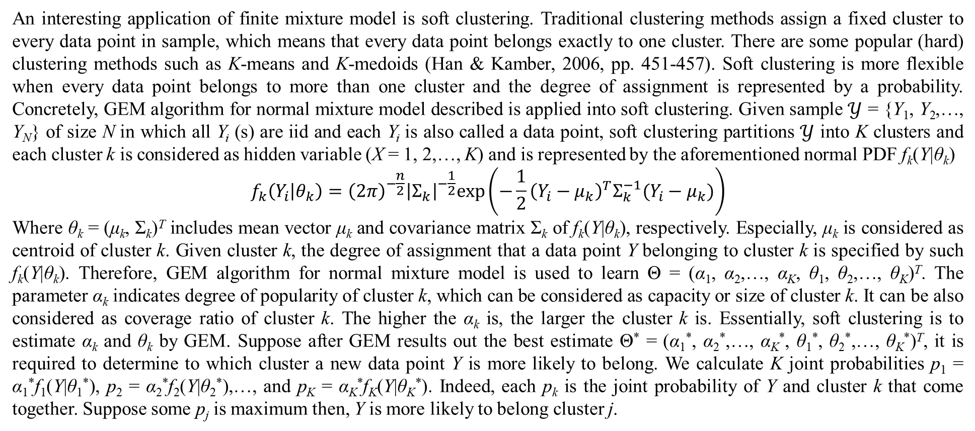
2. Finite mixture model
An interesting application of finite mixture model is soft clustering. Traditional clustering methods assign a fixed cluster to every data point in sample, which means that every data point belongs exactly to one cluster. There are some popular (hard) clustering methods such as K-means and K-medoids (Han & Kamber, 2006, pp. 451-457). Soft clustering is more flexible when every data point belongs to more than one cluster and the degree of assignment is represented by a probability. Concretely, GEM algorithm for normal mixture model described is applied into soft clustering. Given sample $𝒴$ = {Y₁, Y₂,…, Y_{N}} of size N in which all Y_{i} (s) are iid and each Y_{i} is also called a data point, soft clustering partitions $𝒴$ into K clusters and each cluster k is considered as hidden variable (X = 1, 2,…, K) and is represented by the aforementioned normal PDF f_{k}(Y|θ_{k})
$$f_{k}\left(Y_{i} | θ_{k}\right)={\left(2π\right)}^{−\frac{n}{2}}{\left|Σ_{k}\right|}^{−\frac{1}{2}}exp\left(−\frac{1}{2}{\left(Y_{i}−μ_{k}\right)}^{T}Σ_{k}^{−1}(Y_{i}−μ_{k})\right)$$
Where θ_{k} = (μ_{k}, Σ_{k})^{T} includes mean vector μ_{k} and covariance matrix Σ_{k} of f_{k}(Y|θ_{k}), respectively. Especially, μ_{k} is considered as centroid of cluster k. Given cluster k, the degree of assignment that a data point Y belonging to cluster k is specified by such f_{k}(Y|θ_{k}). Therefore, GEM algorithm for normal mixture model is used to learn Θ = (α₁, α₂,…, α_{K}, θ₁, θ₂,…, θ_{K})^{T}. The parameter α_{k} indicates degree of popularity of cluster k, which can be considered as capacity or size of cluster k. It can be also considered as coverage ratio of cluster k. The higher the α_{k} is, the larger the cluster k is. Essentially, soft clustering is to estimate α_{k} and θ_{k} by GEM. Suppose after GEM results out the best estimate Θ* = (α₁*, α₂*,…, α_{K}*, θ₁*, θ₂*,…, θ_{K}*)^{T}, it is required to determine to which cluster a new data point Y is more likely to belong. We calculate K joint probabilities p₁ = α₁*f₁(Y|θ₁*), p₂ = α₂*f₂(Y|θ₂*),…, and p_{K} = α_{K}*f_{K}(Y|θ_{K}*). Indeed, each p_{k} is the joint probability of Y and cluster k that come together. Suppose some p_{j} is maximum then, Y is more likely to belong cluster j.

Slide 22
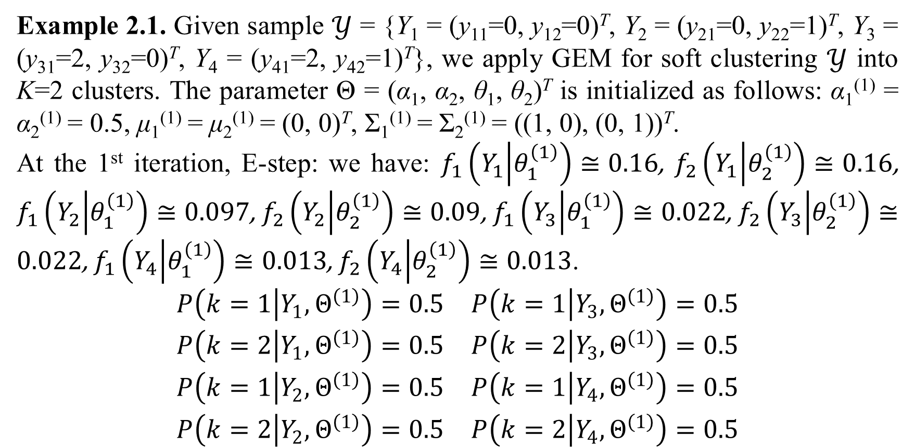
2. Finite mixture model
Example 2.1. Given sample $𝒴$ = {Y₁ = (y₁₁=0, y₁₂=0)^{T}, Y₂ = (y₂₁=0, y₂₂=1)^{T}, Y₃ = (y₃₁=2, y₃₂=0)^{T}, Y₄ = (y₄₁=2, y₄₂=1)^{T}}, we apply GEM for soft clustering $𝒴$ into K=2 clusters. The parameter Θ = (α₁, α₂, θ₁, θ₂)^{T} is initialized as follows: α₁⁽¹⁾ = α₂⁽¹⁾ = 0.5, μ₁⁽¹⁾ = μ₂⁽¹⁾ = (0, 0)^{T}, Σ₁⁽¹⁾ = Σ₂⁽¹⁾ = ((1, 0), (0, 1))^{T}.
At the 1st iteration, E-step: we have: $f_{1}\left(Y_{1} | θ_{1}^{\left(1\right)}\right)≅0.16$, $f_{2}\left(Y_{1} | θ_{2}^{\left(1\right)}\right)≅0.16$, $f_{1}\left(Y_{2} | θ_{1}^{\left(1\right)}\right)≅0.097$, $f_{2}\left(Y_{2} | θ_{2}^{\left(1\right)}\right)≅0.09$, $f_{1}\left(Y_{3} | θ_{1}^{\left(1\right)}\right)≅0.022$, $f_{2}\left(Y_{3} | θ_{2}^{\left(1\right)}\right)≅0.022$, $f_{1}\left(Y_{4} | θ_{1}^{\left(1\right)}\right)≅0.013$, $f_{2}\left(Y_{4} | θ_{2}^{\left(1\right)}\right)≅0.013$.
$$\begin{matrix}P\left(k=1 | Y_{1},Θ^{\left(1\right)}\right)=0.5 & P\left(k=1 | Y_{3},Θ^{\left(1\right)}\right)=0.5 \\ P\left(k=2 | Y_{1},Θ^{\left(1\right)}\right)=0.5 & P\left(k=2 | Y_{3},Θ^{\left(1\right)}\right)=0.5 \\ P\left(k=1 | Y_{2},Θ^{\left(1\right)}\right)=0.5 & P\left(k=1 | Y_{4},Θ^{\left(1\right)}\right)=0.5 \\ P\left(k=2 | Y_{2},Θ^{\left(1\right)}\right)=0.5 & P\left(k=2 | Y_{4},Θ^{\left(1\right)}\right)=0.5\end{matrix}$$

Slide 23
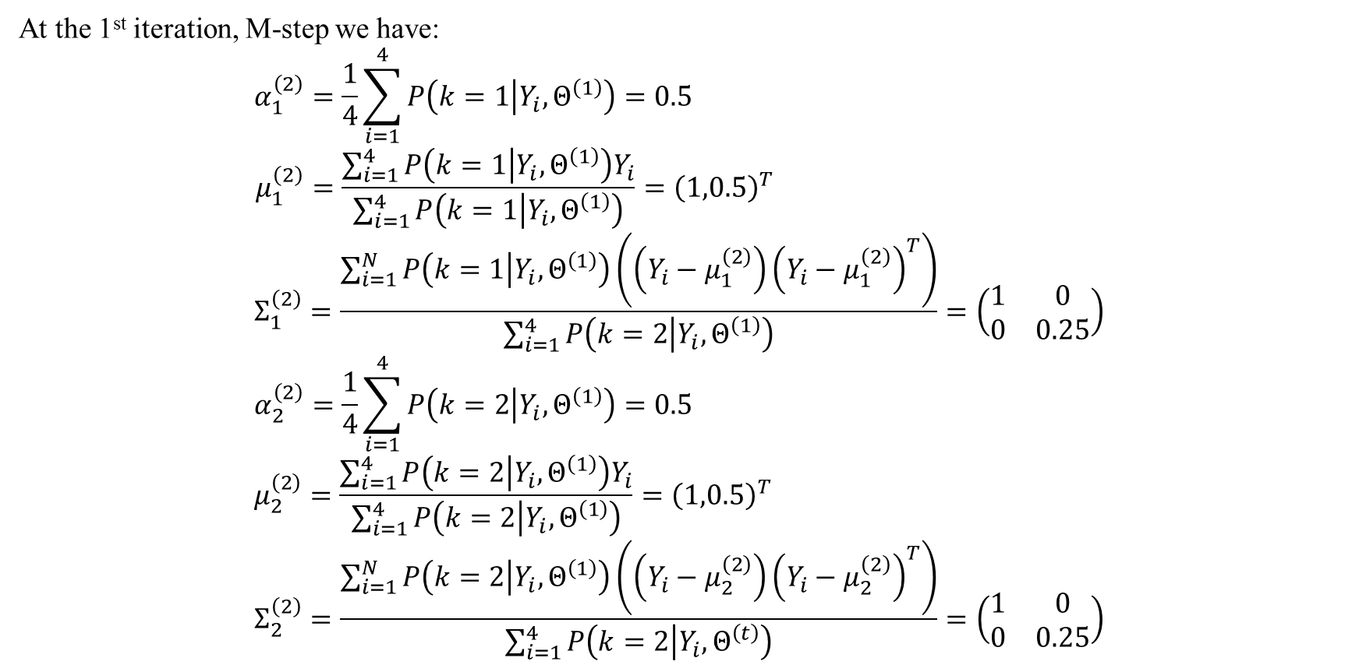
2. Finite mixture model
At the 1st iteration, M-step we have:
$$α_{1}^{\left(2\right)}=\frac{1}{4}\sum_{i=1}^{4}{P\left(k=1 | Y_{i},Θ^{\left(1\right)}\right)}=0.5 \\ μ_{1}^{\left(2\right)}=\frac{\sum_{i=1}^{4}{P\left(k=1 | Y_{i},Θ^{\left(1\right)}\right)Y_{i}}}{\sum_{i=1}^{4}{P\left(k=1 | Y_{i},Θ^{\left(1\right)}\right)}}={\left(1,0.5\right)}^{T} \\ Σ_{1}^{\left(2\right)}=\frac{\sum_{i=1}^{N}{P\left(k=1 | Y_{i},Θ^{\left(1\right)}\right)\left(\left(Y_{i}−μ_{1}^{\left(2\right)}\right){\left(Y_{i}−μ_{1}^{\left(2\right)}\right)}^{T}\right)}}{\sum_{i=1}^{4}{P\left(k=2 | Y_{i},Θ^{\left(1\right)}\right)}}=\left(\begin{matrix}1 & 0 \\ 0 & 0.25\end{matrix}\right) \\ α_{2}^{\left(2\right)}=\frac{1}{4}\sum_{i=1}^{4}{P\left(k=2 | Y_{i},Θ^{\left(1\right)}\right)}=0.5 \\ μ_{2}^{\left(2\right)}=\frac{\sum_{i=1}^{4}{P\left(k=2 | Y_{i},Θ^{\left(1\right)}\right)Y_{i}}}{\sum_{i=1}^{4}{P\left(k=2 | Y_{i},Θ^{\left(1\right)}\right)}}={\left(1,0.5\right)}^{T} \\ Σ_{2}^{\left(2\right)}=\frac{\sum_{i=1}^{N}{P\left(k=2 | Y_{i},Θ^{\left(1\right)}\right)\left(\left(Y_{i}−μ_{2}^{\left(2\right)}\right){\left(Y_{i}−μ_{2}^{\left(2\right)}\right)}^{T}\right)}}{\sum_{i=1}^{4}{P\left(k=2 | Y_{i},Θ^{\left(t\right)}\right)}}=\left(\begin{matrix}1 & 0 \\ 0 & 0.25\end{matrix}\right)$$

Slide 24
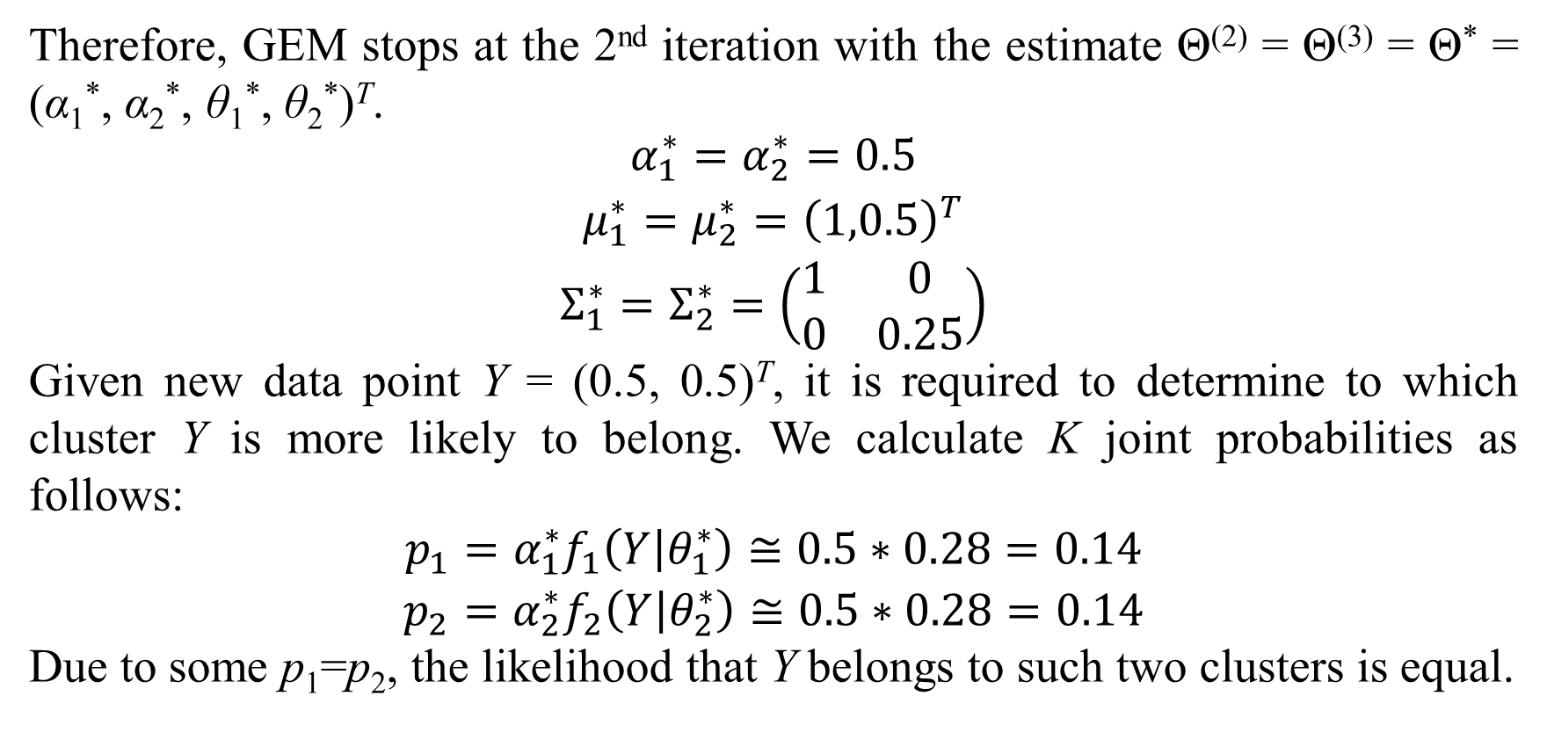
2. Finite mixture model
Therefore, GEM stops at the 2nd iteration with the estimate Θ⁽²⁾ = Θ⁽³⁾ = Θ* = (α₁*, α₂*, θ₁*, θ₂*)^{T}.
$$\begin{matrix}α_{1}^{∗}=α_{2}^{∗}=0.5 \\ μ_{1}^{∗}=μ_{2}^{∗}={\left(1,0.5\right)}^{T} \\ Σ_{1}^{∗}=Σ_{2}^{∗}=\left(\begin{matrix}1 & 0 \\ 0 & 0.25\end{matrix}\right)\end{matrix}$$
Given new data point Y = (0.5, 0.5)^{T}, it is required to determine to which cluster Y is more likely to belong. We calculate K joint probabilities as follows:
$$\begin{matrix}p_{1}=α_{1}^{∗}f_{1}\left(Y | θ_{1}^{∗}\right)≅0.5∗0.28=0.14 \\ p_{2}=α_{2}^{∗}f_{2}\left(Y | θ_{2}^{∗}\right)≅0.5∗0.28=0.14\end{matrix}$$
Due to some p₁=p₂, the likelihood that Y belongs to such two clusters is equal.

Slide 25
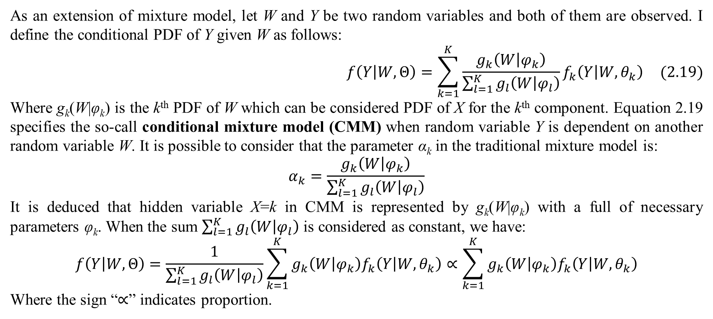
2. Finite mixture model
As an extension of mixture model, let W and Y be two random variables and both of them are observed. I define the conditional PDF of Y given W as follows:
$$f\left(Y | W,Θ\right)=\sum_{k=1}^{K}{\frac{g_{k}\left(W | φ_{k}\right)}{\sum_{l=1}^{K}{g_{l}\left(W | φ_{l}\right)}}f_{k}\left(Y | W,θ_{k}\right)} (2.19)$$
Where g_{k}(W|φ_{k}) is the k^{th} PDF of W which can be considered PDF of X for the k^{th} component. Equation 2.19 specifies the so-call conditional mixture model (CMM) when random variable Y is dependent on another random variable W. It is possible to consider that the parameter α_{k} in the traditional mixture model is:
$$α_{k}=\frac{g_{k}\left(W | φ_{k}\right)}{\sum_{l=1}^{K}{g_{l}\left(W | φ_{l}\right)}}$$
It is deduced that hidden variable X=k in CMM is represented by g_{k}(W|φ_{k}) with a full of necessary parameters φ_{k}. When the sum $\sum_{l=1}^{K}{g_{l}\left(W | φ_{l}\right)}$ is considered as constant, we have:
$$f\left(Y | W,Θ\right)=\frac{1}{\sum_{l=1}^{K}{g_{l}\left(W | φ_{l}\right)}}\sum_{k=1}^{K}{g_{k}\left(W | φ_{k}\right)f_{k}\left(Y | W,θ_{k}\right)}∝\sum_{k=1}^{K}{g_{k}\left(W | φ_{k}\right)f_{k}\left(Y | W,θ_{k}\right)}$$
Where the sign “$∝$” indicates proportion.

Slide 26
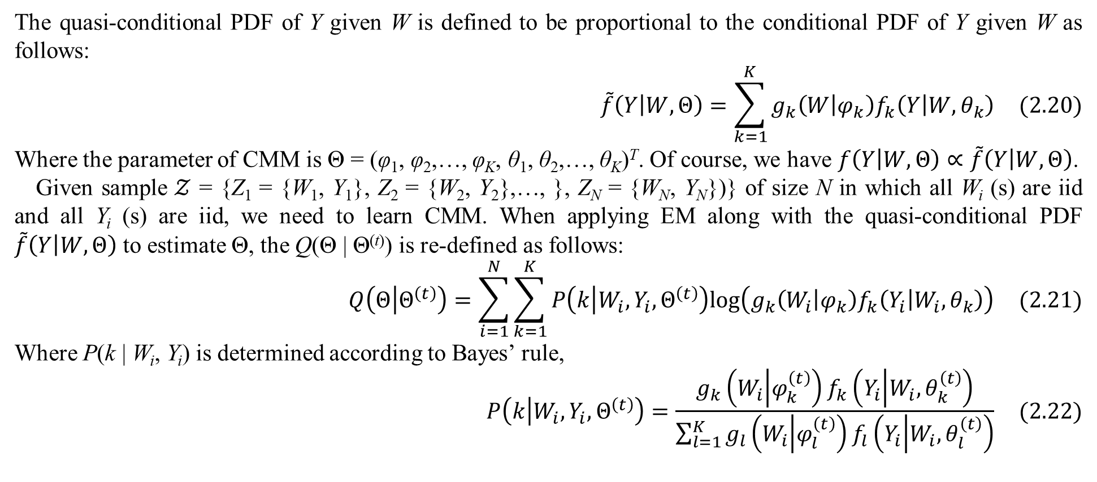
2. Finite mixture model
The quasi-conditional PDF of Y given W is defined to be proportional to the conditional PDF of Y given W as follows:
$$\tilde{f}\left(Y | W,Θ\right)=\sum_{k=1}^{K}{g_{k}\left(W | φ_{k}\right)f_{k}\left(Y | W,θ_{k}\right)} (2.20)$$
Where the parameter of CMM is Θ = (φ₁, φ₂,…, φ_{K}, θ₁, θ₂,…, θ_{K})^{T}. Of course, we have $f\left(Y | W,Θ\right)∝\tilde{f}\left(Y | W,Θ\right)$.
Given sample $𝒵$ = {Z₁ = {W₁, Y₁}, Z₂ = {W₂, Y₂},…, }, Z_{N} = {W_{N}, Y_{N}})} of size N in which all W_{i} (s) are iid and all Y_{i} (s) are iid, we need to learn CMM. When applying EM along with the quasi-conditional PDF $\tilde{f}\left(Y | W,Θ\right)$ to estimate Θ, the Q(Θ | Θ^{(t)}) is re-defined as follows:
$$Q\left(Θ | Θ^{\left(t\right)}\right)=\sum_{i=1}^{N}{\sum_{k=1}^{K}{P\left(k | W_{i},Y_{i},Θ^{\left(t\right)}\right)log\left(g_{k}\left(W_{i} | φ_{k}\right)f_{k}\left(Y_{i} | W_{i},θ_{k}\right)\right)}} (2.21)$$
Where P(k | W_{i}, Y_{i}) is determined according to Bayes’ rule,
$$P\left(k | W_{i},Y_{i},Θ^{\left(t\right)}\right)=\frac{g_{k}\left(W_{i} | φ_{k}^{\left(t\right)}\right)f_{k}\left(Y_{i} | W_{i},θ_{k}^{\left(t\right)}\right)}{\sum_{l=1}^{K}{g_{l}\left(W_{i} | φ_{l}^{\left(t\right)}\right)f_{l}\left(Y_{i} | W_{i},θ_{l}^{\left(t\right)}\right)}} (2.22)$$

Slide 27
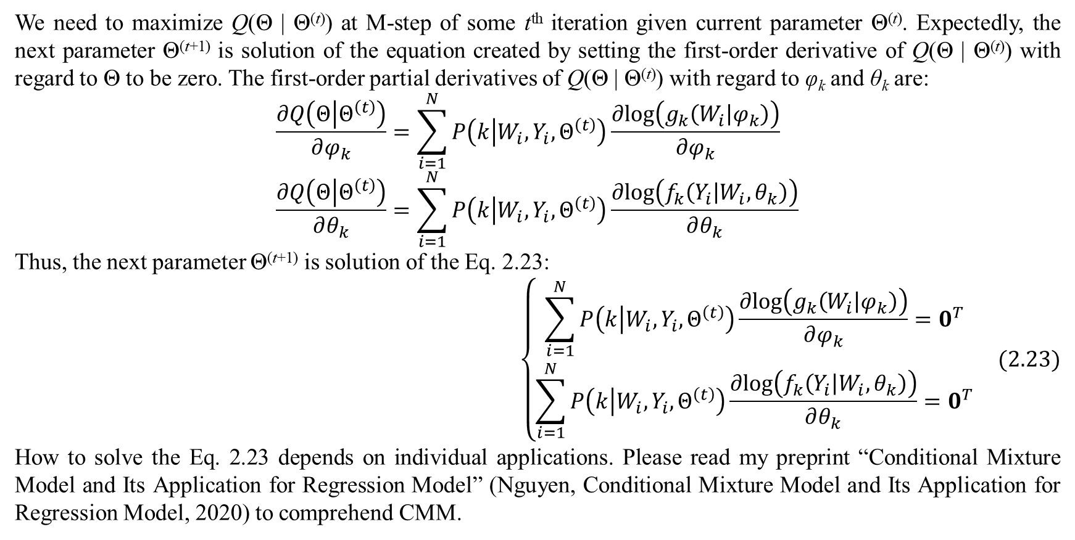
2. Finite mixture model
We need to maximize Q(Θ | Θ^{(t)}) at M-step of some t^{th} iteration given current parameter Θ^{(t)}. Expectedly, the next parameter Θ^{(t+1)} is solution of the equation created by setting the first-order derivative of Q(Θ | Θ^{(t)}) with regard to Θ to be zero. The first-order partial derivatives of Q(Θ | Θ^{(t)}) with regard to φ_{k} and θ_{k} are:
$$\frac{∂Q\left(Θ | Θ^{\left(t\right)}\right)}{∂φ_{k}}=\sum_{i=1}^{N}{P\left(k | W_{i},Y_{i},Θ^{\left(t\right)}\right)\frac{∂log\left(g_{k}\left(W_{i} | φ_{k}\right)\right)}{∂φ_{k}}} \\ \frac{∂Q\left(Θ | Θ^{\left(t\right)}\right)}{∂θ_{k}}=\sum_{i=1}^{N}{P\left(k | W_{i},Y_{i},Θ^{\left(t\right)}\right)\frac{∂log\left(f_{k}\left(Y_{i} | W_{i},θ_{k}\right)\right)}{∂θ_{k}}}$$
Thus, the next parameter Θ^{(t+1)} is solution of the Eq. 2.23:
$$\left\{\begin{matrix}\sum_{i=1}^{N}{P\left(k | W_{i},Y_{i},Θ^{\left(t\right)}\right)\frac{∂log\left(g_{k}\left(W_{i} | φ_{k}\right)\right)}{∂φ_{k}}}=0^{T} \\ \sum_{i=1}^{N}{P\left(k | W_{i},Y_{i},Θ^{\left(t\right)}\right)\frac{∂log\left(f_{k}\left(Y_{i} | W_{i},θ_{k}\right)\right)}{∂θ_{k}}}=0^{T}\end{matrix}\right. (2.23)$$
How to solve the Eq. 2.23 depends on individual applications. Please read my preprint “Conditional Mixture Model and Its Application for Regression Model” (Nguyen, Conditional Mixture Model and Its Application for Regression Model, 2020) to comprehend CMM.

Slide 28
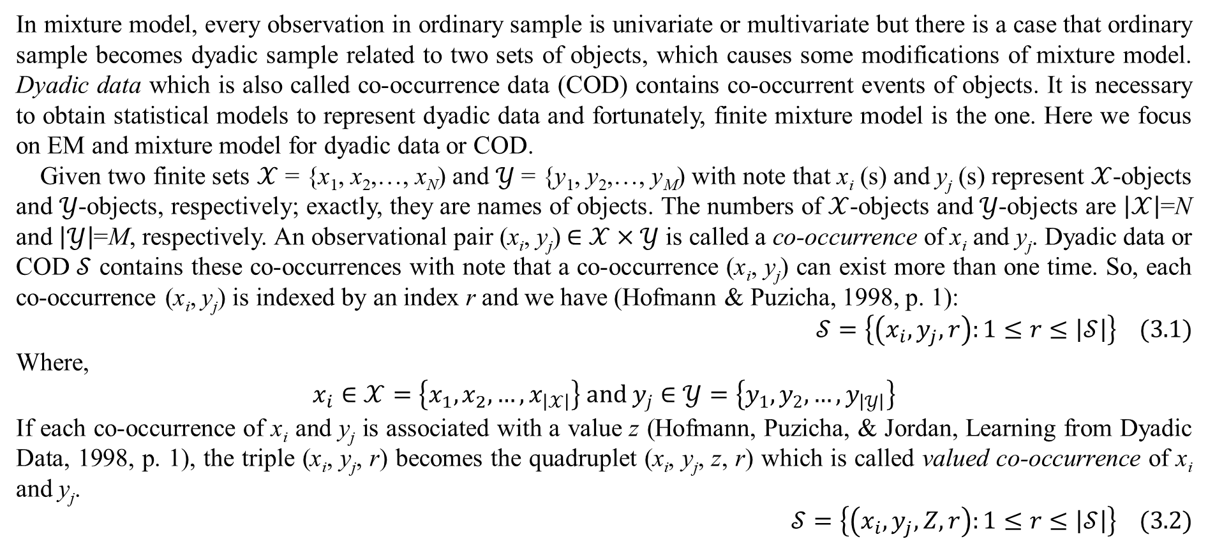
3. Mixture model with dyadic data
In mixture model, every observation in ordinary sample is univariate or multivariate but there is a case that ordinary sample becomes dyadic sample related to two sets of objects, which causes some modifications of mixture model. Dyadic data which is also called co-occurrence data (COD) contains co-occurrent events of objects. It is necessary to obtain statistical models to represent dyadic data and fortunately, finite mixture model is the one. Here we focus on EM and mixture model for dyadic data or COD.
Given two finite sets $𝒳$ = {x₁, x₂,…, x_{N}) and $𝒴$ = {y₁, y₂,…, y_{M}) with note that x_{i} (s) and y_{j} (s) represent $𝒳$-objects and $𝒴$-objects, respectively; exactly, they are names of objects. The numbers of $𝒳$-objects and $𝒴$-objects are $\left|𝒳\right|$=N and $\left|𝒴\right|$=M, respectively. An observational pair (x_{i}, y_{j}) $∈$ $𝒳×𝒴$ is called a co-occurrence of x_{i} and y_{j}. Dyadic data or COD $𝒮$ contains these co-occurrences with note that a co-occurrence (x_{i}, y_{j}) can exist more than one time. So, each co-occurrence (x_{i}, y_{j}) is indexed by an index r and we have (Hofmann & Puzicha, 1998, p. 1):
$$𝒮=\left\{\left(x_{i},y_{j},r\right):1≤r≤\left|𝒮\right|\right\} (3.1)$$
Where,
$$x_{i}∈𝒳=\left\{x_{1},x_{2},…,x_{\left|𝒳\right|}\right\} and y_{j}∈𝒴=\left\{y_{1},y_{2},…,y_{\left|𝒴\right|}\right\}$$
If each co-occurrence of x_{i} and y_{j} is associated with a value z (Hofmann, Puzicha, & Jordan, Learning from Dyadic Data, 1998, p. 1), the triple (x_{i}, y_{j}, r) becomes the quadruplet (x_{i}, y_{j}, z, r) which is called valued co-occurrence of x_{i} and y_{j}.
$$𝒮=\left\{\left(x_{i},y_{j},Z,r\right):1≤r≤\left|𝒮\right|\right\} (3.2)$$

Slide 29
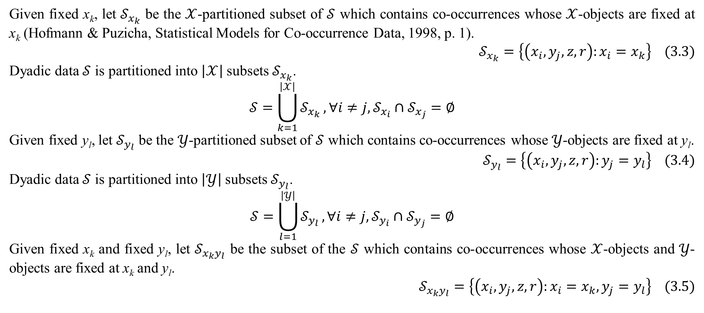
3. Mixture model with dyadic data
Given fixed x_{k}, let $𝒮_{x_{k}}$ be the $𝒳$-partitioned subset of $𝒮$ which contains co-occurrences whose $𝒳$-objects are fixed at x_{k} (Hofmann & Puzicha, Statistical Models for Co-occurrence Data, 1998, p. 1).
$$𝒮_{x_{k}}=\left\{\left(x_{i},y_{j},z,r\right):x_{i}=x_{k}\right\} (3.3)$$
Dyadic data $𝒮$ is partitioned into $\left|𝒳\right|$ subsets $𝒮_{x_{k}}$.
$$𝒮=\bigcup_{k=1}^{\left|𝒳\right|}{𝒮_{x_{k}}},∀i≠j,𝒮_{x_{i}}∩𝒮_{x_{j}}=∅$$
Given fixed y_{l}, let $𝒮_{y_{l}}$ be the $𝒴$-partitioned subset of $𝒮$ which contains co-occurrences whose $𝒴$-objects are fixed at y_{l}.
$$𝒮_{y_{l}}=\left\{\left(x_{i},y_{j},z,r\right):y_{j}=y_{l}\right\} (3.4)$$
Dyadic data $𝒮$ is partitioned into $\left|𝒴\right|$ subsets $𝒮_{y_{l}}$.
$$𝒮=\bigcup_{l=1}^{\left|𝒴\right|}{𝒮_{y_{l}}},∀i≠j,𝒮_{y_{i}}∩𝒮_{y_{j}}=∅$$
Given fixed x_{k} and fixed y_{l}, let $𝒮_{x_{k}y_{l}}$ be the subset of the $𝒮$ which contains co-occurrences whose $𝒳$-objects and $𝒴$-objects are fixed at x_{k} and y_{l}.
$$𝒮_{x_{k}y_{l}}=\left\{\left(x_{i},y_{j},z,r\right):x_{i}=x_{k},y_{j}=y_{l}\right\} (3.5)$$

Slide 30
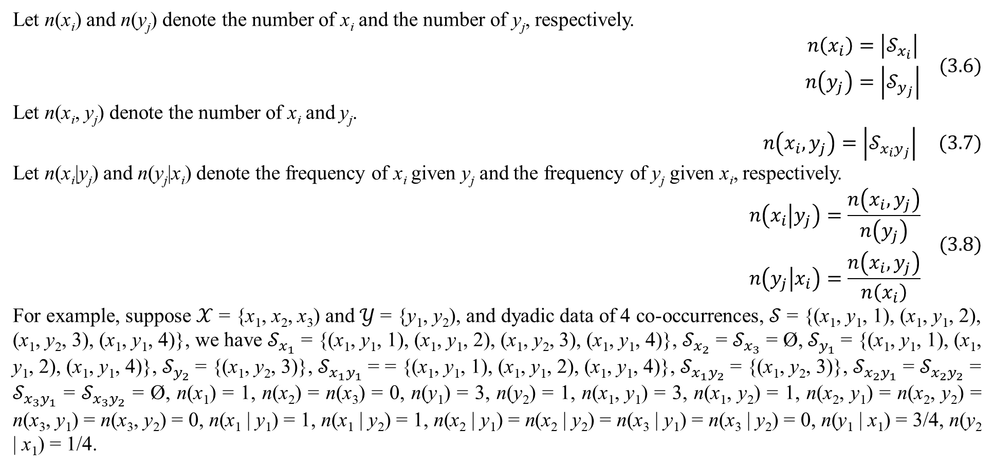
3. Mixture model with dyadic data
Let n(x_{i}) and n(y_{j}) denote the number of x_{i} and the number of y_{j}, respectively.
$$\begin{matrix}n\left(x_{i}\right)=\left|𝒮_{x_{i}}\right| \\ n\left(y_{j}\right)=\left|𝒮_{y_{j}}\right|\end{matrix} (3.6)$$
Let n(x_{i}, y_{j}) denote the number of x_{i} and y_{j}.
$$n\left(x_{i},y_{j}\right)=\left|𝒮_{x_{i}y_{j}}\right| (3.7)$$
Let n(x_{i}|y_{j}) and n(y_{j}|x_{i}) denote the frequency of x_{i} given y_{j} and the frequency of y_{j} given x_{i}, respectively.
$$\begin{matrix}n\left(x_{i} | y_{j}\right)=\frac{n\left(x_{i},y_{j}\right)}{n\left(y_{j}\right)} \\ n\left(y_{j} | x_{i}\right)=\frac{n\left(x_{i},y_{j}\right)}{n\left(x_{i}\right)}\end{matrix} (3.8)$$
For example, suppose $𝒳$ = {x₁, x₂, x₃) and $𝒴$ = {y₁, y₂), and dyadic data of 4 co-occurrences, $𝒮$ = {(x₁, y₁, 1), (x₁, y₁, 2), (x₁, y₂, 3), (x₁, y₁, 4)}, we have $𝒮_{x_{1}}$ = {(x₁, y₁, 1), (x₁, y₁, 2), (x₁, y₂, 3), (x₁, y₁, 4)}, $𝒮_{x_{2}}$ = $𝒮_{x_{3}}$ = Ø, $𝒮_{y_{1}}$ = {(x₁, y₁, 1), (x₁, y₁, 2), (x₁, y₁, 4)}, $𝒮_{y_{2}}$ = {(x₁, y₂, 3)}, $𝒮_{x_{1}y_{1}}$ = = {(x₁, y₁, 1), (x₁, y₁, 2), (x₁, y₁, 4)}, $𝒮_{x_{1}y_{2}}$ = {(x₁, y₂, 3)}, $𝒮_{x_{2}y_{1}}$ = $𝒮_{x_{2}y_{2}}$ = $𝒮_{x_{3}y_{1}}$ = $𝒮_{x_{3}y_{2}}$ = Ø, n(x₁) = 1, n(x₂) = n(x₃) = 0, n(y₁) = 3, n(y₂) = 1, n(x₁, y₁) = 3, n(x₁, y₂) = 1, n(x₂, y₁) = n(x₂, y₂) = n(x₃, y₁) = n(x₃, y₂) = 0, n(x₁ | y₁) = 1, n(x₁ | y₂) = 1, n(x₂ | y₁) = n(x₂ | y₂) = n(x₃ | y₁) = n(x₃ | y₂) = 0, n(y₁ | x₁) = 3/4, n(y₂ | x₁) = 1/4.

Slide 31
3. Mixture model with dyadic data
Suppose each co-occurrence (x_{i}, y_{j}) belongs to a latent variable C and C has K values c_{k} (s). These values c_{k} (s) are called classes or aspects and thus, mixture model for dyadic data is also called aspect model or latent class model which aims to discover the latent variable C. Without loss of generality, let c_{k} = k where k = 1, 2,…, K. The random variable C has discrete distribution such that every value has an associated probability α_{k}. Of course, there are K probabilities α_{k} (s).
There are three kinds of dyadic mixture model for dyadic data such as symmetric mixture model (SMM), asymmetric mixture model (AMM), and product-space mixture model (PMM). These models were introduced by Hofmann and Puzicha (Hofmann & Puzicha, Statistical Models for Co-occurrence Data, 1998).

Slide 32
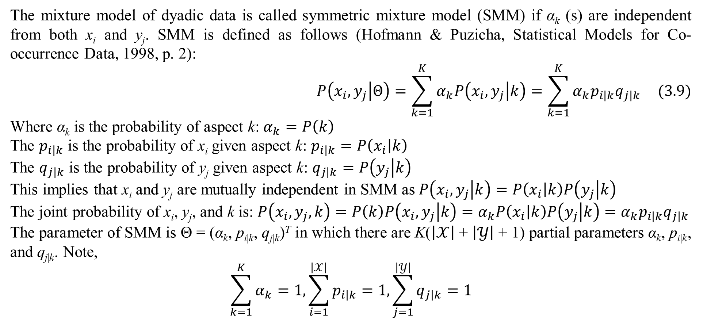
3. Mixture model with dyadic data
The mixture model of dyadic data is called symmetric mixture model (SMM) if α_{k} (s) are independent from both x_{i} and y_{j}. SMM is defined as follows (Hofmann & Puzicha, Statistical Models for Co-occurrence Data, 1998, p. 2):
$$P\left(x_{i},y_{j} | Θ\right)=\sum_{k=1}^{K}{α_{k}P\left(x_{i},y_{j} | k\right)}=\sum_{k=1}^{K}{α_{k}p_{i\left|k\right.}q_{j\left|k\right.}} (3.9)$$
Where α_{k} is the probability of aspect k: $α_{k}=P\left(k\right)$
The $p_{i\left|k\right.}$ is the probability of x_{i} given aspect k: $p_{i\left|k\right.}=P\left(x_{i} | k\right)$
The $q_{j\left|k\right.}$ is the probability of y_{j} given aspect k: $q_{j\left|k\right.}=P\left(y_{j} | k\right)$
This implies that x_{i} and y_{j} are mutually independent in SMM as $P\left(x_{i},y_{j} | k\right)=P\left(x_{i} | k\right)P\left(y_{j} | k\right)$
The joint probability of x_{i}, y_{j}, and k is: $P\left(x_{i},y_{j},k\right)=P\left(k\right)P\left(x_{i},y_{j} | k\right)=α_{k}P\left(x_{i} | k\right)P\left(y_{j} | k\right)=α_{k}p_{i\left|k\right.}q_{j\left|k\right.}$
The parameter of SMM is Θ = (α_{k}, p_{i|k}, q_{j|k})^{T} in which there are K($\left|𝒳\right|$ + $\left|𝒴\right|$ + 1) partial parameters α_{k}, p_{i|k}, and q_{j|k}. Note,
$$\sum_{k=1}^{K}{α_{k}}=1,\sum_{i=1}^{\left|𝒳\right|}{p_{i\left|k\right.}}=1,\sum_{j=1}^{\left|𝒴\right|}{q_{j\left|k\right.}}=1$$

Slide 33
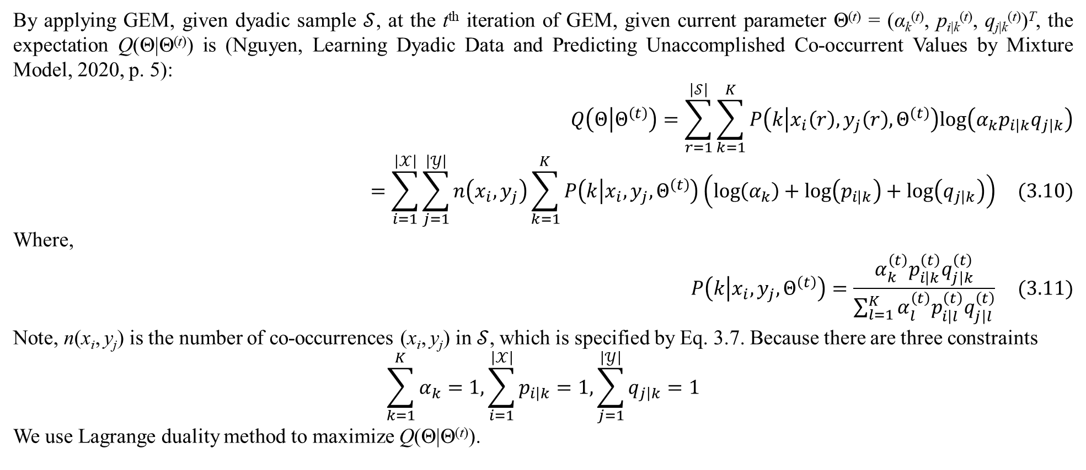
3. Mixture model with dyadic data
By applying GEM, given dyadic sample $𝒮$, at the t^{th} iteration of GEM, given current parameter Θ^{(t)} = (α_{k}^{(t)}, p_{i|k}^{(t)}, q_{j|k}^{(t)})^{T}, the expectation Q(Θ|Θ^{(t)}) is (Nguyen, Learning Dyadic Data and Predicting Unaccomplished Co-occurrent Values by Mixture Model, 2020, p. 5):
$$Q\left(Θ | Θ^{\left(t\right)}\right)=\sum_{r=1}^{\left|𝒮\right|}{\sum_{k=1}^{K}{P\left(k | x_{i}\left(r\right),y_{j}\left(r\right),Θ^{\left(t\right)}\right)log\left(α_{k}p_{i\left|k\right.}q_{j\left|k\right.}\right)}}=\sum_{i=1}^{\left|𝒳\right|}{\sum_{j=1}^{\left|𝒴\right|}{n\left(x_{i},y_{j}\right)\sum_{k=1}^{K}{P\left(k | x_{i},y_{j},Θ^{\left(t\right)}\right)\left(log\left(α_{k}\right)+log\left(p_{i\left|k\right.}\right)+log\left(q_{j\left|k\right.}\right)\right)}}} (3.10)$$
Where,
$$P\left(k | x_{i},y_{j},Θ^{\left(t\right)}\right)=\frac{α_{k}^{\left(t\right)}p_{i\left|k\right.}^{\left(t\right)}q_{j\left|k\right.}^{\left(t\right)}}{\sum_{l=1}^{K}{α_{l}^{\left(t\right)}p_{i\left|l\right.}^{\left(t\right)}q_{j\left|l\right.}^{\left(t\right)}}} (3.11)$$
Note, n(x_{i}, y_{j}) is the number of co-occurrences (x_{i}, y_{j}) in $𝒮$, which is specified by Eq. 3.7. Because there are three constraints
$$\sum_{k=1}^{K}{α_{k}}=1,\sum_{i=1}^{\left|𝒳\right|}{p_{i\left|k\right.}}=1,\sum_{j=1}^{\left|𝒴\right|}{q_{j\left|k\right.}}=1$$
We use Lagrange duality method to maximize Q(Θ|Θ^{(t)}).

Slide 34
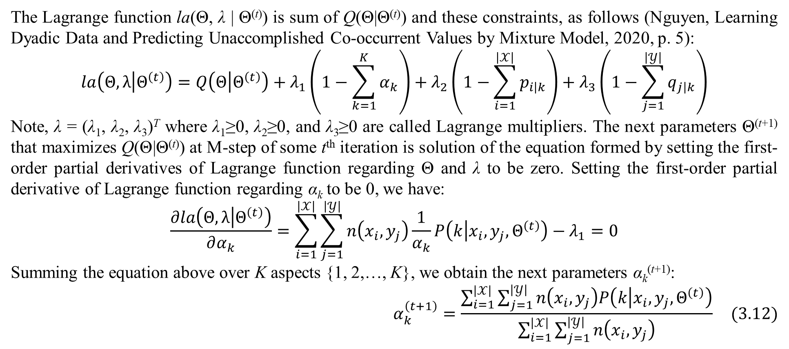
3. Mixture model with dyadic data
The Lagrange function la(Θ, λ | Θ^{(t)}) is sum of Q(Θ|Θ^{(t)}) and these constraints, as follows (Nguyen, Learning Dyadic Data and Predicting Unaccomplished Co-occurrent Values by Mixture Model, 2020, p. 5):
$$la\left(Θ,λ | Θ^{\left(t\right)}\right)=Q\left(Θ | Θ^{\left(t\right)}\right)+λ_{1}\left(1−\sum_{k=1}^{K}{α_{k}}\right)+λ_{2}\left(1−\sum_{i=1}^{\left|𝒳\right|}{p_{i\left|k\right.}}\right)+λ_{3}\left(1−\sum_{j=1}^{\left|𝒴\right|}{q_{j\left|k\right.}}\right)$$
Note, λ = (λ₁, λ₂, λ₃)^{T} where λ₁≥0, λ₂≥0, and λ₃≥0 are called Lagrange multipliers. The next parameters Θ^{(t+1)} that maximizes Q(Θ|Θ^{(t)}) at M-step of some t^{th} iteration is solution of the equation formed by setting the first-order partial derivatives of Lagrange function regarding Θ and λ to be zero. Setting the first-order partial derivative of Lagrange function regarding α_{k} to be 0, we have:
$$\frac{∂la\left(Θ,λ | Θ^{\left(t\right)}\right)}{∂α_{k}}=\sum_{i=1}^{\left|𝒳\right|}{\sum_{j=1}^{\left|𝒴\right|}{n\left(x_{i},y_{j}\right)\frac{1}{α_{k}}P\left(k | x_{i},y_{j},Θ^{\left(t\right)}\right)}}−λ_{1}=0$$
Summing the equation above over K aspects {1, 2,…, K}, we obtain the next parameters α_{k}^{(t+1)}:
$$α_{k}^{\left(t+1\right)}=\frac{\sum_{i=1}^{\left|𝒳\right|}{\sum_{j=1}^{\left|𝒴\right|}{n\left(x_{i},y_{j}\right)P\left(k | x_{i},y_{j},Θ^{\left(t\right)}\right)}}}{\sum_{i=1}^{\left|𝒳\right|}{\sum_{j=1}^{\left|𝒴\right|}{n\left(x_{i},y_{j}\right)}}} (3.12)$$

Slide 35
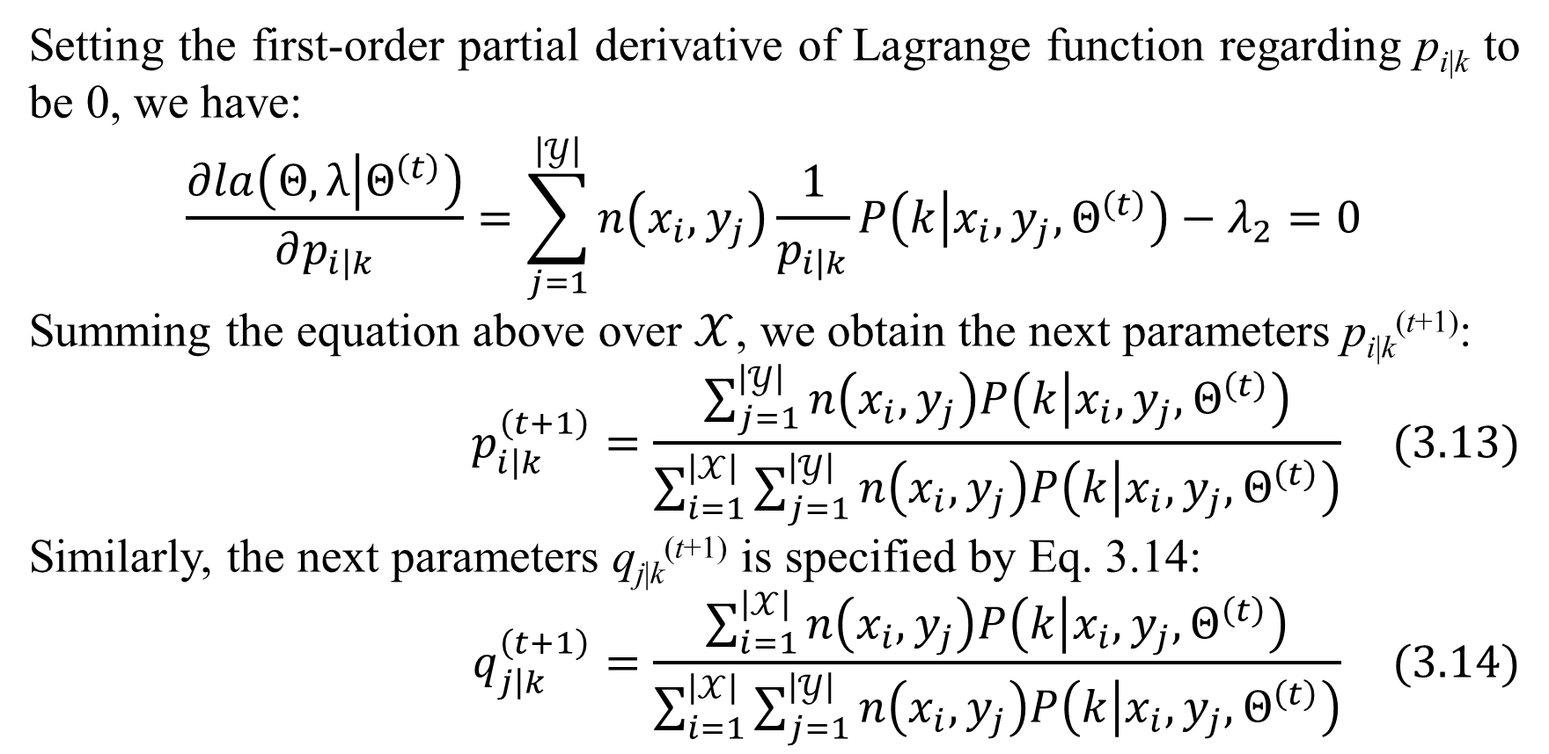
3. Mixture model with dyadic data
Setting the first-order partial derivative of Lagrange function regarding p_{i|k} to be 0, we have:
$$\frac{∂la\left(Θ,λ | Θ^{\left(t\right)}\right)}{∂p_{i\left|k\right.}}=\sum_{j=1}^{\left|𝒴\right|}{n\left(x_{i},y_{j}\right)\frac{1}{p_{i\left|k\right.}}P\left(k | x_{i},y_{j},Θ^{\left(t\right)}\right)}−λ_{2}=0$$
Summing the equation above over $𝒳$, we obtain the next parameters p_{i|k}^{(t+1)}:
$$p_{i\left|k\right.}^{\left(t+1\right)}=\frac{\sum_{j=1}^{\left|𝒴\right|}{n\left(x_{i},y_{j}\right)P\left(k | x_{i},y_{j},Θ^{\left(t\right)}\right)}}{\sum_{i=1}^{\left|𝒳\right|}{\sum_{j=1}^{\left|𝒴\right|}{n\left(x_{i},y_{j}\right)P\left(k | x_{i},y_{j},Θ^{\left(t\right)}\right)}}} (3.13)$$
Similarly, the next parameters q_{j|k}^{(t+1)} is specified by Eq. 3.14:
$$q_{j\left|k\right.}^{\left(t+1\right)}=\frac{\sum_{i=1}^{\left|𝒳\right|}{n\left(x_{i},y_{j}\right)P\left(k | x_{i},y_{j},Θ^{\left(t\right)}\right)}}{\sum_{i=1}^{\left|𝒳\right|}{\sum_{j=1}^{\left|𝒴\right|}{n\left(x_{i},y_{j}\right)P\left(k | x_{i},y_{j},Θ^{\left(t\right)}\right)}}} (3.14)$$

Slide 36
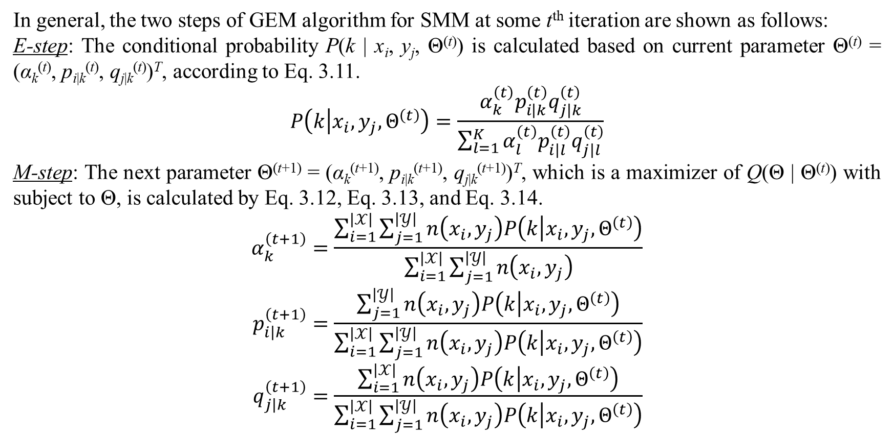
3. Mixture model with dyadic data
In general, the two steps of GEM algorithm for SMM at some t^{th} iteration are shown as follows:
E-step: The conditional probability P(k | x_{i}, y_{j}, Θ^{(t)}) is calculated based on current parameter Θ^{(t)} = (α_{k}^{(t)}, p_{i|k}^{(t)}, q_{j|k}^{(t)})^{T}, according to Eq. 3.11.
$$P\left(k | x_{i},y_{j},Θ^{\left(t\right)}\right)=\frac{α_{k}^{\left(t\right)}p_{i\left|k\right.}^{\left(t\right)}q_{j\left|k\right.}^{\left(t\right)}}{\sum_{l=1}^{K}{α_{l}^{\left(t\right)}p_{i\left|l\right.}^{\left(t\right)}q_{j\left|l\right.}^{\left(t\right)}}}$$
M-step: The next parameter Θ^{(t+1)} = (α_{k}^{(t+1)}, p_{i|k}^{(t+1)}, q_{j|k}^{(t+1)})^{T}, which is a maximizer of Q(Θ | Θ^{(t)}) with subject to Θ, is calculated by Eq. 3.12, Eq. 3.13, and Eq. 3.14.
$$α_{k}^{\left(t+1\right)}=\frac{\sum_{i=1}^{\left|𝒳\right|}{\sum_{j=1}^{\left|𝒴\right|}{n\left(x_{i},y_{j}\right)P\left(k | x_{i},y_{j},Θ^{\left(t\right)}\right)}}}{\sum_{i=1}^{\left|𝒳\right|}{\sum_{j=1}^{\left|𝒴\right|}{n\left(x_{i},y_{j}\right)}}} \\ p_{i\left|k\right.}^{\left(t+1\right)}=\frac{\sum_{j=1}^{\left|𝒴\right|}{n\left(x_{i},y_{j}\right)P\left(k | x_{i},y_{j},Θ^{\left(t\right)}\right)}}{\sum_{i=1}^{\left|𝒳\right|}{\sum_{j=1}^{\left|𝒴\right|}{n\left(x_{i},y_{j}\right)P\left(k | x_{i},y_{j},Θ^{\left(t\right)}\right)}}} \\ q_{j\left|k\right.}^{\left(t+1\right)}=\frac{\sum_{i=1}^{\left|𝒳\right|}{n\left(x_{i},y_{j}\right)P\left(k | x_{i},y_{j},Θ^{\left(t\right)}\right)}}{\sum_{i=1}^{\left|𝒳\right|}{\sum_{j=1}^{\left|𝒴\right|}{n\left(x_{i},y_{j}\right)P\left(k | x_{i},y_{j},Θ^{\left(t\right)}\right)}}}$$

Slide 37
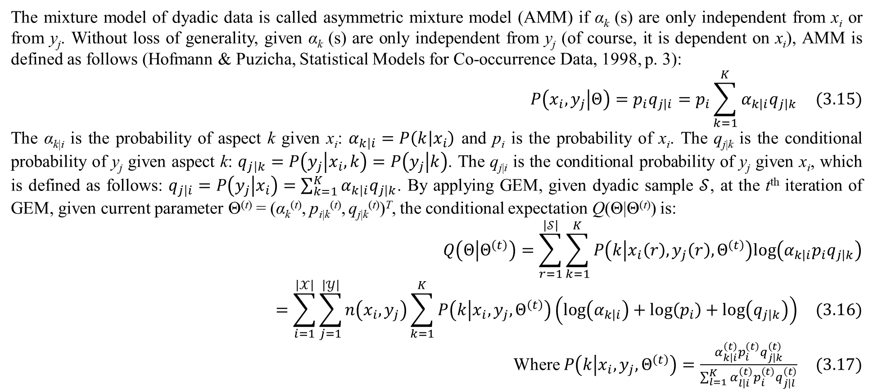
3. Mixture model with dyadic data
The mixture model of dyadic data is called asymmetric mixture model (AMM) if α_{k} (s) are only independent from x_{i} or from y_{j}. Without loss of generality, given α_{k} (s) are only independent from y_{j} (of course, it is dependent on x_{i}), AMM is defined as follows (Hofmann & Puzicha, Statistical Models for Co-occurrence Data, 1998, p. 3):
$$P\left(x_{i},y_{j} | Θ\right)=p_{i}q_{j\left|i\right.}=p_{i}\sum_{k=1}^{K}{α_{k\left|i\right.}q_{j\left|k\right.}} (3.15)$$
The α_{k|i} is the probability of aspect k given x_{i}: $α_{k\left|i\right.}=P\left(k | x_{i}\right)$ and p_{i} is the probability of x_{i}. The q_{j|k} is the conditional probability of y_{j} given aspect k: $q_{j\left|k\right.}=P\left(y_{j} | x_{i},k\right)=P\left(y_{j} | k\right)$. The q_{j|i} is the conditional probability of y_{j} given x_{i}, which is defined as follows: $q_{j\left|i\right.}=P\left(y_{j} | x_{i}\right)=\sum_{k=1}^{K}{α_{k\left|i\right.}q_{j\left|k\right.}}$. By applying GEM, given dyadic sample $𝒮$, at the t^{th} iteration of GEM, given current parameter Θ^{(t)} = (α_{k}^{(t)}, p_{i|k}^{(t)}, q_{j|k}^{(t)})^{T}, the conditional expectation Q(Θ|Θ^{(t)}) is:
$$Q\left(Θ | Θ^{\left(t\right)}\right)=\sum_{r=1}^{\left|𝒮\right|}{\sum_{k=1}^{K}{P\left(k | x_{i}\left(r\right),y_{j}\left(r\right),Θ^{\left(t\right)}\right)log\left(α_{k\left|i\right.}p_{i}q_{j\left|k\right.}\right)}}=\sum_{i=1}^{\left|𝒳\right|}{\sum_{j=1}^{\left|𝒴\right|}{n\left(x_{i},y_{j}\right)\sum_{k=1}^{K}{P\left(k | x_{i},y_{j},Θ^{\left(t\right)}\right)\left(log\left(α_{k\left|i\right.}\right)+log\left(p_{i}\right)+log\left(q_{j\left|k\right.}\right)\right)}}} (3.16)$$
Where $P\left(k | x_{i},y_{j},Θ^{\left(t\right)}\right)=\frac{α_{k\left|i\right.}^{\left(t\right)}p_{i}^{\left(t\right)}q_{j\left|k\right.}^{\left(t\right)}}{\sum_{l=1}^{K}{α_{l\left|i\right.}^{\left(t\right)}p_{i}^{\left(t\right)}q_{j\left|l\right.}^{\left(t\right)}}} (3.17)$

Slide 38
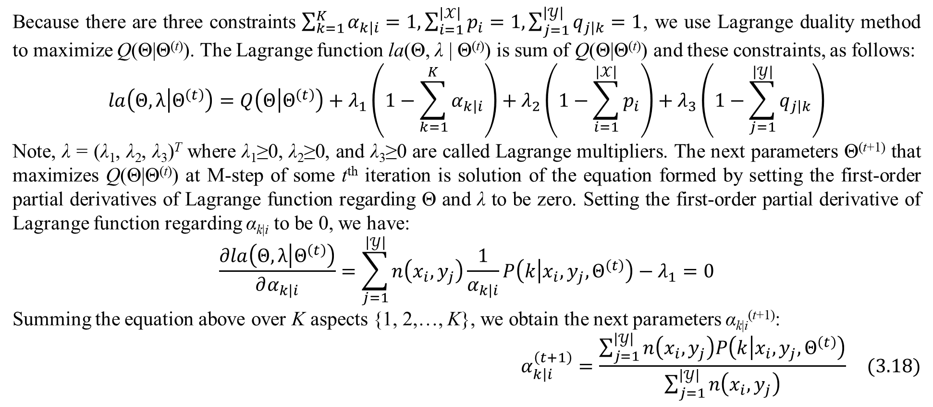
3. Mixture model with dyadic data
Because there are three constraints $\sum_{k=1}^{K}{α_{k\left|i\right.}}=1,\sum_{i=1}^{\left|𝒳\right|}{p_{i}}=1,\sum_{j=1}^{\left|𝒴\right|}{q_{j\left|k\right.}}=1$, we use Lagrange duality method to maximize Q(Θ|Θ^{(t)}). The Lagrange function la(Θ, λ | Θ^{(t)}) is sum of Q(Θ|Θ^{(t)}) and these constraints, as follows:
$$la\left(Θ,λ | Θ^{\left(t\right)}\right)=Q\left(Θ | Θ^{\left(t\right)}\right)+λ_{1}\left(1−\sum_{k=1}^{K}{α_{k\left|i\right.}}\right)+λ_{2}\left(1−\sum_{i=1}^{\left|𝒳\right|}{p_{i}}\right)+λ_{3}\left(1−\sum_{j=1}^{\left|𝒴\right|}{q_{j\left|k\right.}}\right)$$
Note, λ = (λ₁, λ₂, λ₃)^{T} where λ₁≥0, λ₂≥0, and λ₃≥0 are called Lagrange multipliers. The next parameters Θ^{(t+1)} that maximizes Q(Θ|Θ^{(t)}) at M-step of some t^{th} iteration is solution of the equation formed by setting the first-order partial derivatives of Lagrange function regarding Θ and λ to be zero. Setting the first-order partial derivative of Lagrange function regarding α_{k|i} to be 0, we have:
$$\frac{∂la\left(Θ,λ | Θ^{\left(t\right)}\right)}{∂α_{k\left|i\right.}}=\sum_{j=1}^{\left|𝒴\right|}{n\left(x_{i},y_{j}\right)\frac{1}{α_{k\left|i\right.}}P\left(k | x_{i},y_{j},Θ^{\left(t\right)}\right)}−λ_{1}=0$$
Summing the equation above over K aspects {1, 2,…, K}, we obtain the next parameters α_{k|i}^{(t+1)}:
$$α_{k\left|i\right.}^{\left(t+1\right)}=\frac{\sum_{j=1}^{\left|𝒴\right|}{n\left(x_{i},y_{j}\right)P\left(k | x_{i},y_{j},Θ^{\left(t\right)}\right)}}{\sum_{j=1}^{\left|𝒴\right|}{n\left(x_{i},y_{j}\right)}} (3.18)$$

Slide 39
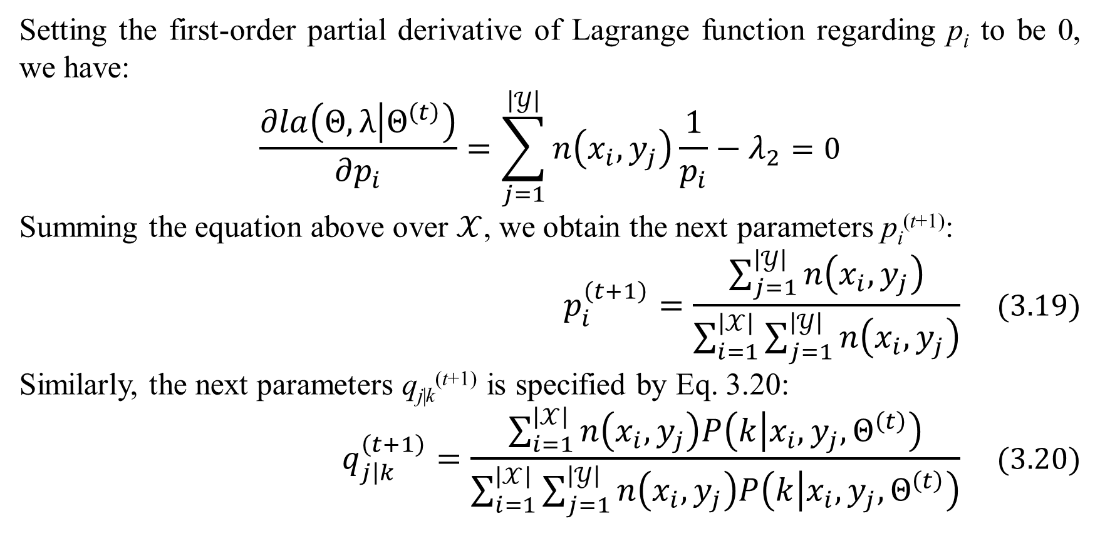
3. Mixture model with dyadic data
Setting the first-order partial derivative of Lagrange function regarding p_{i} to be 0, we have:
$$\frac{∂la\left(Θ,λ | Θ^{\left(t\right)}\right)}{∂p_{i}}=\sum_{j=1}^{\left|𝒴\right|}{n\left(x_{i},y_{j}\right)\frac{1}{p_{i}}}−λ_{2}=0$$
Summing the equation above over $𝒳$, we obtain the next parameters p_{i}^{(t+1)}:
$$p_{i}^{\left(t+1\right)}=\frac{\sum_{j=1}^{\left|𝒴\right|}{n\left(x_{i},y_{j}\right)}}{\sum_{i=1}^{\left|𝒳\right|}{\sum_{j=1}^{\left|𝒴\right|}{n\left(x_{i},y_{j}\right)}}} (3.19)$$
Similarly, the next parameters q_{j|k}^{(t+1)} is specified by Eq. 3.20:
$$q_{j\left|k\right.}^{\left(t+1\right)}=\frac{\sum_{i=1}^{\left|𝒳\right|}{n\left(x_{i},y_{j}\right)P\left(k | x_{i},y_{j},Θ^{\left(t\right)}\right)}}{\sum_{i=1}^{\left|𝒳\right|}{\sum_{j=1}^{\left|𝒴\right|}{n\left(x_{i},y_{j}\right)P\left(k | x_{i},y_{j},Θ^{\left(t\right)}\right)}}} (3.20)$$

Slide 40
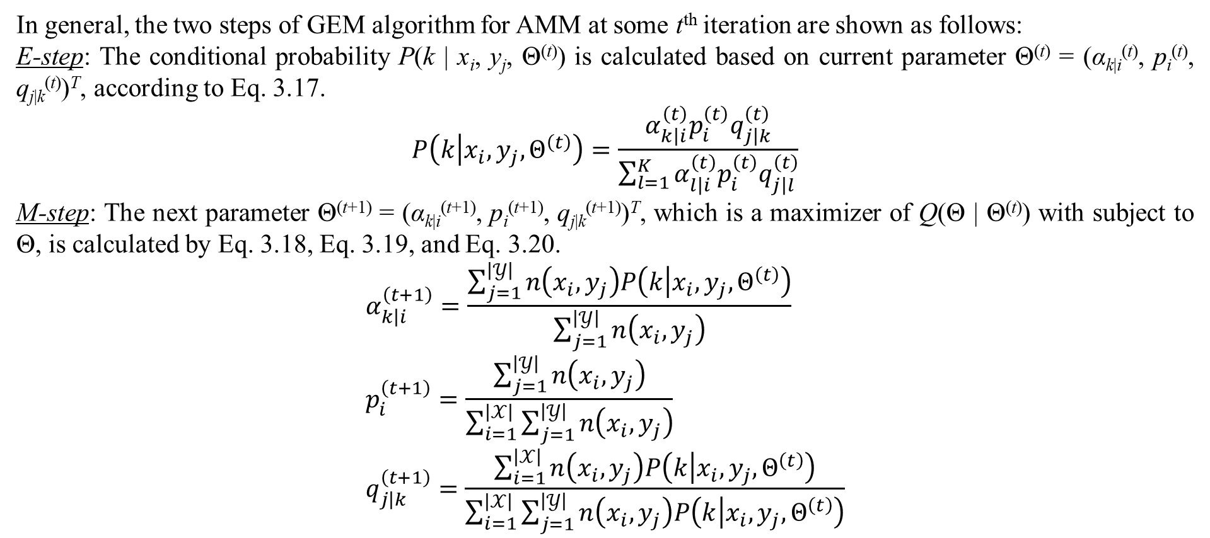
3. Mixture model with dyadic data
In general, the two steps of GEM algorithm for AMM at some t^{th} iteration are shown as follows:
E-step: The conditional probability P(k | x_{i}, y_{j}, Θ^{(t)}) is calculated based on current parameter Θ^{(t)} = (α_{k|i}^{(t)}, p_{i}^{(t)}, q_{j|k}^{(t)})^{T}, according to Eq. 3.17.
$$P\left(k | x_{i},y_{j},Θ^{\left(t\right)}\right)=\frac{α_{k\left|i\right.}^{\left(t\right)}p_{i}^{\left(t\right)}q_{j\left|k\right.}^{\left(t\right)}}{\sum_{l=1}^{K}{α_{l\left|i\right.}^{\left(t\right)}p_{i}^{\left(t\right)}q_{j\left|l\right.}^{\left(t\right)}}}$$
M-step: The next parameter Θ^{(t+1)} = (α_{k|i}^{(t+1)}, p_{i}^{(t+1)}, q_{j|k}^{(t+1)})^{T}, which is a maximizer of Q(Θ | Θ^{(t)}) with subject to Θ, is calculated by Eq. 3.18, Eq. 3.19, and Eq. 3.20.
$$α_{k\left|i\right.}^{\left(t+1\right)}=\frac{\sum_{j=1}^{\left|𝒴\right|}{n\left(x_{i},y_{j}\right)P\left(k | x_{i},y_{j},Θ^{\left(t\right)}\right)}}{\sum_{j=1}^{\left|𝒴\right|}{n\left(x_{i},y_{j}\right)}} \\ p_{i}^{\left(t+1\right)}=\frac{\sum_{j=1}^{\left|𝒴\right|}{n\left(x_{i},y_{j}\right)}}{\sum_{i=1}^{\left|𝒳\right|}{\sum_{j=1}^{\left|𝒴\right|}{n\left(x_{i},y_{j}\right)}}} \\ q_{j\left|k\right.}^{\left(t+1\right)}=\frac{\sum_{i=1}^{\left|𝒳\right|}{n\left(x_{i},y_{j}\right)P\left(k | x_{i},y_{j},Θ^{\left(t\right)}\right)}}{\sum_{i=1}^{\left|𝒳\right|}{\sum_{j=1}^{\left|𝒴\right|}{n\left(x_{i},y_{j}\right)P\left(k | x_{i},y_{j},Θ^{\left(t\right)}\right)}}}$$

Slide 41
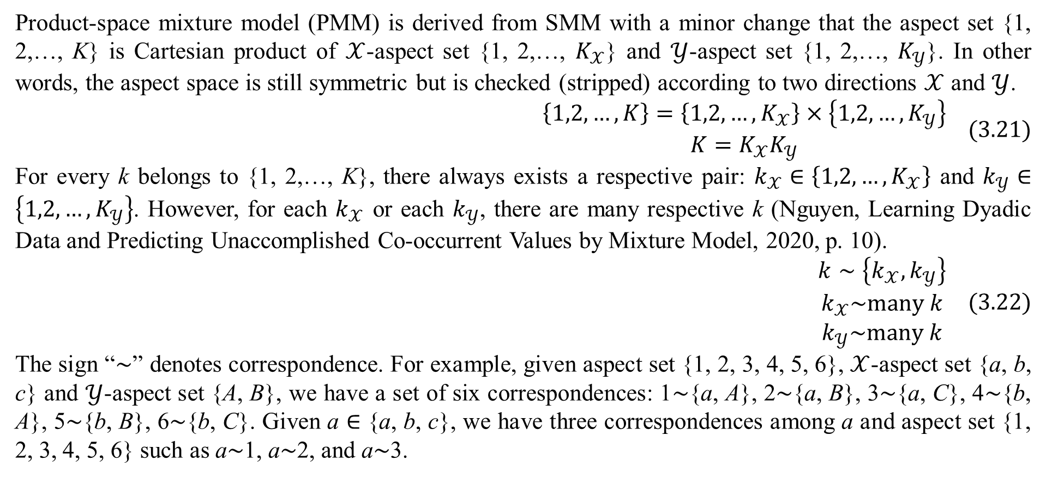
3. Mixture model with dyadic data
Product-space mixture model (PMM) is derived from SMM with a minor change that the aspect set {1, 2,…, K} is Cartesian product of $𝒳$-aspect set {1, 2,…, $K_{𝒳}$} and $𝒴$-aspect set {1, 2,…, $K_{𝒴}$}. In other words, the aspect space is still symmetric but is checked (stripped) according to two directions $𝒳$ and $𝒴$.
$$\begin{matrix}\left\{1,2,…,K\right\}=\left\{1,2,…,K_{𝒳}\right\}×\left\{1,2,…,K_{𝒴}\right\} \\ K=K_{𝒳}K_{𝒴}\end{matrix} (3.21)$$
For every k belongs to {1, 2,…, K}, there always exists a respective pair: $k_{𝒳}∈\left\{1,2,…,K_{𝒳}\right\}$ and $k_{𝒴}∈\left\{1,2,…,K_{𝒴}\right\}$. However, for each $k_{𝒳}$ or each $k_{𝒴}$, there are many respective k (Nguyen, Learning Dyadic Data and Predicting Unaccomplished Co-occurrent Values by Mixture Model, 2020, p. 10).
$$\begin{matrix}k∼\left\{k_{𝒳},k_{𝒴}\right\} \\ k_{𝒳}\sim many k \\ k_{𝒴}\sim many k\end{matrix} (3.22)$$
The sign “$∼$” denotes correspondence. For example, given aspect set {1, 2, 3, 4, 5, 6}, $𝒳$-aspect set {a, b, c} and $𝒴$-aspect set {A, B}, we have a set of six correspondences: 1$∼${a, A}, 2$∼${a, B}, 3$∼${a, C}, 4$∼${b, A}, 5$∼${b, B}, 6$∼${b, C}. Given a $∈$ {a, b, c}, we have three correspondences among a and aspect set {1, 2, 3, 4, 5, 6} such as a$∼$1, a$∼$2, and a$∼$3.

Slide 42
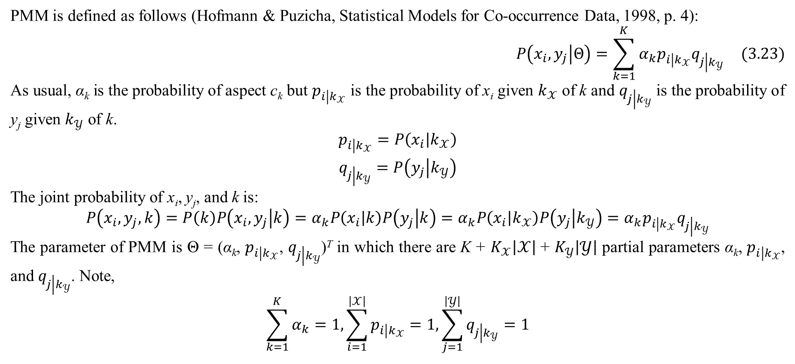
3. Mixture model with dyadic data
PMM is defined as follows (Hofmann & Puzicha, Statistical Models for Co-occurrence Data, 1998, p. 4):
$$P\left(x_{i},y_{j} | Θ\right)=\sum_{k=1}^{K}{α_{k}p_{i\left|k_{𝒳}\right.}q_{j\left|k_{𝒴}\right.}} (3.23)$$
As usual, α_{k} is the probability of aspect c_{k} but $p_{i\left|k_{𝒳}\right.}$ is the probability of x_{i} given $k_{𝒳}$ of k and $q_{j\left|k_{𝒴}\right.}$ is the probability of y_{j} given $k_{𝒴}$ of k.
$$\begin{matrix}p_{i\left|k_{𝒳}\right.}=P\left(x_{i} | k_{𝒳}\right) \\ q_{j\left|k_{𝒴}\right.}=P\left(y_{j} | k_{𝒴}\right)\end{matrix}$$
The joint probability of x_{i}, y_{j}, and k is:
$$P\left(x_{i},y_{j},k\right)=P\left(k\right)P\left(x_{i},y_{j} | k\right)=α_{k}P\left(x_{i} | k\right)P\left(y_{j} | k\right)=α_{k}P\left(x_{i} | k_{𝒳}\right)P\left(y_{j} | k_{𝒴}\right)=α_{k}p_{i\left|k_{𝒳}\right.}q_{j\left|k_{𝒴}\right.}$$
The parameter of PMM is Θ = (α_{k}, $p_{i\left|k_{𝒳}\right.}$, $q_{j\left|k_{𝒴}\right.}$)^{T} in which there are K + $K_{𝒳}\left|𝒳\right|$ + $K_{𝒴}\left|𝒴\right|$ partial parameters α_{k}, $p_{i\left|k_{𝒳}\right.}$, and $q_{j\left|k_{𝒴}\right.}$. Note,
$$\sum_{k=1}^{K}{α_{k}}=1,\sum_{i=1}^{\left|𝒳\right|}{p_{i\left|k_{𝒳}\right.}}=1,\sum_{j=1}^{\left|𝒴\right|}{q_{j\left|k_{𝒴}\right.}}=1$$

Slide 43
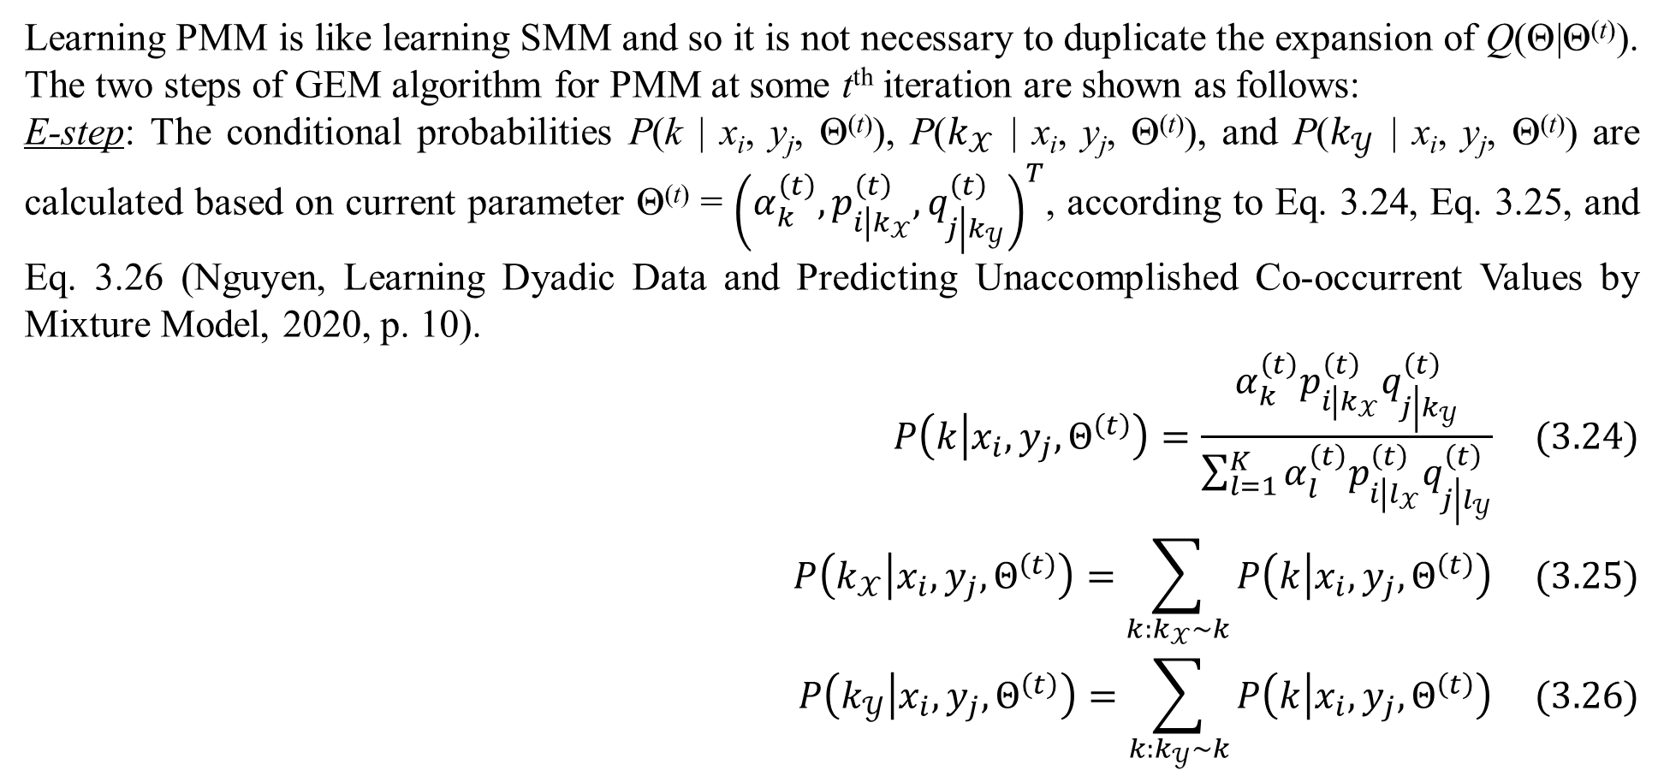
3. Mixture model with dyadic data
Learning PMM is like learning SMM and so it is not necessary to duplicate the expansion of Q(Θ|Θ^{(t)}). The two steps of GEM algorithm for PMM at some t^{th} iteration are shown as follows:
E-step: The conditional probabilities P(k | x_{i}, y_{j}, Θ^{(t)}), P($k_{𝒳}$ | x_{i}, y_{j}, Θ^{(t)}), and P($k_{𝒴}$ | x_{i}, y_{j}, Θ^{(t)}) are calculated based on current parameter Θ^{(t)} = ${\left(α_{k}^{\left(t\right)},p_{i\left|k_{𝒳}\right.}^{\left(t\right)},q_{j\left|k_{𝒴}\right.}^{\left(t\right)}\right)}^{T}$, according to Eq. 3.24, Eq. 3.25, and Eq. 3.26 (Nguyen, Learning Dyadic Data and Predicting Unaccomplished Co-occurrent Values by Mixture Model, 2020, p. 10).
$$P\left(k | x_{i},y_{j},Θ^{\left(t\right)}\right)=\frac{α_{k}^{\left(t\right)}p_{i\left|k_{𝒳}\right.}^{\left(t\right)}q_{j\left|k_{𝒴}\right.}^{\left(t\right)}}{\sum_{l=1}^{K}{α_{l}^{\left(t\right)}p_{i\left|l_{𝒳}\right.}^{\left(t\right)}q_{j\left|l_{𝒴}\right.}^{\left(t\right)}}} (3.24)$$
$$P\left(k_{𝒳} | x_{i},y_{j},Θ^{\left(t\right)}\right)=\sum_{k:k_{𝒳}\sim k}{P\left(k | x_{i},y_{j},Θ^{\left(t\right)}\right)} (3.25)$$
$$P\left(k_{𝒴} | x_{i},y_{j},Θ^{\left(t\right)}\right)=\sum_{k:k_{𝒴}\sim k}{P\left(k | x_{i},y_{j},Θ^{\left(t\right)}\right)} (3.26)$$

Slide 44
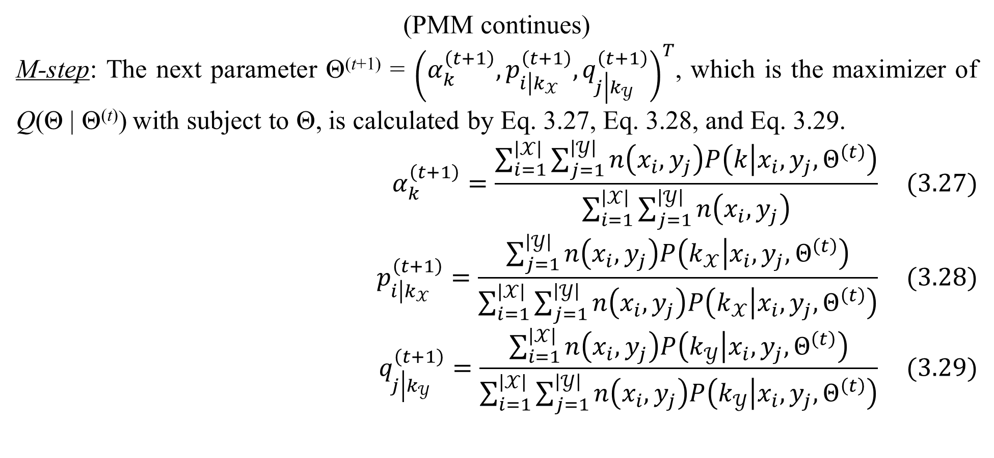
3. Mixture model with dyadic data
(PMM continues)
M-step: The next parameter Θ^{(t+1)} = ${\left(α_{k}^{\left(t+1\right)},p_{i\left|k_{𝒳}\right.}^{\left(t+1\right)},q_{j\left|k_{𝒴}\right.}^{\left(t+1\right)}\right)}^{T}$, which is the maximizer of Q(Θ | Θ^{(t)}) with subject to Θ, is calculated by Eq. 3.27, Eq. 3.28, and Eq. 3.29.
$$α_{k}^{\left(t+1\right)}=\frac{\sum_{i=1}^{\left|𝒳\right|}{\sum_{j=1}^{\left|𝒴\right|}{n\left(x_{i},y_{j}\right)P\left(k | x_{i},y_{j},Θ^{\left(t\right)}\right)}}}{\sum_{i=1}^{\left|𝒳\right|}{\sum_{j=1}^{\left|𝒴\right|}{n\left(x_{i},y_{j}\right)}}} (3.27)$$
$$p_{i\left|k_{𝒳}\right.}^{\left(t+1\right)}=\frac{\sum_{j=1}^{\left|𝒴\right|}{n\left(x_{i},y_{j}\right)P\left(k_{𝒳} | x_{i},y_{j},Θ^{\left(t\right)}\right)}}{\sum_{i=1}^{\left|𝒳\right|}{\sum_{j=1}^{\left|𝒴\right|}{n\left(x_{i},y_{j}\right)P\left(k_{𝒳} | x_{i},y_{j},Θ^{\left(t\right)}\right)}}} (3.28)$$
$$q_{j\left|k_{𝒴}\right.}^{\left(t+1\right)}=\frac{\sum_{i=1}^{\left|𝒳\right|}{n\left(x_{i},y_{j}\right)P\left(k_{𝒴} | x_{i},y_{j},Θ^{\left(t\right)}\right)}}{\sum_{i=1}^{\left|𝒳\right|}{\sum_{j=1}^{\left|𝒴\right|}{n\left(x_{i},y_{j}\right)P\left(k_{𝒴} | x_{i},y_{j},Θ^{\left(t\right)}\right)}}} (3.29)$$

Slide 45
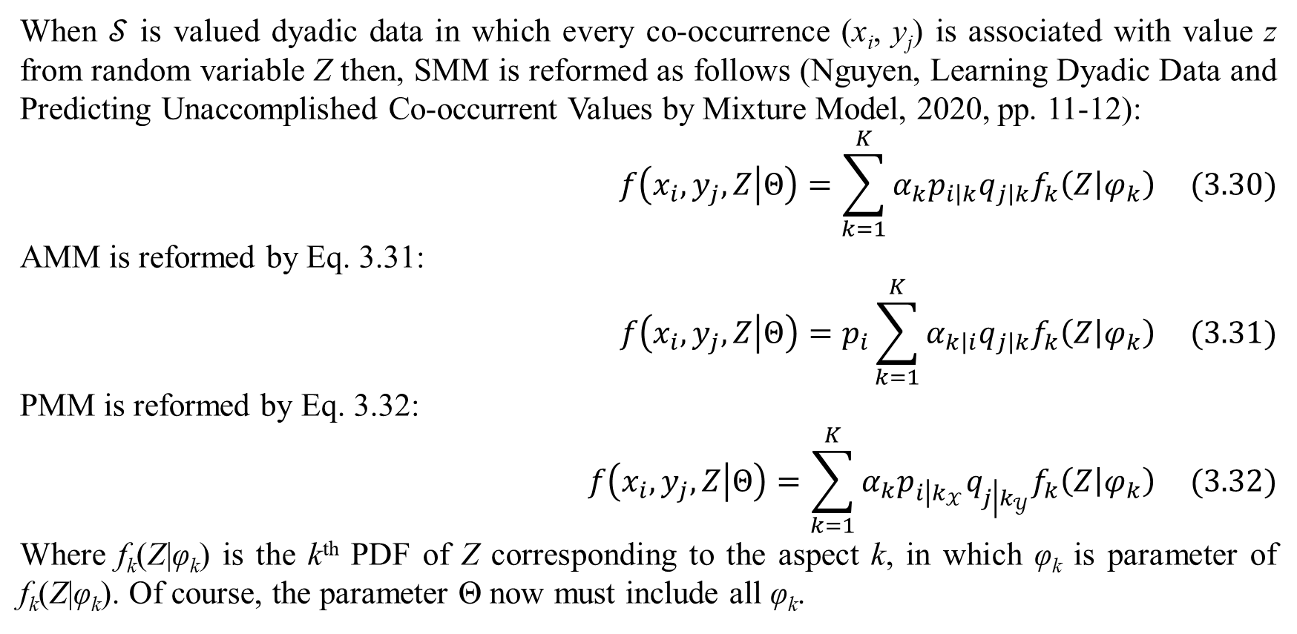
3. Mixture model with dyadic data
When $𝒮$ is valued dyadic data in which every co-occurrence (x_{i}, y_{j}) is associated with value z from random variable Z then, SMM is reformed as follows (Nguyen, Learning Dyadic Data and Predicting Unaccomplished Co-occurrent Values by Mixture Model, 2020, pp. 11-12):
$$f\left(x_{i},y_{j},Z | Θ\right)=\sum_{k=1}^{K}{α_{k}p_{i\left|k\right.}q_{j\left|k\right.}f_{k}\left(Z | φ_{k}\right)} (3.30)$$
AMM is reformed by Eq. 3.31:
$$f\left(x_{i},y_{j},Z | Θ\right)=p_{i}\sum_{k=1}^{K}{α_{k\left|i\right.}q_{j\left|k\right.}f_{k}\left(Z | φ_{k}\right)} (3.31)$$
PMM is reformed by Eq. 3.32:
$$f\left(x_{i},y_{j},Z | Θ\right)=\sum_{k=1}^{K}{α_{k}p_{i\left|k_{𝒳}\right.}q_{j\left|k_{𝒴}\right.}f_{k}\left(Z | φ_{k}\right)} (3.32)$$
Where f_{k}(Z|φ_{k}) is the k^{th} PDF of Z corresponding to the aspect k, in which φ_{k} is parameter of f_{k}(Z|φ_{k}). Of course, the parameter Θ now must include all φ_{k}.

Slide 46
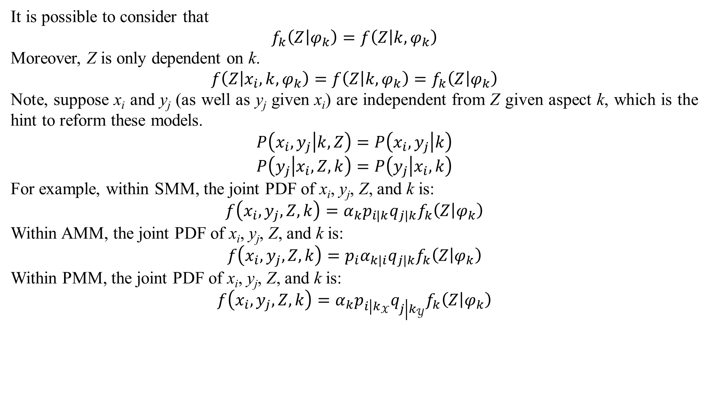
3. Mixture model with dyadic data
It is possible to consider that
$$f_{k}\left(Z | φ_{k}\right)=f\left(Z | k,φ_{k}\right)$$
Moreover, Z is only dependent on k.
$$f\left(Z | x_{i},k,φ_{k}\right)=f\left(Z | k,φ_{k}\right)=f_{k}\left(Z | φ_{k}\right)$$
Note, suppose x_{i} and y_{j} (as well as y_{j} given x_{i}) are independent from Z given aspect k, which is the hint to reform these models.
$$P\left(x_{i},y_{j} | k,Z\right)=P\left(x_{i},y_{j} | k\right)$$
$$P\left(y_{j} | x_{i},Z,k\right)=P\left(y_{j} | x_{i},k\right)$$
For example, within SMM, the joint PDF of x_{i}, y_{j}, Z, and k is:
$$f\left(x_{i},y_{j},Z,k\right)=α_{k}p_{i\left|k\right.}q_{j\left|k\right.}f_{k}\left(Z | φ_{k}\right)$$
Within AMM, the joint PDF of x_{i}, y_{j}, Z, and k is:
$$f\left(x_{i},y_{j},Z,k\right)=p_{i}α_{k\left|i\right.}q_{j\left|k\right.}f_{k}\left(Z | φ_{k}\right)$$
Within PMM, the joint PDF of x_{i}, y_{j}, Z, and k is:
$$f\left(x_{i},y_{j},Z,k\right)=α_{k}p_{i\left|k_{𝒳}\right.}q_{j\left|k_{𝒴}\right.}f_{k}\left(Z | φ_{k}\right)$$

Slide 47
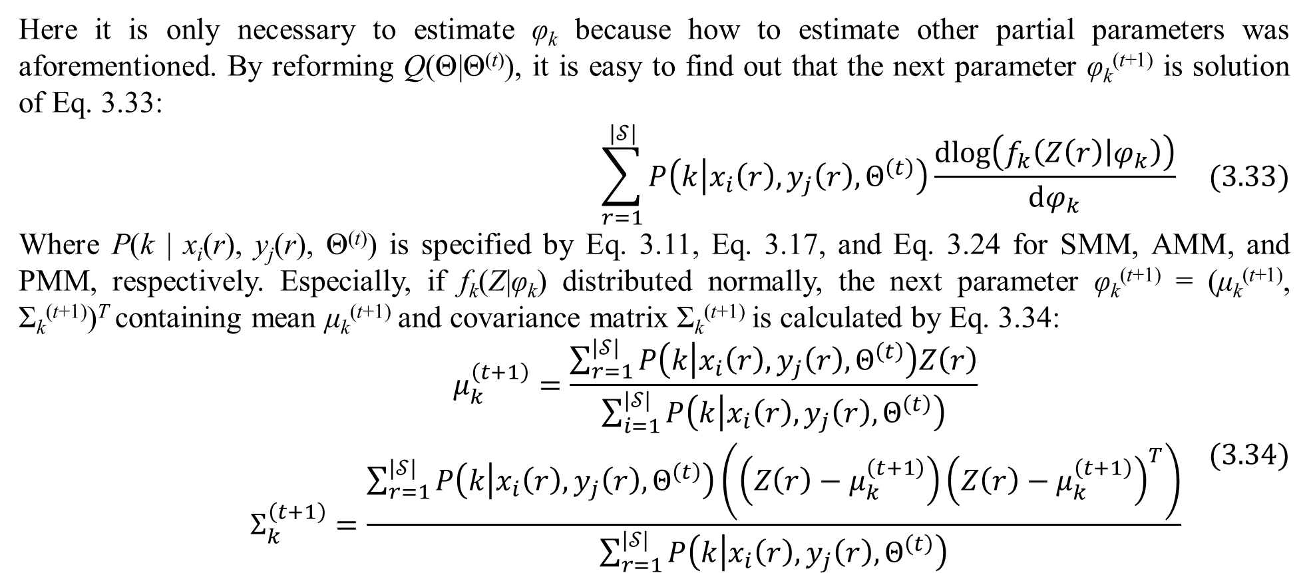
3. Mixture model with dyadic data
Here it is only necessary to estimate φ_{k} because how to estimate other partial parameters was aforementioned. By reforming Q(Θ|Θ^{(t)}), it is easy to find out that the next parameter φ_{k}^{(t+1)} is solution of Eq. 3.33:
$$\sum_{r=1}^{\left|𝒮\right|}{P\left(k | x_{i}\left(r\right),y_{j}\left(r\right),Θ^{\left(t\right)}\right)\frac{dlog\left(f_{k}\left(Z\left(r\right) | φ_{k}\right)\right)}{dφ_{k}}} (3.33)$$
Where P(k | x_{i}(r), y_{j}(r), Θ^{(t)}) is specified by Eq. 3.11, Eq. 3.17, and Eq. 3.24 for SMM, AMM, and PMM, respectively. Especially, if f_{k}(Z|φ_{k}) distributed normally, the next parameter φ_{k}^{(t+1)} = (μ_{k}^{(t+1)}, Σ_{k}^{(t+1)})^{T} containing mean μ_{k}^{(t+1)} and covariance matrix Σ_{k}^{(t+1)} is calculated by Eq. 3.34:
$$\begin{matrix}μ_{k}^{\left(t+1\right)}=\frac{\sum_{r=1}^{\left|𝒮\right|}{P\left(k | x_{i}\left(r\right),y_{j}\left(r\right),Θ^{\left(t\right)}\right)Z\left(r\right)}}{\sum_{i=1}^{\left|𝒮\right|}{P\left(k | x_{i}\left(r\right),y_{j}\left(r\right),Θ^{\left(t\right)}\right)}} \\ Σ_{k}^{\left(t+1\right)}=\frac{\sum_{r=1}^{\left|𝒮\right|}{P\left(k | x_{i}\left(r\right),y_{j}\left(r\right),Θ^{\left(t\right)}\right)\left(\left(Z\left(r\right)−μ_{k}^{\left(t+1\right)}\right){\left(Z\left(r\right)−μ_{k}^{\left(t+1\right)}\right)}^{T}\right)}}{\sum_{r=1}^{\left|𝒮\right|}{P\left(k | x_{i}\left(r\right),y_{j}\left(r\right),Θ^{\left(t\right)}\right)}}\end{matrix} (3.34)$$

Slide 48
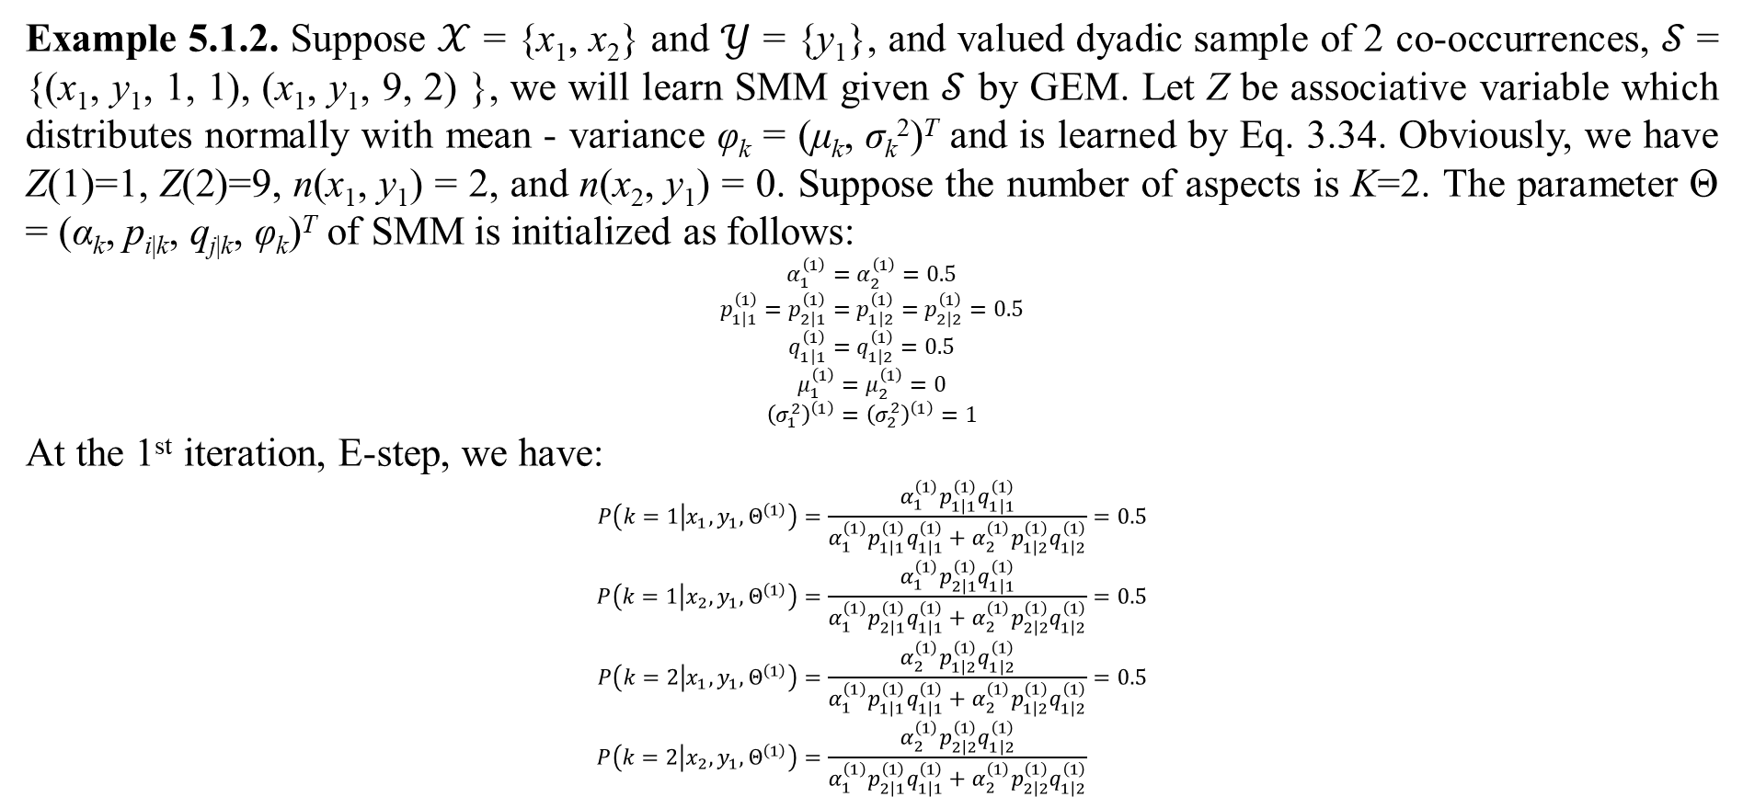
3. Mixture model with dyadic data
Example 5.1.2. Suppose $𝒳$ = {x₁, x₂} and $𝒴$ = {y₁}, and valued dyadic sample of 2 co-occurrences, $𝒮$ = {(x₁, y₁, 1, 1), (x₁, y₁, 9, 2) }, we will learn SMM given $𝒮$ by GEM. Let Z be associative variable which distributes normally with mean - variance φ_{k} = (μ_{k}, σ_{k}²)^{T} and is learned by Eq. 3.34. Obviously, we have Z(1)=1, Z(2)=9, n(x₁, y₁) = 2, and n(x₂, y₁) = 0. Suppose the number of aspects is K=2. The parameter Θ = (α_{k}, p_{i|k}, q_{j|k}, φ_{k})^{T} of SMM is initialized as follows:
$$α_{1}^{\left(1\right)}=α_{2}^{\left(1\right)}=0.5$$
$$p_{1\left|1\right.}^{\left(1\right)}=p_{2\left|1\right.}^{\left(1\right)}=p_{1\left|2\right.}^{\left(1\right)}=p_{2\left|2\right.}^{\left(1\right)}=0.5$$
$$q_{1\left|1\right.}^{\left(1\right)}=q_{1\left|2\right.}^{\left(1\right)}=0.5$$
$$μ_{1}^{\left(1\right)}=μ_{2}^{\left(1\right)}=0$$
$${\left(σ_{1}^{2}\right)}^{\left(1\right)}={\left(σ_{2}^{2}\right)}^{\left(1\right)}=1$$
At the 1st iteration, E-step, we have:
$$P\left(k=1 | x_{1},y_{1},Θ^{\left(1\right)}\right)=\frac{α_{1}^{\left(1\right)}p_{1\left|1\right.}^{\left(1\right)}q_{1\left|1\right.}^{\left(1\right)}}{α_{1}^{\left(1\right)}p_{1\left|1\right.}^{\left(1\right)}q_{1\left|1\right.}^{\left(1\right)}+α_{2}^{\left(1\right)}p_{1\left|2\right.}^{\left(1\right)}q_{1\left|2\right.}^{\left(1\right)}}=0.5 \\ P\left(k=1 | x_{2},y_{1},Θ^{\left(1\right)}\right)=\frac{α_{1}^{\left(1\right)}p_{2\left|1\right.}^{\left(1\right)}q_{1\left|1\right.}^{\left(1\right)}}{α_{1}^{\left(1\right)}p_{2\left|1\right.}^{\left(1\right)}q_{1\left|1\right.}^{\left(1\right)}+α_{2}^{\left(1\right)}p_{2\left|2\right.}^{\left(1\right)}q_{1\left|2\right.}^{\left(1\right)}}=0.5 \\ P\left(k=2 | x_{1},y_{1},Θ^{\left(1\right)}\right)=\frac{α_{2}^{\left(1\right)}p_{1\left|2\right.}^{\left(1\right)}q_{1\left|2\right.}^{\left(1\right)}}{α_{1}^{\left(1\right)}p_{1\left|1\right.}^{\left(1\right)}q_{1\left|1\right.}^{\left(1\right)}+α_{2}^{\left(1\right)}p_{1\left|2\right.}^{\left(1\right)}q_{1\left|2\right.}^{\left(1\right)}}=0.5 \\ P\left(k=2 | x_{2},y_{1},Θ^{\left(1\right)}\right)=\frac{α_{2}^{\left(1\right)}p_{2\left|2\right.}^{\left(1\right)}q_{1\left|2\right.}^{\left(1\right)}}{α_{1}^{\left(1\right)}p_{2\left|1\right.}^{\left(1\right)}q_{1\left|1\right.}^{\left(1\right)}+α_{2}^{\left(1\right)}p_{2\left|2\right.}^{\left(1\right)}q_{1\left|2\right.}^{\left(1\right)}}$$

Slide 49
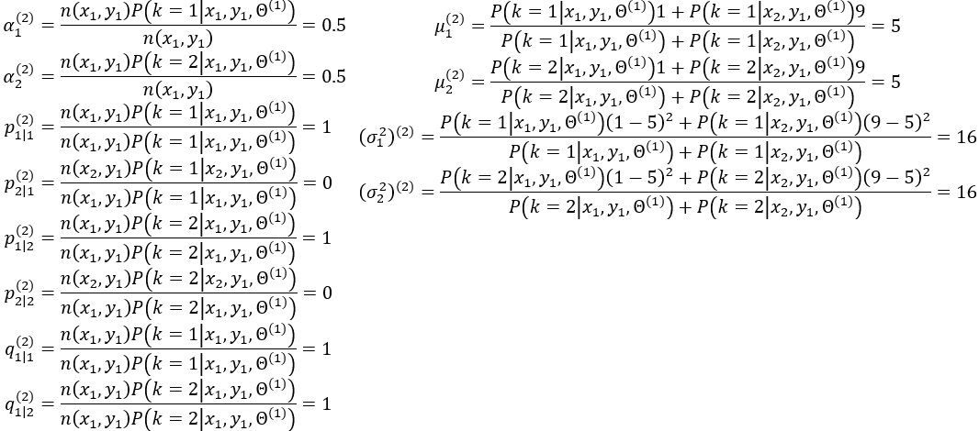
3. Mixture model with dyadic data
At the 1st iteration, M-step, we have:

Slide 50
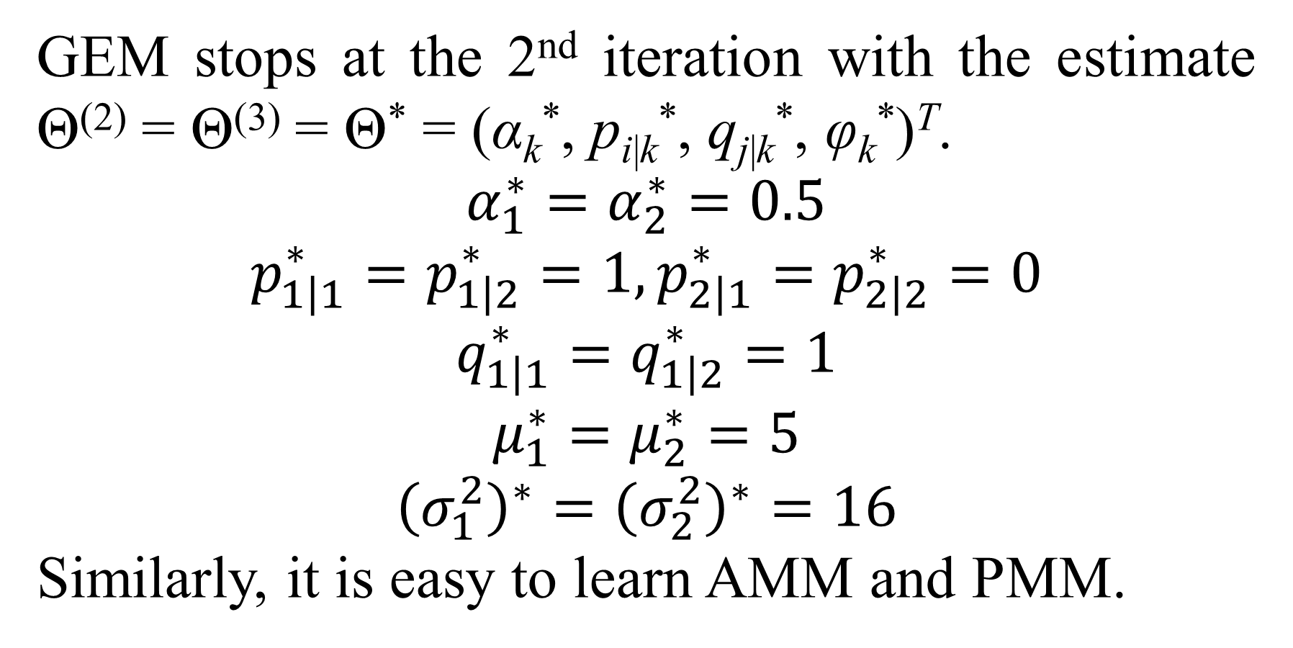
3. Mixture model with dyadic data
GEM stops at the 2nd iteration with the estimate Θ⁽²⁾ = Θ⁽³⁾ = Θ* = (α_{k}*, p_{i|k}*, q_{j|k}*, φ_{k}*)^{T}.
$$α_{1}^{∗}=α_{2}^{∗}=0.5$$
$$p_{1\left|1\right.}^{∗}=p_{1\left|2\right.}^{∗}=1,p_{2\left|1\right.}^{∗}=p_{2\left|2\right.}^{∗}=0$$
$$q_{1\left|1\right.}^{∗}=q_{1\left|2\right.}^{∗}=1$$
$$μ_{1}^{∗}=μ_{2}^{∗}=5$$
$${\left(σ_{1}^{2}\right)}^{∗}={\left(σ_{2}^{2}\right)}^{∗}=16$$
Similarly, it is easy to learn AMM and PMM.

Slide 51
4. Mixture regression model
This section describes shortly a special regression model associated with mixture model in which missing values are acceptable. Please read my papers “Mixture Regression Model for Incomplete Data” (Nguyen & Shafiq, Mixture Regression Model for Incomplete Data, 2018) and “Fetal Weight Estimation in Case of Missing Data” (Nguyen & Ho, Fetal Weight Estimation in Case of Missing Data, 2018) to comprehend regression model and incomplete data.

Slide 52
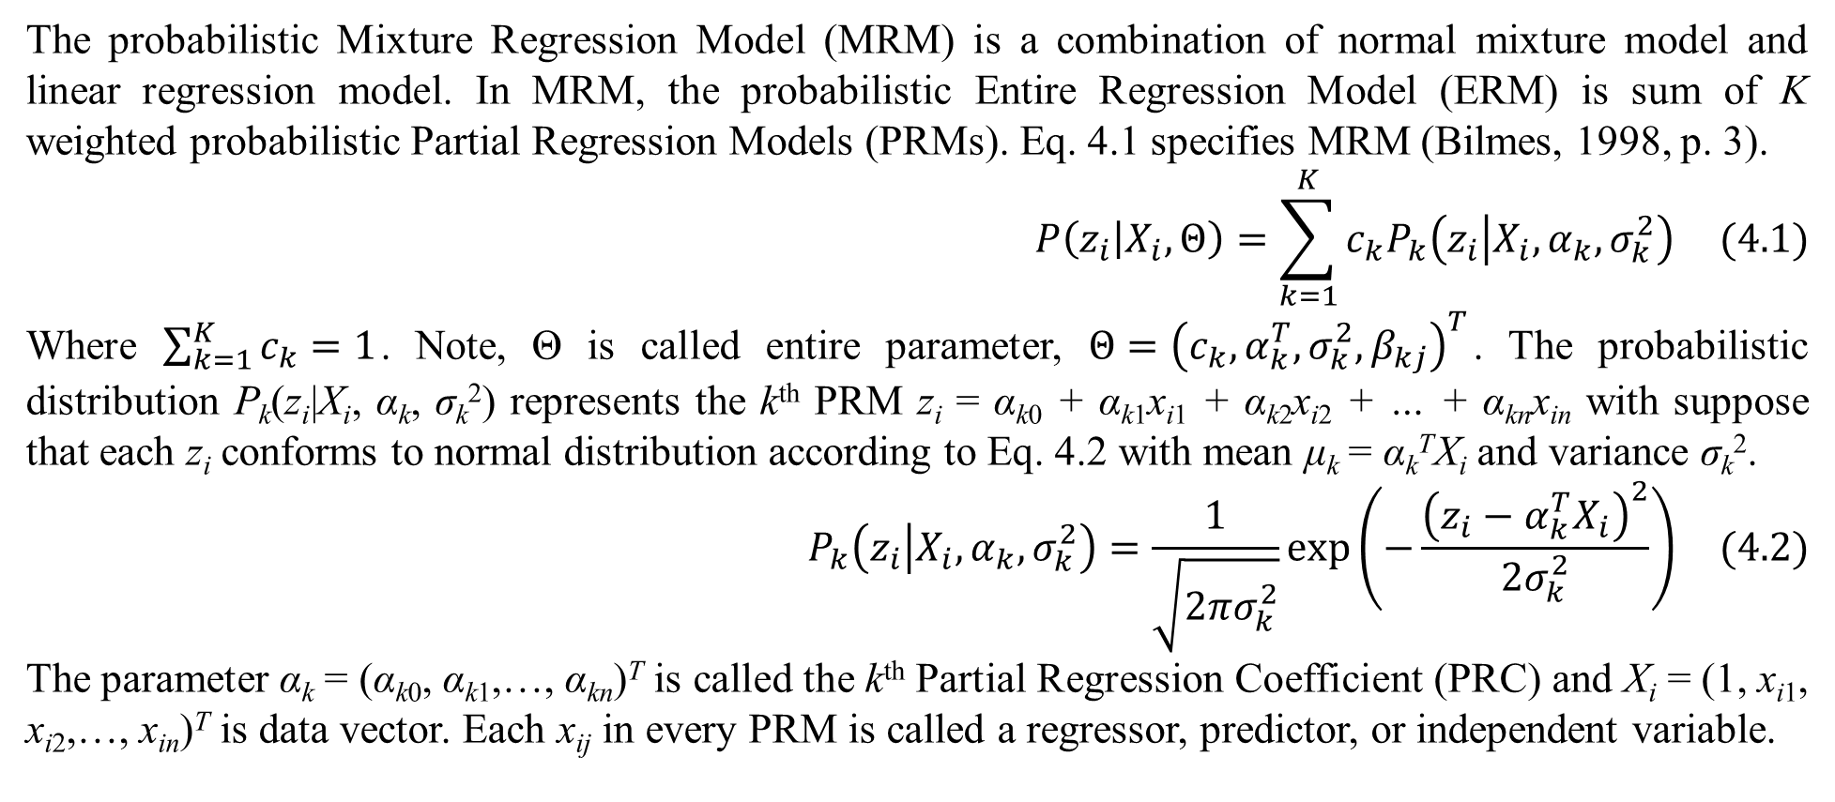
4. Mixture regression model
The probabilistic Mixture Regression Model (MRM) is a combination of normal mixture model and linear regression model. In MRM, the probabilistic Entire Regression Model (ERM) is sum of K weighted probabilistic Partial Regression Models (PRMs). Eq. 4.1 specifies MRM (Bilmes, 1998, p. 3).
$$P\left(z_{i} | X_{i},Θ\right)=\sum_{k=1}^{K}{c_{k}P_{k}\left(z_{i} | X_{i},α_{k},σ_{k}^{2}\right)} (4.1)$$
Where $\sum_{k=1}^{K}{c_{k}}=1$. Note, Θ is called entire parameter, $Θ={\left(c_{k},α_{k}^{T},σ_{k}^{2},β_{kj}\right)}^{T}$. The probabilistic distribution P_{k}(z_{i}|X_{i}, α_{k}, σ_{k}²) represents the k^{th} PRM z_{i} = α_{k0} + α_{k1}x_{i1} + α_{k2}x_{i2} + … + α_{kn}x_{in} with suppose that each z_{i} conforms to normal distribution according to Eq. 4.2 with mean μ_{k} = α_{k}^{T}X_{i} and variance σ_{k}².
$$P_{k}\left(z_{i} | X_{i},α_{k},σ_{k}^{2}\right)=\frac{1}{\sqrt{2πσ_{k}^{2}}}exp\left(−\frac{{\left(z_{i}−α_{k}^{T}X_{i}\right)}^{2}}{2σ_{k}^{2}}\right) (4.2)$$
The parameter α_{k} = (α_{k0}, α_{k1},…, α_{kn})^{T} is called the k^{th} Partial Regression Coefficient (PRC) and X_{i} = (1, x_{i1}, x_{i2},…, x_{in})^{T} is data vector. Each x_{ij} in every PRM is called a regressor, predictor, or independent variable.

Slide 53
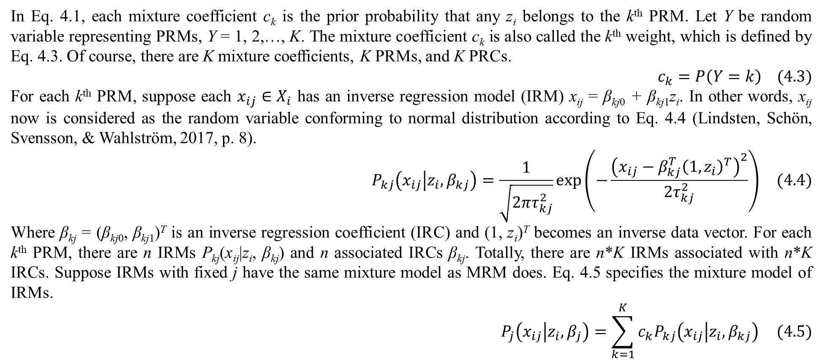
4. Mixture regression model
In Eq. 4.1, each mixture coefficient c_{k} is the prior probability that any z_{i} belongs to the k^{th} PRM. Let Y be random variable representing PRMs, Y = 1, 2,…, K. The mixture coefficient c_{k} is also called the k^{th} weight, which is defined by Eq. 4.3. Of course, there are K mixture coefficients, K PRMs, and K PRCs.
$$c_{k}=P\left(Y=k\right) (4.3)$$
For each k^{th} PRM, suppose each $x_{ij}∈X_{i}$ has an inverse regression model (IRM) x_{ij} = β_{kj0} + β_{kj1}z_{i}. In other words, x_{ij} now is considered as the random variable conforming to normal distribution according to Eq. 4.4 (Lindsten, Schön, Svensson, & Wahlström, 2017, p. 8).
$$P_{kj}\left(x_{ij} | z_{i},β_{kj}\right)=\frac{1}{\sqrt{2πτ_{kj}^{2}}}exp\left(−\frac{{\left(x_{ij}−β_{kj}^{T}{\left(1,z_{i}\right)}^{T}\right)}^{2}}{2τ_{kj}^{2}}\right) (4.4)$$
Where β_{kj} = (β_{kj0}, β_{kj1})^{T} is an inverse regression coefficient (IRC) and (1, z_{i})^{T} becomes an inverse data vector. For each k^{th} PRM, there are n IRMs P_{kj}(x_{ij}|z_{i}, β_{kj}) and n associated IRCs β_{kj}. Totally, there are n*K IRMs associated with n*K IRCs. Suppose IRMs with fixed j have the same mixture model as MRM does. Eq. 4.5 specifies the mixture model of IRMs.
$$P_{j}\left(x_{ij} | z_{i},β_{j}\right)=\sum_{k=1}^{K}{c_{k}P_{kj}\left(x_{ij} | z_{i},β_{kj}\right)} (4.5)$$

Slide 54
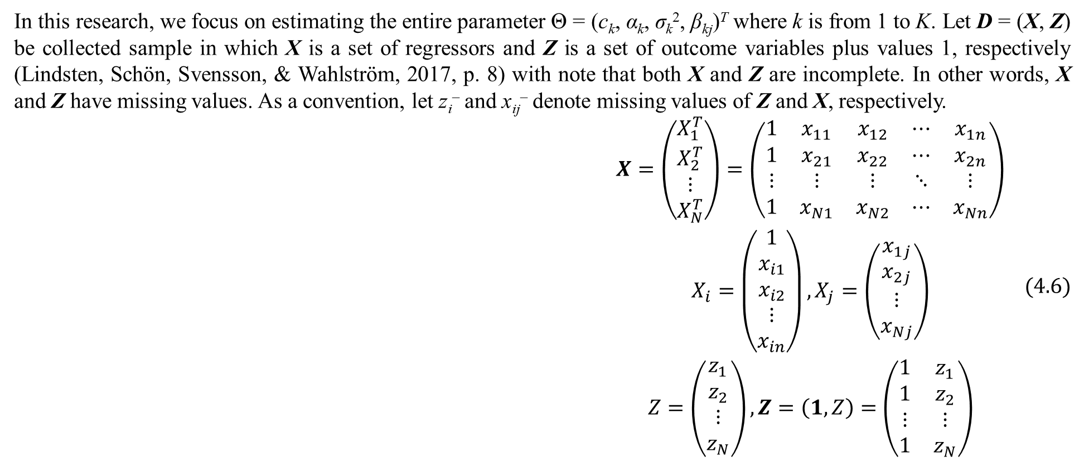
4. Mixture regression model
In this research, we focus on estimating the entire parameter Θ = (c_{k}, α_{k}, σ_{k}², β_{kj})^{T} where k is from 1 to K. Let D = (X, Z) be collected sample in which X is a set of regressors and Z is a set of outcome variables plus values 1, respectively (Lindsten, Schön, Svensson, & Wahlström, 2017, p. 8) with note that both X and Z are incomplete. In other words, X and Z have missing values. As a convention, let z_{i}– and x_{ij}– denote missing values of Z and X, respectively.
$$\begin{matrix}X=\left(\begin{matrix}X_{1}^{T} \\ X_{2}^{T} \\ ⋮ \\ X_{N}^{T}\end{matrix}\right)=\left(\begin{matrix}1 & x_{11} & x_{12} & ⋯ & x_{1n} \\ 1 & x_{21} & x_{22} & ⋯ & x_{2n} \\ ⋮ & ⋮ & ⋮ & ⋱ & ⋮ \\ 1 & x_{N1} & x_{N2} & ⋯ & x_{Nn}\end{matrix}\right) \\ X_{i}=\left(\begin{matrix}1 \\ x_{i1} \\ x_{i2} \\ ⋮ \\ x_{in}\end{matrix}\right),X_{j}=\left(\begin{matrix}x_{1j} \\ x_{2j} \\ ⋮ \\ x_{Nj}\end{matrix}\right) \\ Z=\left(\begin{matrix}z_{1} \\ z_{2} \\ ⋮ \\ z_{N}\end{matrix}\right),Z=\left(1,Z\right)=\left(\begin{matrix}1 & z_{1} \\ 1 & z_{2} \\ ⋮ & ⋮ \\ 1 & z_{N}\end{matrix}\right)\end{matrix} (4.6)$$

Slide 55
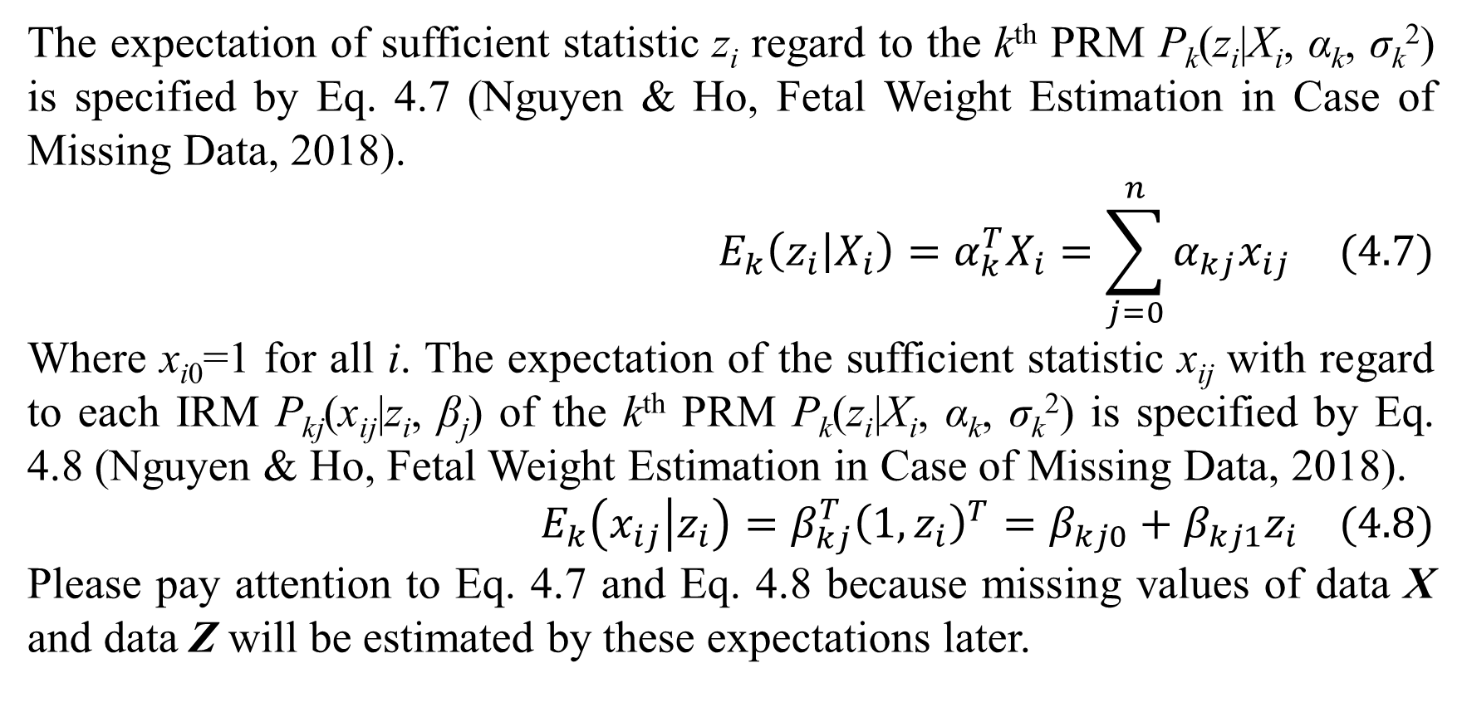
4. Mixture regression model
The expectation of sufficient statistic z_{i} regard to the k^{th} PRM P_{k}(z_{i}|X_{i}, α_{k}, σ_{k}²) is specified by Eq. 4.7 (Nguyen & Ho, Fetal Weight Estimation in Case of Missing Data, 2018).
$$E_{k}\left(z_{i} | X_{i}\right)=α_{k}^{T}X_{i}=\sum_{j=0}^{n}{α_{kj}x_{ij}} (4.7)$$
Where x_{i0}=1 for all i. The expectation of the sufficient statistic x_{ij} with regard to each IRM P_{kj}(x_{ij}|z_{i}, β_{j}) of the k^{th} PRM P_{k}(z_{i}|X_{i}, α_{k}, σ_{k}²) is specified by Eq. 4.8 (Nguyen & Ho, Fetal Weight Estimation in Case of Missing Data, 2018).
$$E_{k}\left(x_{ij} | z_{i}\right)=β_{kj}^{T}{\left(1,z_{i}\right)}^{T}=β_{kj0}+β_{kj1}z_{i} (4.8)$$
Please pay attention to Eq. 4.7 and Eq. 4.8 because missing values of data X and data Z will be estimated by these expectations later.

Slide 56
4. Mixture regression model
Because X and Z are incomplete, we apply expectation maximization (EM) algorithm into estimating Θ* = (c_{k}*, α_{k}*, (σ_{k}²)*, β_{kj}*)^{T}. According to DLR (Dempster, Laird, & Rubin, 1977), EM algorithm has many iterations and each iteration has expectation step (E-step) and maximization step (M-step) for estimating parameters. Given current parameter Θ^{(t)} = (c_{k}^{(t)}, α_{k}^{(t)}, (σ_{k}²)^{(t)}, β_{kj}^{(t)})^{T} at the t^{th} iteration, missing values z_{i}– and x_{ij}– are calculated in E-step so that X and Z become complete. In M-step, the next parameter Θ^{(t+1)} = (c_{k}^{(t+1)}, α_{k}^{(t+1)}, (σ_{k}²)^{(t+1)}, β_{kj}^{(t+1)})^{T} is determined based on the complete data X and Z fulfilled in E-step. Here we proposed a so-called Mixture Regression Expectation Maximization (MREM) which is the full combination of Regression Expectation Maximization (REM) algorithm (Nguyen & Ho, Fetal Weight Estimation in Case of Missing Data, 2018) and mixture model in which we use two EM processes in the same loop. Firstly, we use the first EM process for exponential family of probability distributions to estimate missing values in E-step. The technique is the same to the technique of REM in previous research (Nguyen & Ho, Fetal Weight Estimation in Case of Missing Data, 2018). Secondly, we use the second EM process to estimate Θ* for full mixture model in M-step.

Slide 57

4. Mixture regression model
Firstly, we focus on fulfilling missing values in E-step. As a result, Eq. 4.9 is used to estimate or fulfill missing values for each k^{th} PRM (Nguyen & Ho, Fetal Weight Estimation in Case of Missing Data, 2018) as Eq. 4.9.
$$\begin{matrix}z_{i}^{−}=\frac{\sum_{j∈M_{i}}{α_{kj}^{\left(t\right)}β_{kj0}^{\left(t\right)}}+\sum_{l∉M_{i}}{α_{kl}^{\left(t\right)}x_{il}}}{1−\sum_{j∈M_{i}}{α_{kj}^{\left(t\right)}β_{kj1}^{\left(t\right)}}} \\ x_{ij}^{−}=\left\{\begin{matrix}β_{kj0}^{\left(t\right)}+β_{kj1}^{\left(t\right)}z_{i}ifz_{i}is not missing \\ β_{kj0}^{\left(t\right)}+β_{kj1}^{\left(t\right)}z_{i}^{−}ifz_{i}is missing\end{matrix}\right.\end{matrix} (4.9)$$
Please read my paper “Mixture Regression Model for Incomplete Data” to comprehend how to derive Eq. 4.9. Now in M-step we use EM algorithm again to estimate the next parameter Θ^{(t+1)} = (c_{k}^{(t+1)}, α_{k}^{(t+1)}, (σ_{k}²)^{(t+1)}, β_{kj}^{(t+1)})^{T} with current known parameter Θ^{(t)} = (c_{k}^{(t)}, α_{k}^{(t)}, (σ_{k}²)^{(t)}, β_{kj}^{(t+1)})^{T} given data X and data Z fulfilled in E-step. The conditional expectation Q(Θ|Θ^{(t)}) with unknown Θ is determined as in previous section (Bilmes, 1998, p. 4):
$$Q\left(Θ | Θ^{\left(t\right)}\right)=\sum_{k=1}^{K}{\sum_{i=1}^{N}{P\left(Y=k | X_{i},z_{i},α_{k}^{\left(t\right)},{\left(σ_{k}^{2}\right)}^{\left(t\right)}\right)log\left(c_{k}\right)}}+\sum_{k=1}^{K}{\sum_{i=1}^{N}{P\left(Y=k | X_{i},z_{i},α_{k}^{\left(t\right)},{\left(σ_{k}^{2}\right)}^{\left(t\right)}\right)log\left(P_{k}\left(z_{i} | X_{i},α_{k},σ_{k}^{2}\right)\right)}}$$
The next parameter Θ^{(t+1)} is a constrained optimizer of Q(Θ|Θ^{(t)}).

Slide 58

4. Mixture regression model
By applying Lagrange method, each next mixture coefficient c_{k}^{(t+1)} is specified by Eq. 4.10 (Bilmes, 1998, p. 7).
$$c_{k}^{\left(t+1\right)}=\frac{1}{N}\sum_{i=1}^{N}{P\left(Y=k | X_{i},z_{i},α_{k}^{\left(t\right)},{\left(σ_{k}^{2}\right)}^{\left(t\right)}\right)} (4.10)$$
Where P(Y=k | X_{i}, z_{i}, α_{k}^{(t)}, (σ_{k}²)^{(t)}) is specified by Eq. 4.11 (Bilmes, 1998, p. 3).
$$P\left(Y=k | X_{i},z_{i},α_{k}^{\left(t\right)},{\left(σ_{k}^{2}\right)}^{\left(t\right)}\right)=\frac{c_{k}^{\left(t\right)}P_{k}\left(z_{i} | X_{i},α_{k}^{\left(t\right)},{\left(σ_{k}^{2}\right)}^{\left(t\right)}\right)}{\sum_{l}^{K}{c_{l}^{\left(t\right)}P_{l}\left(z_{i} | X_{i},α_{k}^{\left(t\right)},{\left(σ_{k}^{2}\right)}^{\left(t\right)}\right)}} (4.11)$$
By applying Lagrange method, each next regression coefficient α_{k}^{(t+1)} is solution of Eq. 4.12 (Bilmes, 1998, p. 7).
$$\sum_{i=1}^{N}{P\left(Y=k | X_{i},z_{i},α_{k}^{\left(t\right)},{\left(σ_{k}^{2}\right)}^{\left(t\right)}\right)\left(z_{i}−{\left(α_{k}^{\left(t\right)}\right)}^{T}X_{i}\right)X_{i}^{T}}=0^{T} (4.12)$$
Eq. 4.12 is equivalent to Eq. 4.13:
$$\sum_{i=1}^{N}{P\left(Y=k | X_{i},z_{i},α_{k}^{\left(t\right)},{\left(σ_{k}^{2}\right)}^{\left(t\right)}\right)α_{k}^{T}X_{i}X_{i}^{T}}=\sum_{i=1}^{N}{P\left(Y=k | X_{i},z_{i},α_{k}^{\left(t\right)},{\left(σ_{k}^{2}\right)}^{\left(t\right)}\right)z_{i}X_{i}^{T}} (4.13)$$

Slide 59

4. Mixture regression model
Let,
$$U_{i}^{\left(t\right)}=P\left(Y=k | X_{i},z_{i},α_{k}^{\left(t\right)},{\left(σ_{k}^{2}\right)}^{\left(t\right)}\right)X_{i}$$
The left-hand side of Eq. 4.13 becomes:
$$\sum_{i=1}^{N}{α_{k}^{T}U_{i}^{\left(t\right)}X_{i}^{T}}=α_{k}^{T}{\left(U^{\left(t\right)}\right)}^{T}X$$
Where U^{(t)} is specified by Eq. 4.14.
$$\begin{matrix}U^{\left(t\right)}=\left(\begin{matrix}{\left(U_{1}^{\left(t\right)}\right)}^{T} \\ {\left(U_{2}^{\left(t\right)}\right)}^{T} \\ ⋮ \\ {\left(U_{N}^{\left(t\right)}\right)}^{T}\end{matrix}\right)=\left(\begin{matrix}u_{10}^{\left(t\right)} & u_{11}^{\left(t\right)} & ⋯ & u_{1n}^{\left(t\right)} \\ u_{20}^{\left(t\right)} & u_{21}^{\left(t\right)} & ⋯ & u_{2n}^{\left(t\right)} \\ ⋮ & ⋮ & ⋱ & ⋮ \\ u_{N0}^{\left(t\right)} & u_{N1}^{\left(t\right)} & ⋯ & u_{Nn}^{\left(t\right)}\end{matrix}\right) \\ u_{ij}^{\left(t\right)}=x_{ij}P\left(Y=k | X_{i},z_{i},α_{k}^{\left(t\right)},{\left(σ_{k}^{2}\right)}^{\left(t\right)}\right)\end{matrix} (4.14)$$

Slide 60

4. Mixture regression model
Let,
$$V_{i}^{\left(t\right)}=P\left(Y=k | X_{i},z_{i},α_{k}^{\left(t\right)},{\left(σ_{k}^{2}\right)}^{\left(t\right)}\right)Z$$
The right-hand side of Eq. 4.13 becomes:
$$\sum_{i=1}^{N}{V_{i}^{\left(t\right)}X_{i}^{T}}=\sum_{i=1}^{N}{\left(v_{i0}^{\left(t\right)}x_{i0},v_{i1}^{\left(t\right)}x_{i1},…,v_{in}^{\left(t\right)}x_{in}\right)}={\left(V_{i}^{\left(t\right)}\right)}^{T}X$$
Where V_{i}^{(t)} is specified by Eq. 4.15.
$$\begin{matrix}V_{i}^{\left(t\right)}=\left(\begin{matrix}v_{i0}^{\left(t\right)} \\ v_{i1}^{\left(t\right)} \\ ⋮ \\ v_{in}^{\left(t\right)}\end{matrix}\right) \\ v_{ij}^{\left(t\right)}=z_{i}P\left(Y=k | X_{i},z_{i},α_{k}^{\left(t\right)},{\left(σ_{k}^{2}\right)}^{\left(t\right)}\right)\end{matrix} (4.15)$$

Slide 61

4. Mixture regression model
As a result, the next regression coefficient α_{k}^{(t+1)}, which is solution of Eq. 4.12, is specified by Eq. 4.16.
$$α_{k}^{\left(t+1\right)}={\left(X^{T}U^{\left(t\right)}\right)}^{−1}X^{T}V_{i}^{\left(t\right)} (4.16)$$
The proposed Eq. 4.16 is most important in this research because it is the integration of least squares method and mixture model. If we think deeply, it is the key to combine REM and mixture model. In other words, it is the key to combine two EM processes in the same loop. By applying Lagrange method, each next partial variance (σ_{k}²)^{(t+1)} is specified by Eq. 4.17 (Bilmes, 1998, p. 7).
$${\left(σ_{k}^{2}\right)}^{\left(t+1\right)}=\frac{\sum_{i=1}^{N}{{\left(z_{i}−{\left(α_{k}^{\left(t+1\right)}\right)}^{T}X_{i}\right)}^{2}P\left(Y=k | X_{i},z_{i},α_{k}^{\left(t\right)},{\left(σ_{k}^{2}\right)}^{\left(t\right)}\right)}}{\sum_{i=1}^{N}{P\left(Y=k | X_{i},z_{i},α_{k}^{\left(t\right)},{\left(σ_{k}^{2}\right)}^{\left(t\right)}\right)}} (4.17)$$
By using maximum likelihood estimation (MLE) method (Lindsten, Schön, Svensson, & Wahlström, 2017, pp. 8-9), we retrieve Eq. 4.18 to estimate each next IRC β_{kj}^{(t+1)} (Montgomery & Runger, 2010, p. 457).
$$β_{kj}^{\left(t+1\right)}={\left(Z^{T}Z\right)}^{−1}Z^{T}X_{j} (4.18)$$

Slide 62

4. Mixture regression model
In general, MREM is the full combination of REM and mixture model in which two EM processes are applied into the same loop of E-step and M-step.
E-step: This is the first EM process. Missing values (z_{i}–)_{k} and (x_{ij}–)_{k} for each k^{th} PRM are fulfilled by Eq. 4.9 given current parameter Θ^{(t)}. In other words, the whole sample (X, Z) has K versions (X_{k}, Z_{k}) for K PRMs.
$${\left(z_{i}^{−}\right)}_{k}=\frac{\sum_{j∈M_{i}}{α_{kj}^{\left(t\right)}β_{kj0}^{\left(t\right)}}+\sum_{l∉M_{i}}{α_{kl}^{\left(t\right)}{\left(x_{il}\right)}_{k}}}{1−\sum_{j∈M_{i}}{α_{kj}^{\left(t\right)}β_{kj1}^{\left(t\right)}}},{\left(x_{ij}^{−}\right)}_{k}=\left\{\begin{matrix}β_{kj0}^{\left(t\right)}+β_{kj1}^{\left(t\right)}{\left(z_{i}\right)}_{k}if{\left(z_{i}\right)}_{k}is not missing \\ β_{kj0}^{\left(t\right)}+β_{kj1}^{\left(t\right)}{\left(z_{i}^{−}\right)}_{k}if{\left(z_{i}\right)}_{k}is missing\end{matrix}\right.$$
The whole sample (X, Z) is fulfilled to become complete data when its missing values z_{i}– and x_{ij}– are aggregated from (z_{i}–)_{k} and (x_{ij}–)_{k} of K versions (X_{k}, Z_{k}): $z_{i}^{−}=\sum_{k=1}^{K}{c_{k}^{\left(t\right)}{\left(z_{i}^{−}\right)}_{k}}$, $x_{ij}^{−}=\sum_{k=1}^{K}{c_{k}^{\left(t\right)}{\left(x_{ij}^{−}\right)}_{k}}$.
M-step: This is the second EM process. The next parameter Θ^{(t+1)} is determined by Eqs. 4.10, 4.16, 4.17, and 4.18 and the complete data (X, Z) fulfilled in E-step.
$$c_{k}^{\left(t+1\right)}=\frac{1}{N}\sum_{i=1}^{N}{P\left(Y=k | X_{i},z_{i},α_{k}^{\left(t\right)},{\left(σ_{k}^{2}\right)}^{\left(t\right)}\right)},α_{k}^{\left(t+1\right)}={\left(X^{T}U^{\left(t\right)}\right)}^{−1}X^{T}V_{i}^{\left(t\right)}$$
$$\begin{matrix}{\left(σ_{k}^{2}\right)}^{\left(t+1\right)}=\frac{\sum_{i=1}^{N}{{\left(z_{i}−{\left(α_{k}^{\left(t+1\right)}\right)}^{T}X_{i}\right)}^{2}P\left(Y=k | X_{i},z_{i},α_{k}^{\left(t\right)},{\left(σ_{k}^{2}\right)}^{\left(t\right)}\right)}}{\sum_{i=1}^{N}{P\left(Y=k | X_{i},z_{i},α_{k}^{\left(t\right)},{\left(σ_{k}^{2}\right)}^{\left(t\right)}\right)}}\end{matrix},β_{kj}^{\left(t+1\right)}={\left(Z^{T}Z\right)}^{−1}Z^{T}X_{j}$$

Slide 63
4. Mixture regression model
EM algorithm stops if at some t^{th} iteration, we have Θ^{(t)} = Θ^{(t+1)} = Θ*. Note, Θ⁽¹⁾ at the first iteration is initialized arbitrarily. Here MREM stops if ratio deviation between Θ^{(t)} and Θ^{(t+1)} is smaller than a small enough terminated threshold ε> 0 or MREM reaches a large enough number of iterations. The smaller the terminated threshold is, the more accurate MREM is. MREM uses both the terminated threshold ε = 0.1% = 0.001 and the maximum number of iterations (10000). The maximum number of iterations prevents MREM from running for a long time.
There are some more problems related to missing data inside the mixture regression model that I proposed but this report focuses on the mixture model. Therefore, I suspend discussion on mixture model here. I wish to have another opportunity to present more about mixture model and regression model.

Slide 64
References
Bilmes, J. A. (1998). A Gentle Tutorial of the EM Algorithm and its Application to Parameter Estimation for Gaussian Mixture and Hidden Markov Models. International Computer Science Institute, Department of Electrical Engineering and Computer Science. Berkeley: University of Washington. Retrieved from http://melodi.ee.washington.edu/people/bilmes/mypubs/bilmes1997-em.pdf
Burden, R. L., & Faires, D. J. (2011). Numerical Analysis (9th Edition ed.). (M. Julet, Ed.) Brooks/Cole Cengage Learning.
Dempster, A. P., Laird, N. M., & Rubin, D. B. (1977). Maximum Likelihood from Incomplete Data via the EM Algorithm. (M. Stone, Ed.) Journal of the Royal Statistical Society, Series B (Methodological), 39(1), 1-38.
Han, J., & Kamber, M. (2006). Data Mining: Concepts and Techniques (2nd Edition ed.). (J. Gray, Ed.) San Francisco, CA, USA: Morgan Kaufmann Publishers, Elsevier.
Hofmann, T., & Puzicha, J. (1998). Statistical Models for Co-occurrence Data. Massachusetts Institute of Technology, Artificial Intelligence Laboratory. MIT Publisher. Retrieved from https://dspace.mit.edu/bitstream/handle/1721.1/7253/AIM-1625.pdf?sequence=2
Hofmann, T., Puzicha, J., & Jordan, M. I. (1998). Learning from Dyadic Data. In M. J. Kearns, S. A. Solla, & D. A. Cohn (Ed.), Advances in Neural Information Processing Systems 11 (NIPS 1998). 11, pp. 466-472. Denver: MIT Press. Retrieved from https://papers.nips.cc/paper/1503-learning-from-dyadic-data
Lindsten, F., Schön, T. B., Svensson, A., & Wahlström, N. (2017). Probabilistic modeling – linear regression & Gaussian processes. Uppsala University, Department of Information Technology. Uppsala: Uppsala University. Retrieved January 24, 2018, from http://www.it.uu.se/edu/course/homepage/sml/literature/probabilistic_modeling_compendium.pdf

Slide 65
References
Montgomery, D. C., & Runger, G. C. (2010). Applied Statistics and Probability for Engineers (5th ed.). Hoboken, New Jersey, USA: John Wiley & Sons. Retrieved from https://books.google.com.vn/books?id=_f4KrEcNAfEC
Nguyen, L. (2015). Matrix Analysis and Calculus (1st ed.). (C. Evans, Ed.) Hanoi, Vietnam: Lambert Academic Publishing. Retrieved from https://www.shuyuan.sg/store/gb/book/matrix-analysis-and-calculus/isbn/978-3-659-69400-4
Nguyen, L. (2020, October 28). Conditional Mixture Model and Its Application for Regression Model. Preprints. doi:10.20944/preprints202010.0550.v2
Nguyen, L. (2020, November 2). Learning Dyadic Data and Predicting Unaccomplished Co-occurrent Values by Mixture Model. Preprints. doi:10.20944/preprints202011.0038.v1
Nguyen, L. (2020). Tutorial on EM algorithm. MDPI. Preprints. doi:10.20944/preprints201802.0131.v8
Nguyen, L., & Ho, T.-H. T. (2018). Fetal Weight Estimation in Case of Missing Data. (T. Schmutte, Ed.) Experimental Medicine (EM) - Special Issue "Medicine and Healthy Food".
Nguyen, L., & Shafiq, A. (2018, December 31). Mixture Regression Model for Incomplete Data. (L. d. Istael, Ed.) Revista Sociedade Científica, 1(3), 1-25. doi:10.5281/zenodo.2528978
Ta, P. D. (2014). Numerical Analysis Lecture Notes. Vietnam Institute of Mathematics, Numerical Analysis and Scientific Computing. Hanoi: Vietnam Institute of Mathematics. Retrieved 2014
Wikipedia. (2014, August 4). Karush–Kuhn–Tucker conditions. (Wikimedia Foundation) Retrieved November 16, 2014, from Wikipedia website: http://en.wikipedia.org/wiki/Karush–Kuhn–Tucker_conditions
Wikipedia. (2016, March September). Exponential family. (Wikimedia Foundation) Retrieved 2015, from Wikipedia website: https://en.wikipedia.org/wiki/Exponential_family

Slide 66
Thank you for listening

